Slide 1
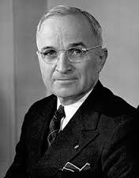
Task on Entry
“If we let Korea down, the Soviets will keep right on going and swallow up one piece of Asia after another…If we were to let Asia go, the Near East would collapse and no telling what would happen in Europe...Korea is like the Greece of the Far East. If we are tough enough now, if we stand up to them like we did in Greece three years ago, they won’t take any more steps.”
Use the Connect, Extend, Challenge thinking routine to evaluate this extract from a speech by President Truman.
President Harry S. Truman
Want to know the latest?
Follow us… Twitter @GEMS_WSO | Facebook GEMSWSO

Slide 2
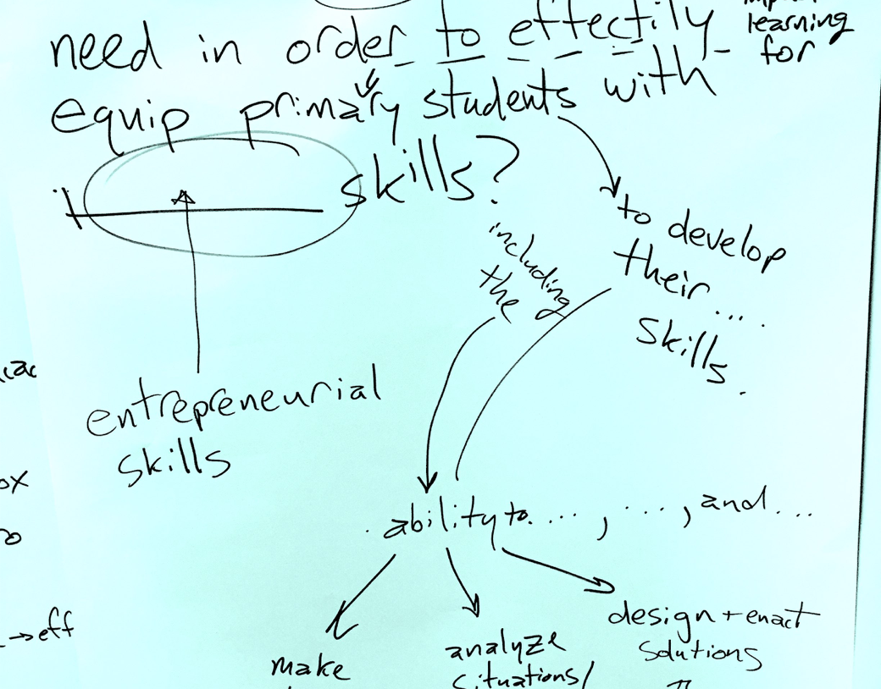
Task on Entry: Connect, Extend , Challenge
How are the ideas and information presented in the extract CONNECTED to what you already know?
Connect
What new ideas did you get from the extract that EXTENDED or pushed your thinking in new directions?
Extend
What is still CHALLENGING or confusing for you to get your mind around? What questions, wonderings or puzzles do you now have?
Challenge

Slide 3
The Big Question: To what extent could the US policy of containment in Asia between 1947 and 1958 be considered a success?
Learning Objective:
Key Terms
Containment
Domino effect
Massive retaliation
Brinkmanship
To understand the background to US involvement in Asia, 1947-1958.
To begin judging how successful the US policy of containment was in Asia, 1947-1958.
Learning Outcomes:
Grade 4
I can describe America’s key attempts at containment in Asia, 1947-1958.
Grade 5
I can identify how successful the US policy of containment was in one Asian country, 1947-1958.
Grade 6-7
I am starting to explain how successful the US policy of containment was across a number of different countries in Asia, 1947-1958.

Slide 4
Learner Profile and ATL Focus
I can use the ATL skill of research [information literacy and media literacy] to help gain the skills needed to develop knowledge and understanding.
I can gather and organise relevant information to formulate an argument.
I actively use visible thinking strategies and techniques
I am willing to revise understanding based on new information and evidence.
I can consider content (What did I learn about today? What don’t I yet understand? What questions do I have now?)

Slide 5
Activate Activity
You are going to work in pairs to consider how successful the policy of containment was in Japan and Taiwan.
Use pp. 58-59 in Rogers & Thomas to make your teaching notes.
You may choose what format you make them in.
Partner A: Focus on Japan.
What were America’s aims in Japan?
Which objective was the most important for Japan and why?
How did the policy towards Japan change between the end of WWII and the outbreak of the Korean War? (1945-1950)
Was containment a success in Japan?
Partner B: Focus on Taiwan
How did the US policy towards Taiwan change after 1950?
Why did Eisenhower threaten to use atomic weapons against China?
What do Eisenhower’s policies of ‘massive retaliation’ and ‘brinkmanship’ mean?
Was containment a success in Taiwan?

Slide 6
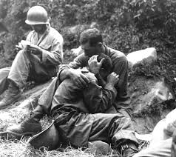
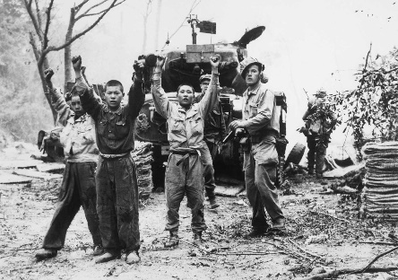
Consolidate Activity
“To what extent could the US policy of containment in Asia between 1947 and 1958 be considered a success? “
Total Success
Total Failure
Want to know the latest?
Follow us… Twitter @GEMS_WSO | Facebook GEMSWSO

Slide 7
The Big Question: To what extent could the US policy of containment in Asia between 1947 and 1958 be considered a success?
Learning Objective:
Key Terms
Containment
Domino effect
Massive retaliation
Brinkmanship
To understand the background to US involvement in Asia, 1947-1958.
To begin judging how successful the US policy of containment was in Asia, 1947-1958.
Learning Outcomes:
Grade 4
I can describe America’s key attempts at containment in Asia, 1947-1958.
Grade 5
I can identify how successful the US policy of containment was in one Asian country, 1947-1958.
Grade 6-7
I am starting to explain how successful the US policy of containment was across a number of different countries in Asia, 1947-1958.

Slide 8
Activate Activity: To what extent did the US and USSR influence the Chinese Civil War?
Q1. How did Mao seek to undermine Chiang’s claim to be the leader of China?
Q2. Why were the US and USSR unable to achieve a peaceful settlement in China, 1945-46?
1. You have 20 minutes to read p. 101-109 in Authoritarian Rulers.
2. There are four stations around the room.
3. You will have five minutes at each station.
4. Answer each question using detailed, specific and relevant evidence.
Silent debate!
Q4. What was the significance of the Sino-Societ Pact, 14th February 1950?
Q3. Why was the Chinese Communist party able to win the civil war?

Slide 9
Consolidate Activity
“To what extent could the US policy of containment in Asia between 1947 and 1958 be considered a success? “
Total Success
Total Failure
Want to know the latest?
Follow us… Twitter @GEMS_WSO | Facebook GEMSWSO

Slide 10
The Big Question: To what extent could the US policy of containment in Asia between 1947 and 1958 be considered a success?
Learning Objective:
Key Terms
Containment
domino effect
massive retaliation
brinkmanship
To understand the background to US involvement in Asia, 1947-1958.
To begin judging how successful the US policy of containment was in Asia, 1947-1958.
Learning Outcomes:
Grade 4
I can describe America’s key attempts at containment in Asia, 1947-1958.
Grade 5
I can identify how successful the US policy of containment was in one Asian country, 1947-1958.
Grade 6-7
I am starting to explain how successful the US policy of containment was across a number of different countries in Asia, 1947-1958.

Slide 11
Learner Profile and ATL Reflection
I can use the ATL skill of research [information literacy and media literacy] to help gain the skills needed to develop knowledge and understanding.
I can gather and organise relevant information to formulate an argument.
I actively use visible thinking strategies and techniques
I am willing to revise understanding based on new information and evidence.
I can consider content (What did I learn about today? What don’t I yet understand? What questions do I have now?)

Slide 12
Consolidate Activity
How have your ideas about American aims in the Cold War changed?
“ I used to think…..”
“ Now I
think…..”
Notes:
Get verbal feedback from class. They do not have to write anything down, but if they do make it BOB.

