Slide 1
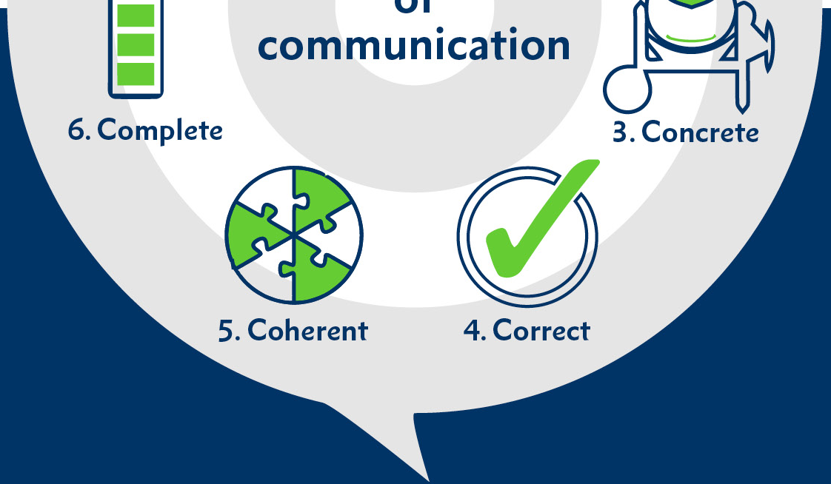
Toolkits for Communication
1. Make sure that it’s easy for people reading your work to understand your meaning. Use language that is correct.
7. All communication should be friendly, open and honest.
6. Check your have included all relevant facts.
7.
2. Delete any repetition and stick to your points.
3. Use facts, key words and pictures to make sure your work is understood.
5. Does your work make sense? Check all points link back to the topic. Have you got a logical sequence?
4. Check your work for errors. Ask someone else to proofread your work.
Want to know the latest?
Follow us… Twitter @GEMS_WSO | Facebook GEMSWSO

