Slide 1
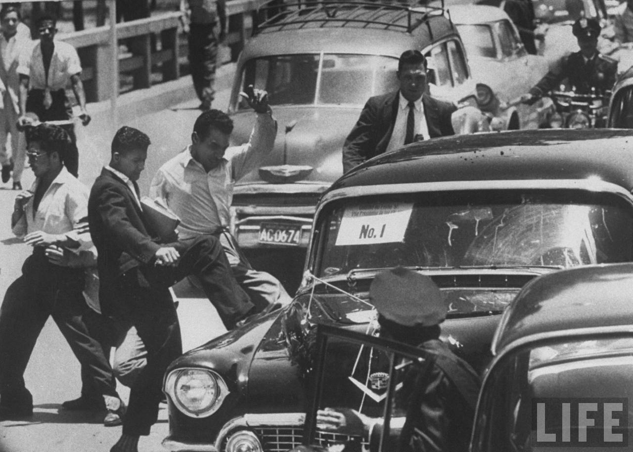
Task on Entry
What can you learn about the success of US foreign policy in Latin America from Source A?
TOK: As an historian, why do we use a range of sources to form our conclusions about past events?
A photograph of Vice President Nixon’s car under attack in Caracas, Venezuela, in 1958.

Slide 2
Eisenhower’s ‘New Look’ and Latin America
Communication
Inquirer
Learning Objective:
KEY TERMS:
protectionist
OAS (Organisation of American States)
OPA (Operation Pan America)
To know the key aims of Vice President Nixon’s visits to Latin America.
To consider how ‘new’ and successful Eisenhower’s relations with Latin America were 1953-1961.
Learning Outcomes:
Grade 4
You can describe the aims of Nixon’s visits to a range of Latin American acountries.
Grade 5
You can assess the consequences and significance of Nixon's visits on US foreign policy and relations with Latin America.
Grade 6/7
You can judge to what extent Eisenhower’s relations with Latin America were ‘new’ and successful.

Slide 3
Connect Activity – Flipped Quiz
If these are the answers, what are the questions?
For each of the answers or statements, you need to come up with a question that would lead to that answer.
Creating the impression that one is willing to push events to the point of war rather than concede.
Reconcile the demands of the military with the treasury.
Juan José Arévalo.
Jacobo Árbenz Guzman.
June 1954.
You have 15 seconds to come up with a question.

Slide 4
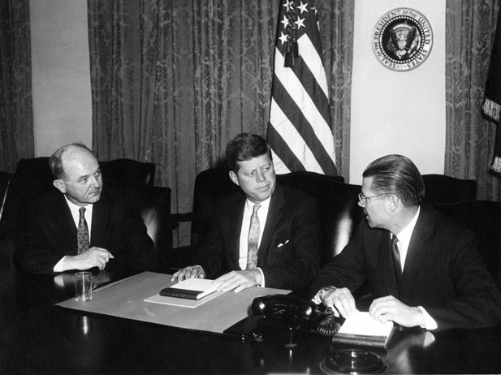
Activate Activity – A ‘New Look’ at the New Look in Latin America
It is December 1960. You are members of President Elect Kennedy’s transition team.
You have been tasked with producing a one page After Action Report (AAR) assessing to what extent President Eisenhower’s foreign policy was successful in Latin America.
The AAR will be used to brief the President Elect’s Cabinet choices and the National Security Committee on the current state of US foreign policy in relation to Latin America.

Slide 5
Activate Activity – A ‘New Look’ at the New Look in Latin America
Each team will assess a different aspect of US foreign policy in Latin America between 1953 and 1961.
Team 1: The Bolivian Revolution and Vice President Nixon’s first visit to Latin America (1955) – p. 79-80
Team 2: The aims of Vice President Nixon’s second visit; learnings from Paraguay and Argentina – p.80-82
Team 3: Vice President Nixon in Peru, Venezuela and “Operation Poor Richard” - p.82-84
Please complete your report in a format that is shareable with other team members.
You have thirty minutes to prepare you AAR.

Slide 6
Demonstrate - President Eisenhower and Latin America assessed.
Each team will verbally present their findings to the Cabinet.
The focus of this meeting is to consider this question:
‘To what extent could President Eisenhower’s relations with Latin America be considered ‘new’ and successful by the end of his administration?’
Once the findings have been reported and shared, all foreign policy experts will be expected to contribute to the debate on this question.
“Latin America is close to us, they buy more from us than all of Europe. We must keep our eyes on this part of the world.”-Vice President Richard Milhouse Nixon, 1955
Please complete your report in a format that is shareable with other team members.
You have thirty minutes to prepare you AAR.

Slide 7
Consolidate
As a result of the lesson today I:
Know…
Understand…
Can use the information to….

Slide 8
Eisenhower’s ‘New Look’ and Latin America
Communication
Inquirer
Learning Objective:
KEY TERMS:
protectionist
OAS (Organisation of American States)
OPA (Operation Pan America)
To know the key aims of Vice President Nixon’s visits to Latin America.
To consider how ‘new’ and successful Eisenhower’s relations with Latin America were 1953-1961.
Learning Outcomes:
Grade 4
You can describe the aims of Nixon’s visits to a range of Latin American acountries.
Grade 5
You can assess the consequences and significance of Nixon's visits on US foreign policy and relations with Latin America.
Grade 6/7
You can judge to what extent Eisenhower’s relations with Latin America were ‘new’ and successful.

