Slide 1
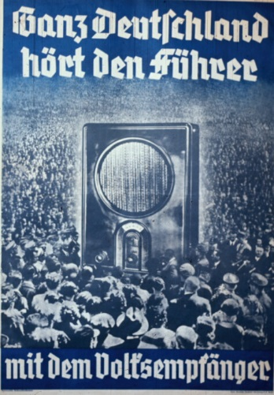
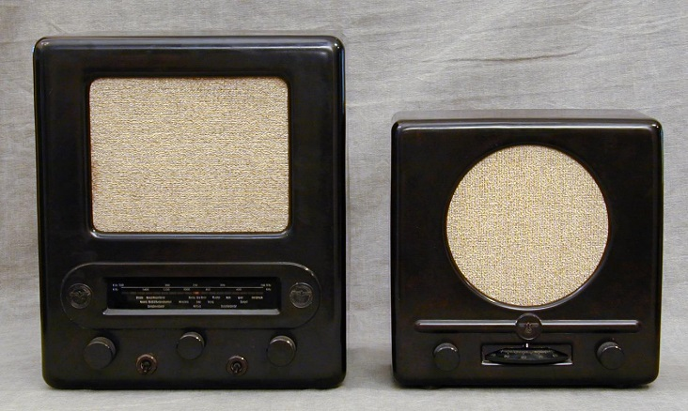
1. Radio
“What the press has been in the 19th century, radio will be for the 20th century”
Goebbels immediately saw the value of radio as a propaganda vehicle. He placed all radio stations under Nazi control.
Hitler made frequent broadcasts and cheap, mass-produced radios were sold or placed in cafes, factories and school. They even placed speakers in the streets.
All households that possessed a radio had to pay 2 marks a month to cover the cost of radio broadcasting. Goebbels also arranged for two cheap types of radios priced at 35 and 72 marks that were known as ‘People’s Receivers’.

Slide 2
1. Radio
‘We...intend a principled transformation in the worldview of our entire society, a revolution of the greatest possible extent that will leave nothing out, changing the life of our nation in every regard ... It would not have been possible for us to take power or to use it in the ways we have without the radio and the airplane. It is no exaggeration to say that the German revolution, at least in the form it took, would have been impossible without the airplane and the radio.’
By the 1930s, there were more radios per person in Germany than anywhere else in Europe. 16 million sets by 1943.
Goebbels also made it a treasonable offense to listen to overseas broadcasts.
Anyone caught doing so faced a spell in a feared concentration camp and in the first year of the war alone, 1500 Germans were imprisoned for listening to London-based broadcasts.

Slide 3
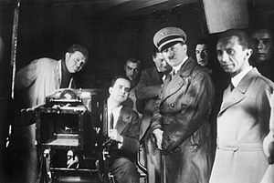
2. Cinema
“We are convinced that films constitute one of the most modern and scientific means of influencing the mass. Therefore the government must not neglect them.” Goebbels
In 1933, German cinema had audiences of over 250 million.
Films were shown alongside 45-minute government newsreels, publicising Germany’s achievements.
From 1934, directors had to send the plot of every new film to Goebbels for approval.
Fiction and documentary films were all used to spread the Nazi message.
Notes:
http://www.youtube.com/watch?v=YZbFHADF-XU

Slide 4
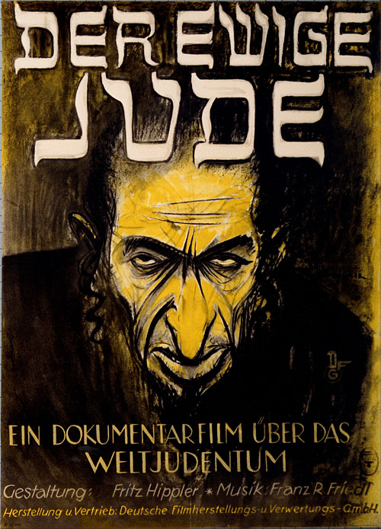
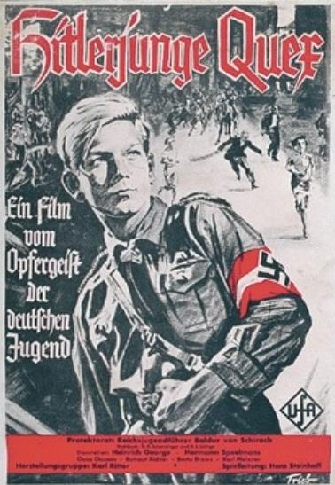
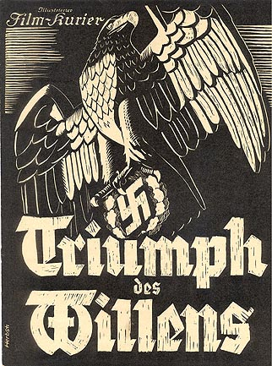
2. Cinema
The ‘Eternal Jew’ by Fritz Hippler in 1940 was an anti-semitic film comparing Jews to rats.
‘Hitlerjunge Quex’ by Hans Steinhoff in 1933 was about a boy who joins the Hitler Youth and is killed by the Communists.
‘Truimph of the Will’ was a documentary of the Nuremberg Rally of 1934 by Leni Riefenstahl. Her coverage of the 1936 Berlin Olympics was also famous for its approach.
Notes:
http://www.youtube.com/watch?v=RlHVin56U2w
http://www.youtube.com/watch?v=YZbFHADF-XU

Slide 5
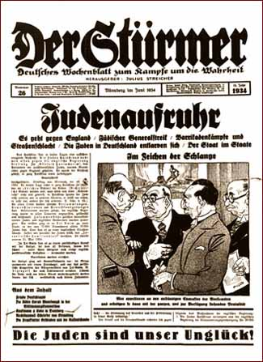
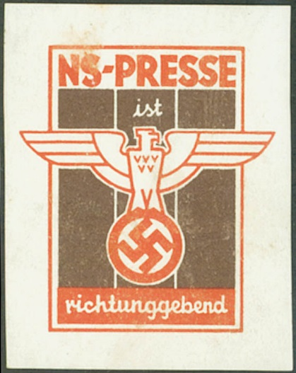
3. The Press
The Reich Press Law of Oct 4th 1933, banned all Jewish or liberal editors and journalist. The government could now ban newspapers in order to force owners into bankruptcy.
Newspapers had to print views which the Ministry agreed with or face the consequences.
Journalists were given press briefings with information the government wanted publicise.
Notes:
http://www.youtube.com/watch?v=RlHVin56U2w
http://www.youtube.com/watch?v=YZbFHADF-XU

Slide 6
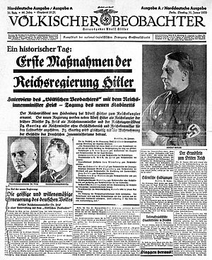
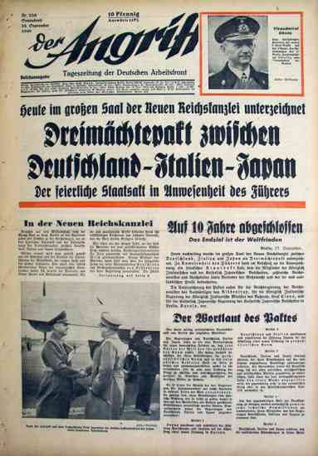
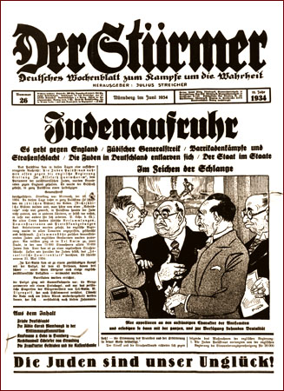
3. The Press
‘Volkischer Beobachter’ (Racial Observer) was the primary newspaper of the Nazi Party. It was printed in Munich in the morning.
‘Der Angriff’ (The Assault) was founded by Goebbels in 1927. It was printed in Berlin in the afternoon.
‘Der Stúrmer’ (The Attacker) was owned by the anti-Semite Julius Streicher. Hitler claimed it was his favourite paper.

Slide 7
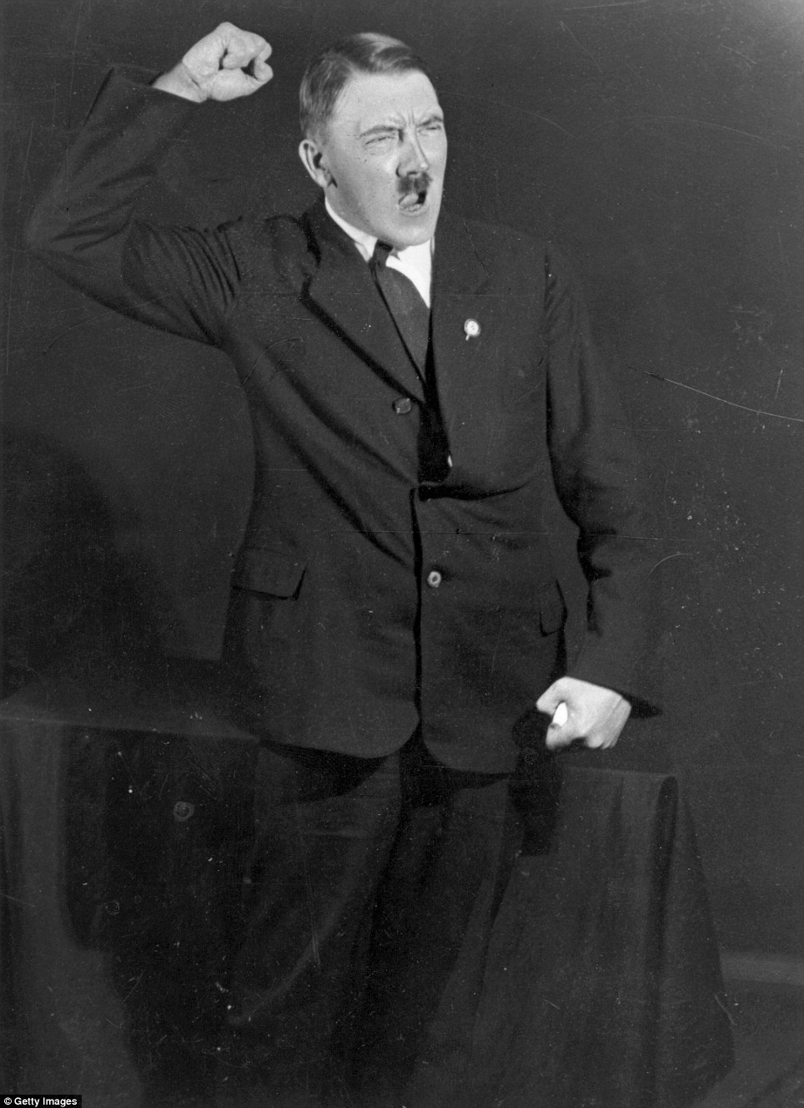
4. Photographs
Hitler had an official photographer, Heinrich Hoffman. Key images were carefully stage managed.
Hitler practised expressions and poses before the camera. A series of photographs were widely reproduced, some as postcards, others inside cigarette packets.

Slide 9
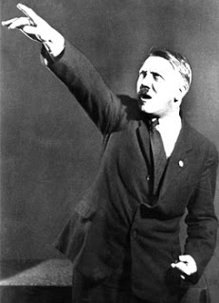

Slide 12
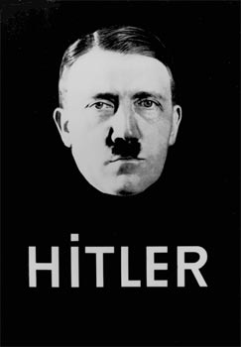
5. Posters
The Nazis made great use of political posters during the Weimar Republic.
After 1933, they had a monopoly which was used to deepen support.
‘Hitler’: a 1932 poster:

Slide 13
‘Long live Germany’: a 1930s poster by K. Stanber

Slide 14
‘Build youth hostels and homes’

Slide 15
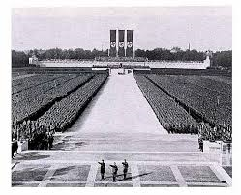
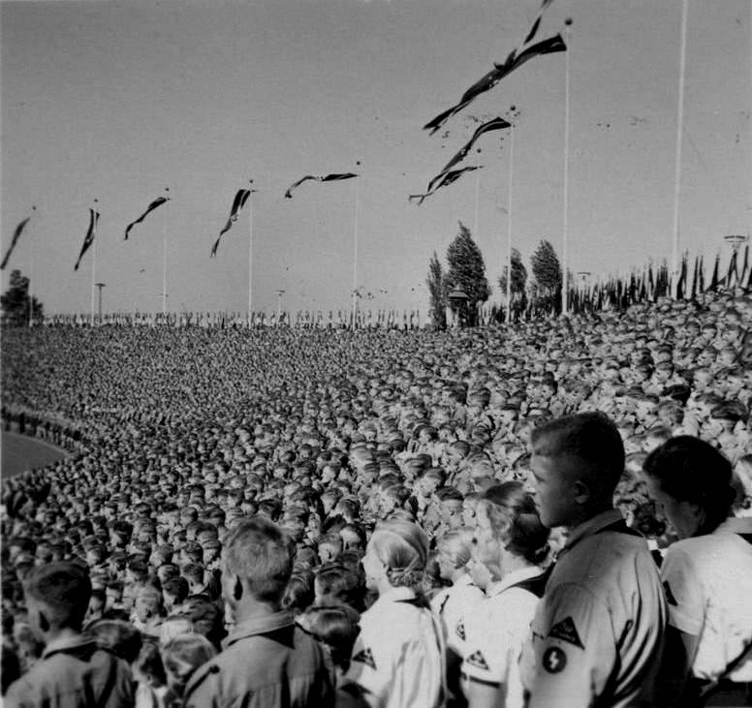
6. Meetings and Rallies
Nazi support was strengthened by attending mass rallies. They were carefully organised, using the architecture of light like modern day pop concerts.
Uniforms, disciplined mass movements, stirring music, striking flags and symbols, often at night, created a powerful feeling of wishing to belong. Then came the address by Hitler, the master at manipulating mass emotions.
Notes:
http://www.youtube.com/watch?v=1dyns367ExE&bpctr=1368951658

Slide 18
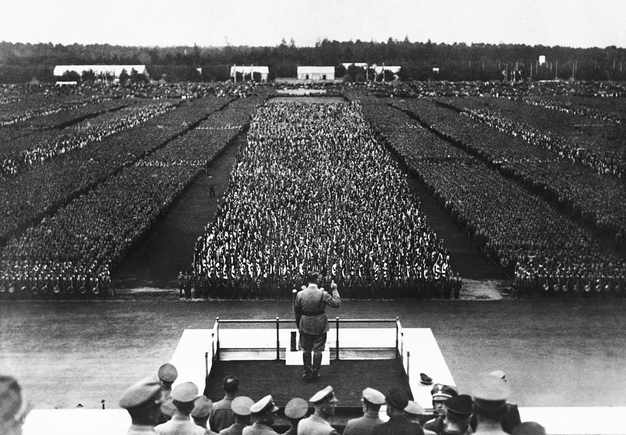

Slide 19
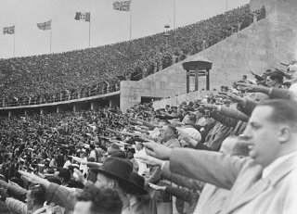
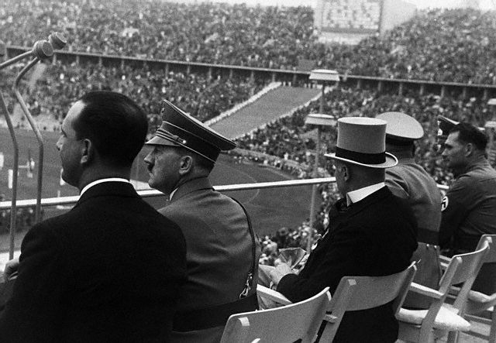
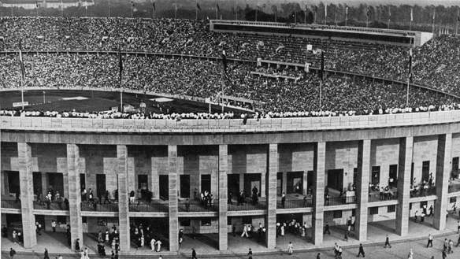
7. Sport
Hitler and Goebbels used the 1936 Berlin Olympics to show Nazi Germany in a good light. Film maker Leni Riefenstahl was employed to film the event.
The Nazi built an Olympic stadium seating 110,000 people to reflect the power of Germany.
All events were organised faultlessly, showing German efficiency.
Germany won the most medals, 33 gold, proving Aryan superiority?
Notes:
http://www.youtube.com/watch?v=1dyns367ExE&bpctr=1368951658

Slide 20
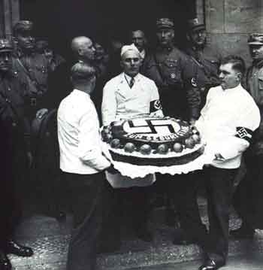
8. Festivals
30 Jan – Day of the Seizing of Power
24 Feb – Founding of the Party Day
Mar – Commemoration of Heroes
20 Apr – Hitler’s Birthday
1 May – National Day of Labour
May – Mother’s Day
21 Jun – Summer solstice
July – Day of German Culture
Sept – Nuremburg Rally
Oct – Thanks for Harvest
9 Nov – Munich Putsch Day
Dec - Yuletide
The calendar in Nazi Germany was peppered with new festivals, celebrating key dates in the Nazi year. On these days rallies were held. Streets would be festooned with swastika flags.
Notes:
http://www.youtube.com/watch?v=1dyns367ExE&bpctr=1368951658

Slide 21
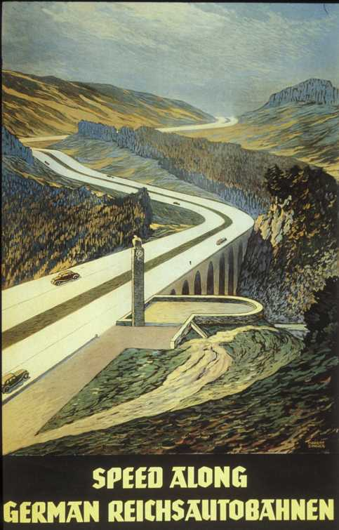
9. Autobahns
Photographers, newsreel makers and even painters sold the message of a revived German nation working together for the common good, symbolising the political strength, willpower and achievement of Hitler’s Germany.
Notes:
http://www.youtube.com/watch?v=1dyns367ExE&bpctr=1368951658

Slide 23
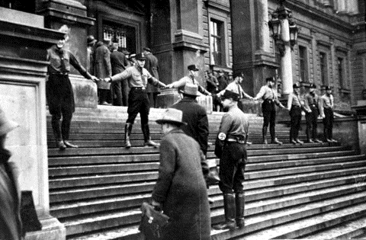
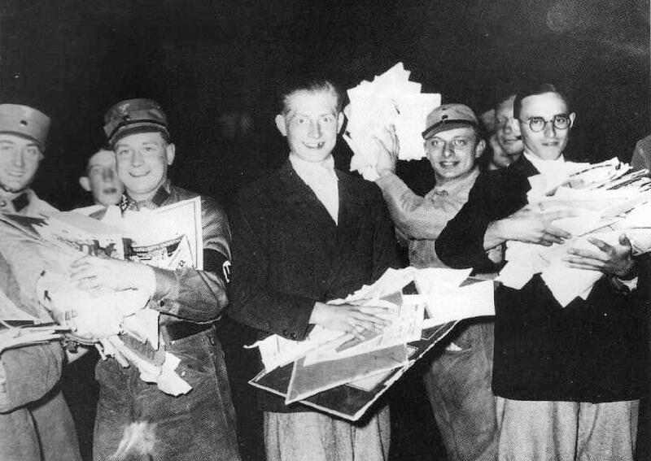
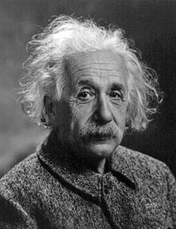
10. Universities
University researchers and lecturers were directed by the Ministry to support Nazi views or face dismissal.
Between 1933 and 1938, 3000 academics were dismissed. Senior professors and rectors were handpicked by Nazis.
Anyone appointed to a university post had to be approved by government and had to complete a 6-week training course at a National Socialist Lecturers Alliance Camp.

Slide 24
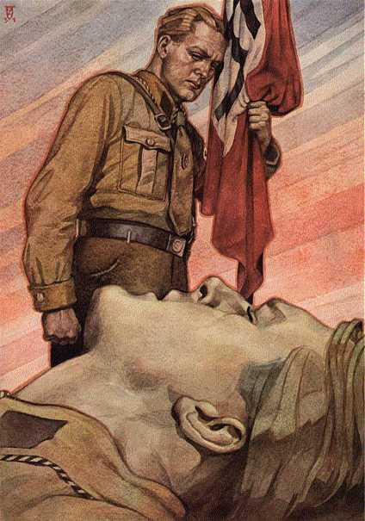
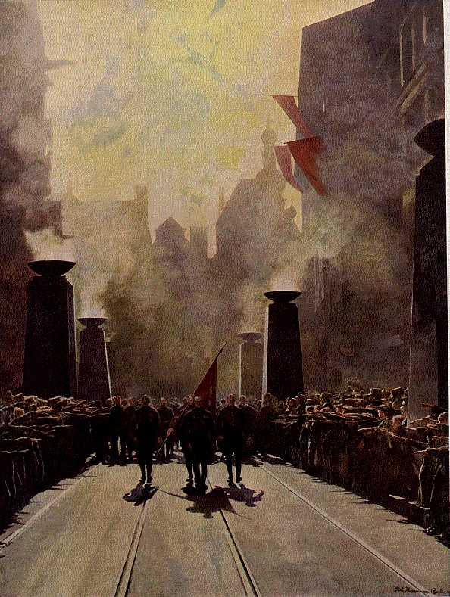
The Arts
The Reich Chamber of Culture was created by Goebbels to control the arts. The content of every play, book, novel, film and concert was subject to supervision.
All writers, musicians, artists and actors had to be members. If the Nazis disapproved, you could be barred from working although most artist practiced ‘self-censorship’.
Leading figures from each field of the arts was co-opted, threatened or bribed into working with Goebbels.

Slide 25
11. Literature
“Whereas previously the works of German writers had been translated into many languages, scarcely a writer active in the Third Reich achieved a reputation beyond its borders.”
Louis Snyder
Nazis decided what books would be available. Books they didn’t like were banned. Millions of books from universities and libraries were burnt like on May 10th 1933 in Berlin.
Authors could only write about 4 topics; Front experience, World View, Regional Novels & Racial Doctrine.
By 1939, over 2500 authors had left Germany including Thomas & Heinrich Mann, Erich Maria Remarque and Bertolt Brecht.
“Any book which acts subversively on our future will be destroyed…the soul of the German people can express itself again. These flames not only illuminate the end of an old era, they also light up a new.” Goebbels
“Where you burn books, you ultimately burn people.” Bertolt Brecht

Slide 26
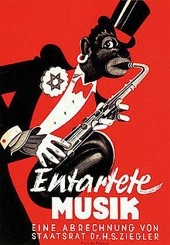
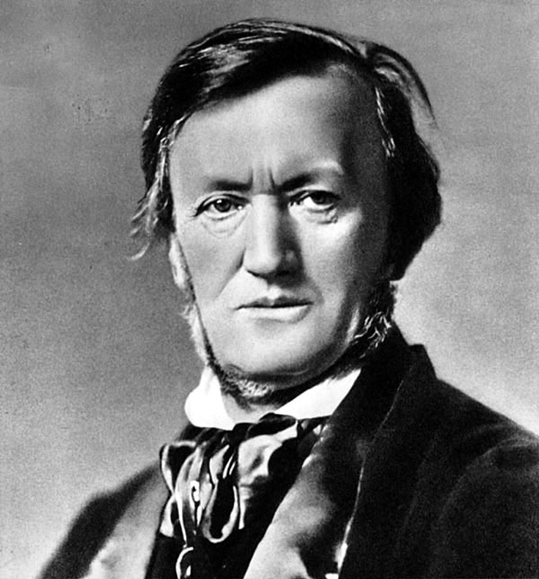
12. Music
Music was also censured and had to conform to the Nazi ideal. Modern and experimental music was banned.
Jazz music was banned as it was seen as black music and therefore inferior.
The work of Mendelssohn was banned because he was part Jewish. Orchestras were also purged of Jews.
Hitler particularly liked the work of Robert Wagner, who he thought ‘personified’ Nazism.

Slide 27
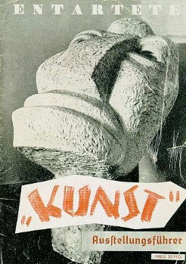
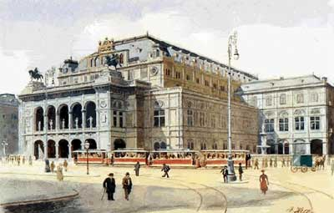
13. Visual Art
Art was heavily censored. The Ministry disapproved of almost all modern art. They wanted art which classical realist art that showed heroic German folk tales.
Art under Weimar like expressionism, cubism and impressionism was all banned.
Hitler preferred the romantic form of art and wanted art to display the ‘true German spirit’.

Slide 28
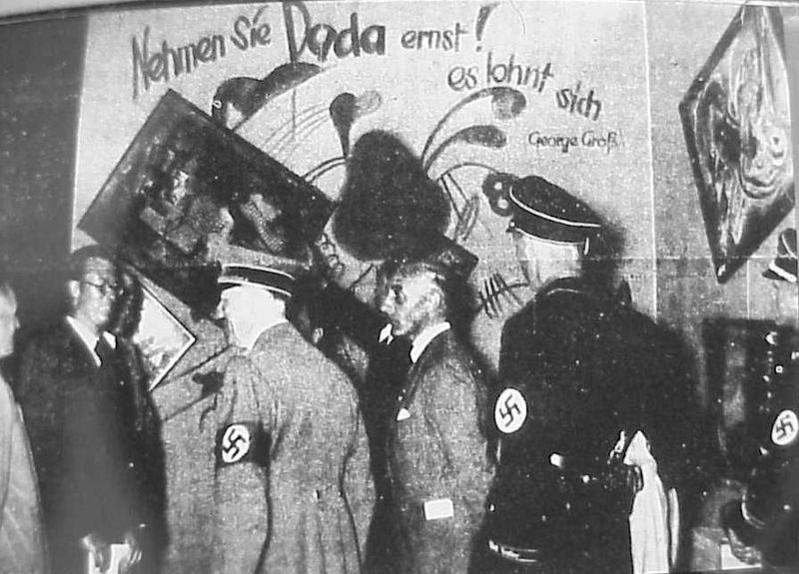
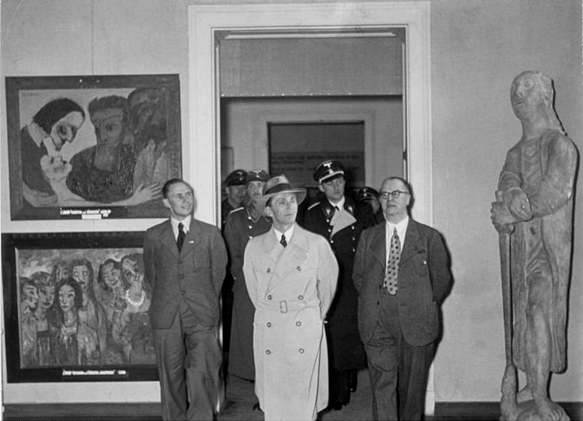
13. Visual Art
All artists had to join the Reich Chamber of Visual Arts. 42,000 artists were given approval but could be expelled if they were ‘politically unreliable’.
‘Degenerate Art’ (Entartet) was put on display by Hitler in Munich on March 31st 1936. People were encouraged to criticise it.
Art was also used to glorify Hitler himself. His image was used to personify the Nazi Party and unify the nation.
Notes:
http://www.youtube.com/watch?v=1QE4Ld1mkoM

Slide 29
‘Stormtroopers advancing under Gas’ by Otto Dix, 1924
Entartete!

Slide 30
‘Cripples’ by Otto Dix, 1920
Entartete!

Slide 31
‘Le Canot, (En Canot), Im Boot’ by Jean Metzinger, 1913
Entartete!

Slide 32
‘In the beginning was the word’ by Hoyer, 1937
Notes:
Emphasises the importance that Hitler and the Nazis put on the spoken word. Hitler as Messianic figure.

Slide 33
‘The Wool Collection at a Munich Local Group’ by Adolf Reich, 1942
Notes:
Emphasises the importance that Hitler and the Nazis put on the spoken word. Hitler as Messianic figure.

Slide 34
‘Farm Family from Kahlenberg’ by Adolph Wissel, 1939
Notes:
Emphasises the importance that Hitler and the Nazis put on the spoken word. Hitler as Messianic figure.

Slide 35
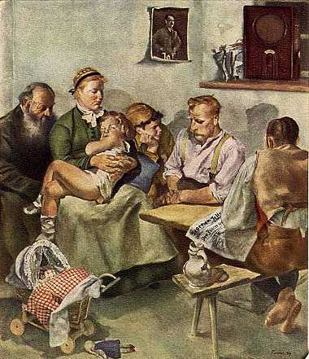
‘The Fuhrer Speaks’ by Paul Padua, 1939

Slide 36
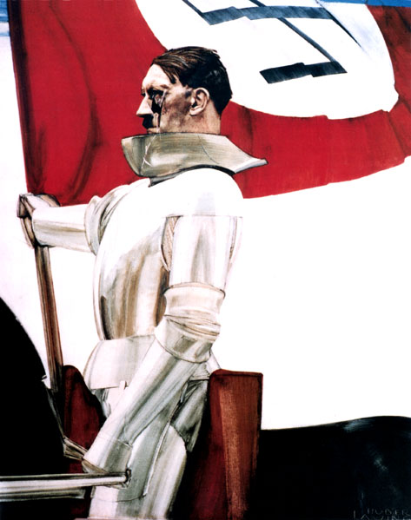
‘The Flag Bearer’ by Hubert Lanzinger, 1939

Slide 37
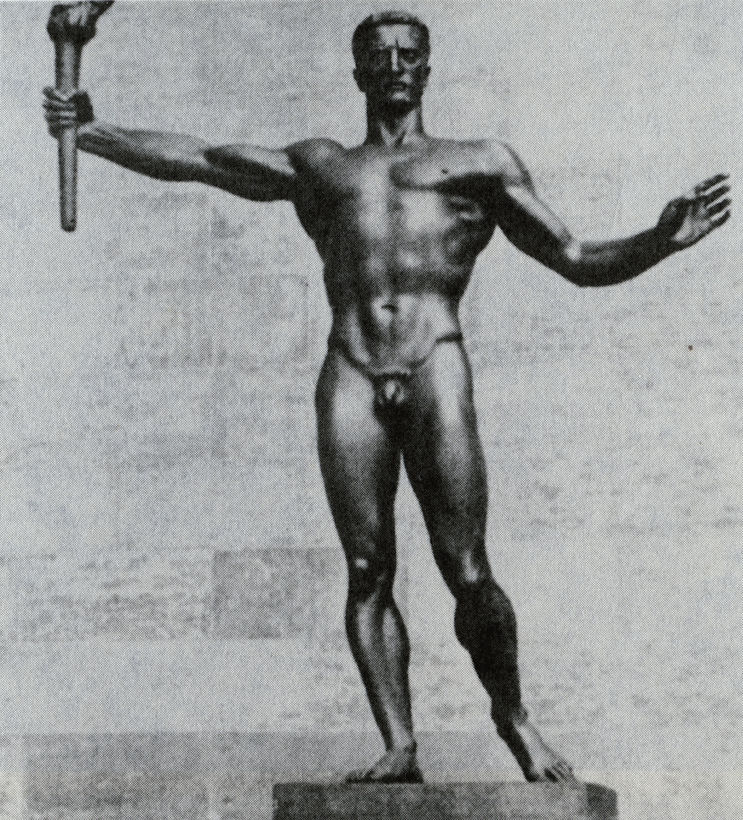
14. Sculpture
Sculpture portrayed stereotyped Nazi virtues, in perfect but lifeless body shapes.
Sculptured muscle men paraded on Nazi buildings, reflecting the biologically pure, vigorous Aryan race.
Sculpture was more accessible to people as it adorned many buildings.
Notes:
http://www.youtube.com/watch?v=1dyns367ExE&bpctr=1368951658

Slide 39
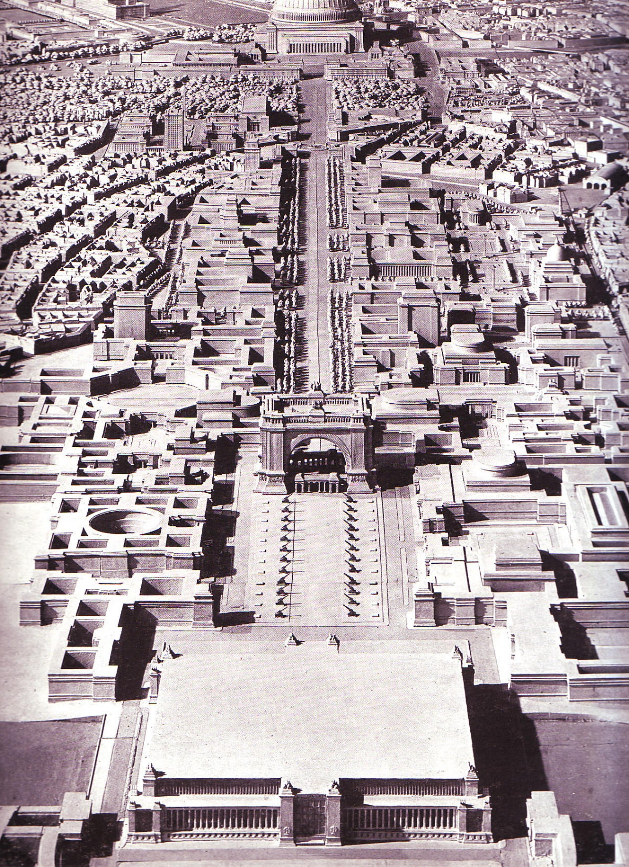
15. Architecture
Hitler describe architecture as ‘the word in stone’. Buildings were experienced by large numbers of people, and could last, thus representing the Thousand Year Reich the Nazis were building.
Hitler preferred neo-classical, monumental style. The individual was dwarfed in front of the buildings strengthening the authority of government.
Notes:
http://www.youtube.com/watch?v=1dyns367ExE&bpctr=1368951658

Slide 42
Form of Propaganda | Specific Example of that propaganda form | Possible Message from that form | Assessment of Impact
Radio
Cinema
The Press
Photographs
Posters
Meetings & Rallies
Sport
Festivals
Autobahns
Universities
Literature
Music
Paintings
Sculpture
Architecture

