Slide 1
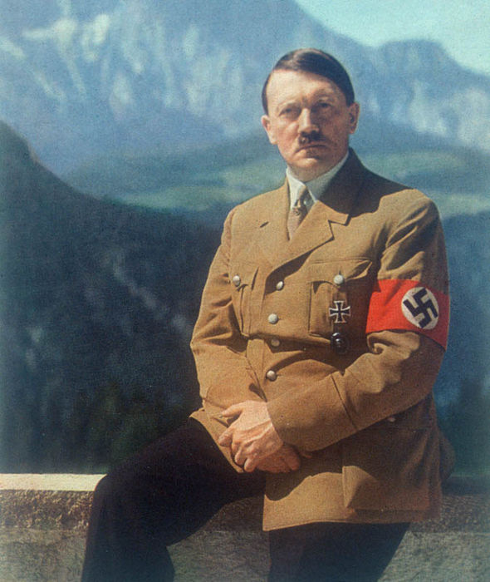
Was Hitler’s rise to power inevitable?
Some topics in History are quite controversial. The reasons surrounding Hitler’s rise to power have create a lot of debate.
Over the next 4 lessons you are going to research the different historians viewpoints and present your ideas. You will need to present a strong argument for why your viewpoint is the correct one.
Create a 3-4 minute persuasive argument about an interpretation of Hitler’s rise to power. There are 7 on the next slide.
How do I write a persuasive argument?

Slide 2
Was Hitler’s rise to power inevitable?
View 1: Hitler as a product of Germany’s history
View 2: Germany deviates from the proper course of European development
View 3: In Germany, as elsewhere in Europe, war and Depression create dictatorship
View 4:Nazism as a product of capitalism in crisis
View 5: Nazism as an emotional response to a crisis
View 6: Nazism as the product of the fanatical determination of one man, Adolf Hitler
View 7: Hitler was just bad luck

Slide 3
View 1: Hitler as a product of Germany’s history
Research Focus:
Who ruled Germany before the war?
What type of government/ruler did Germany have?
Why did Germans want to have an autocratic (one strong) ruler?
How had Brüning already started to remove democracy before Hitler came to power?
Worksheet
G - Why did Parliamentary Government decline
H – Brüning savior or destroyer

Slide 4
View 2: Germany deviates from the proper course of European development
Research Focus:
What is a ‘sonderweg’?
Why did the Middle Class in Germany vote for Hitler?
How did authoritarianism develop? P13-17
Worksheet
See worksheet D ‘Why did people support the Nazis?’

Slide 5
View 3: In Germany, as elsewhere in Europe, war and Depression create dictatorship
Research Focus:
The impact of WWI on Germany.
The terms of the Treaty of Versailles.
What other dictators were emerging in Europe after WWI?
Worksheet
H - Problems facing the Weimar Republic 1919-23

Slide 6
View 4: Nazism as a product of capitalism in crisis
Research Focus:
Which groups feared a communist take-over?
Find examples of the economic problems in Germany after WWI and before Hitler comes to power.
How did Hitler appeal to capitalist groups within Germany?
Worksheet
J - The Great Depression
F – Who supported the Nazis and why

Slide 7
View 5: Nazism as an emotional response to a crisis
Research Focus:
What political problems had Weimar Germany face in the 1920’s?
How did economic crisis affected Germans in different social groups?
How did Hitler appeal to German society? Was he seen as a ‘savior?’ If so, how and why?
Worksheet
J - The Great Depression
F – Who supported the Nazis and why
I – Problems facing Weimar Germany

Slide 8
View 6: Nazism as the product of the fanatical determination of one man, Adolf Hitler
Research Focus
How was Hitler’s personality appealing to the public?
How did Hitler convince political leaders to give him power?
What ideas did Hitler have and why were these appealing?
What role did the Nazis Party play in Hitler coming to power?
Worksheets
A - What role does Hitler play in the rise of the Nazis
B – How well organized were the Nazis
C – How important were the SA

Slide 9
View 7: Hitler was just bad luck
Research Focus:
What role did other people play in Hitler’s rise to power? Look at Brüning, Schleicher and Hindenburg
How significant were events outside of Germany in Hitler’s rise to power. Consider the Wall Street Crash.
Worksheets
A - What role does Hitler play in the rise of the Nazis
H – Brüning savior or destroyer

