Slide 1
Task on Entry
Key Question: What circumstances favoured the rise of Mao Zedong?
Work in groups of 3 to write answers to each of the questions on a board
Make sure you label each response ‘Think, Puzzle or Explore’ AND add your name

Slide 2
Key Question: What circumstances favoured the rise of Mao Zedong?
Learning Objective:
Critical Thinking
To explain how the war with Japan helped the Communist Party gain more support.
To explain why the communists won the Civil War.
6-7 Grade
You can analyse the different events and reach a judgement comparing different events to explain which is the most significant.
Learning Outcomes:
5 Grade
You can explain why some events are more significant than others in Mao’s rise to power.
4 Grade
You can identify why different events were significant in Mao’s rise to power.

Slide 3
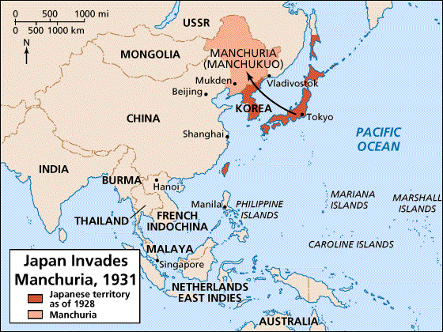
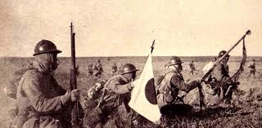
Connect: Reviewing the Japanese Occupation, 1931-1945
The Japanese Invasion of Manchuria
In 1931, the Japanese invaded the northern province of Manchuria. They renamed it Manchukuo. Chiang did little to stop them. He was preoccupied with the threat from the CCP.
He actually ordered troops not to resist, fearing a full-scale invasion of China.

Slide 4
Disease of the Soul?
“The Japanese are a disease of the skin, it can be cured. The Communists are a disease of the soul; it affects the whole body.”
Chiang Kai-Shek, speaking in 1936
People were furious that he hadn’t stood up to Japanese aggression. Chiang believed that national unity had to be achieved before attacking the Japanese.
In 1936 he ordered another extermination campaign against the CCP in their new base at Yanan.
Look at the above source. In your own words, explain what Chiang means.

Slide 5
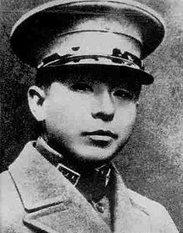
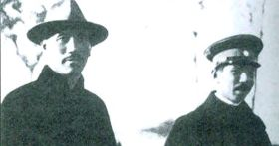
The Rise of Zhang Xueliang
However KMT troops, commanded by Zhang Xueliang the warlord of Manchuria, refused to fight the Communists.
In 1936, Zhang made an agreement with the CCP not to fight each other. Chiang was furious.

Slide 6
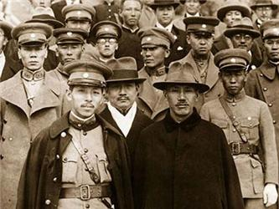
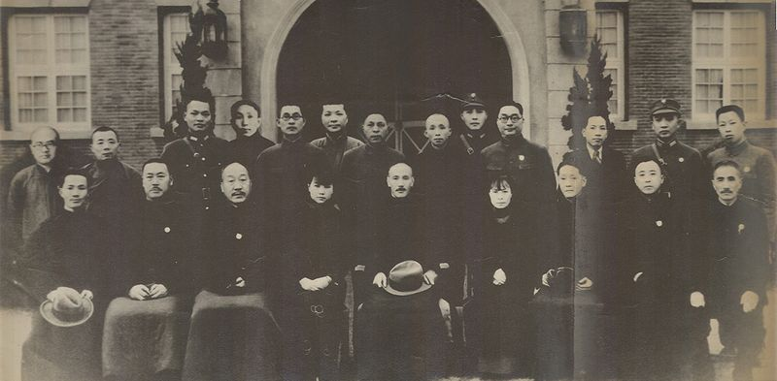
The Xi’an Incident & United Front
Chiang opposed the agreement but in December 1936 he was kidnapped at Xian by Zhang’s troops and kept prisoner for 2 weeks.
He was eventually released when he agreed to form a 2nd United Front with the CCP against Japan.
The Russians government agreed to give military aid.

Slide 7
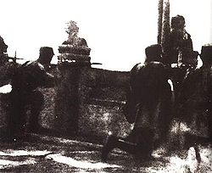
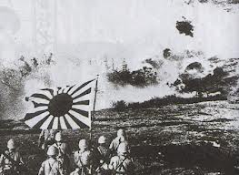
The Japanese Invasion of China
Despite the United Front, the well-equipped, modern Japanese armies swept south into the rest of China.
In July 1937, Japanese troops attacked Chinese troops at the Marco Polo Bridge, near Peking.
This was the start of a full scale war which lasted until 1945.

Slide 8
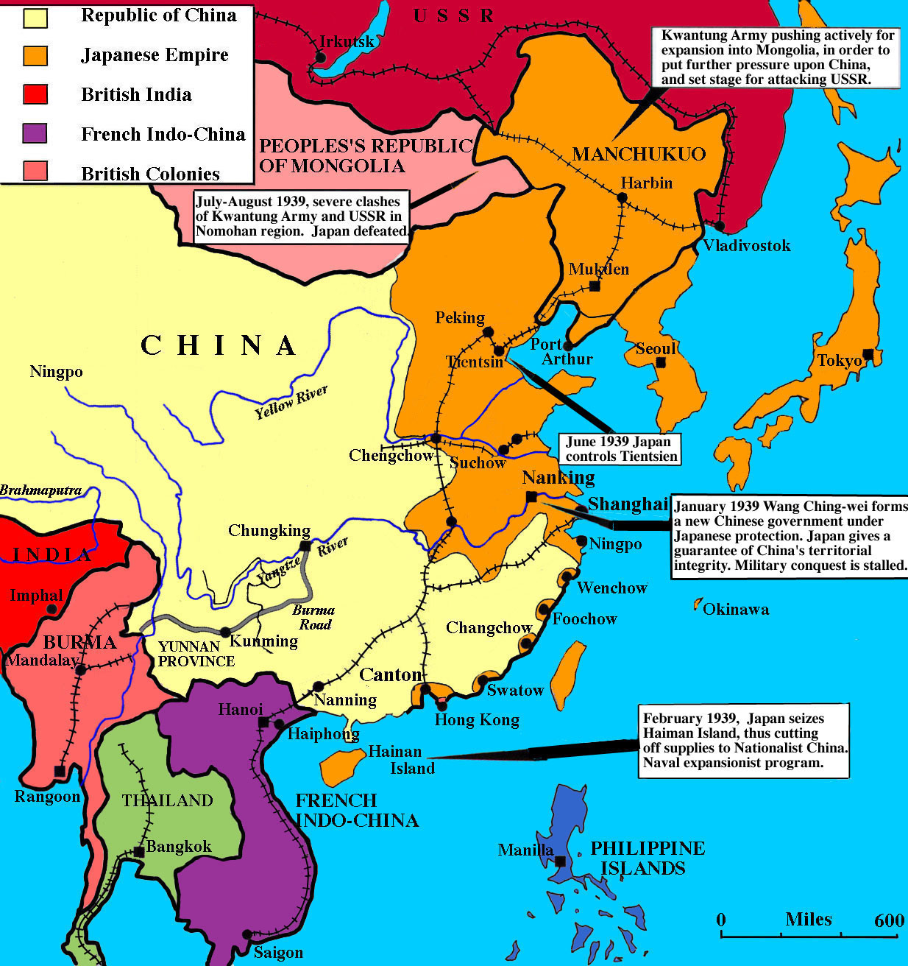

Slide 9
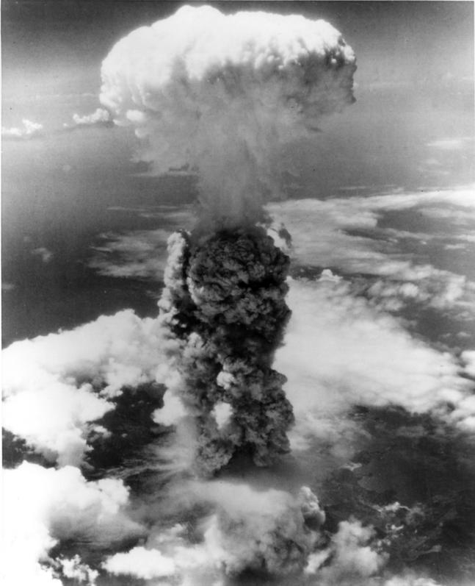
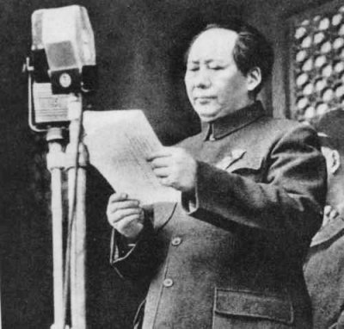
The Outcome of the War
Before the Invasion in 1937, the CCP controlled only 30,000 sq. miles with 2 million people.
By 1945, the CCP controlled 300,000 sq. miles with 95 million people.
TASK: Read the worksheets to find out how the CCP managed to gain so much support during the war.

Slide 10
Activate 1: Toolkits for Active Reading - The Symbols Approach
As you read through the two worksheets.
Use the symbols approach to code the text.
It’s like highlighting, just with symbols.
THEN:
Answer question 1 to 8 on Worksheet 1.
Want to know the latest?
Follow us… Twitter @GEMS_WSO | Facebook GEMSWSO

Slide 11
Key Question: What circumstances favoured the rise of Mao Zedong?
Learning Objective:
Critical Thinking
To explain how the war with Japan helped the Communist Party gain more support.
To explain why the communists won the Civil War.
6-7 Grade
You can analyse the different events and reach a judgement comparing different events to explain which is the most significant.
Learning Outcomes:
5 Grade
You can explain why some events are more significant than others in Mao’s rise to power.
4 Grade
You can identify why different events were significant in Mao’s rise to power.

Slide 12
China in 1945
When war ended in Aug 1945, the CCP controlled most of the countryside & the KMT was stuck in Sichuan province.
The war ended too soon for Chiang. He was hoping that the USA would send armies to China to defeat the Japanese AND communists.
The CCP was already accepting the surrender of the Japanese in many areas and taking over.
‘The CCP had effectively won the civil war by 1945.’
Do you agree? Explain your opinions in details.

Slide 13
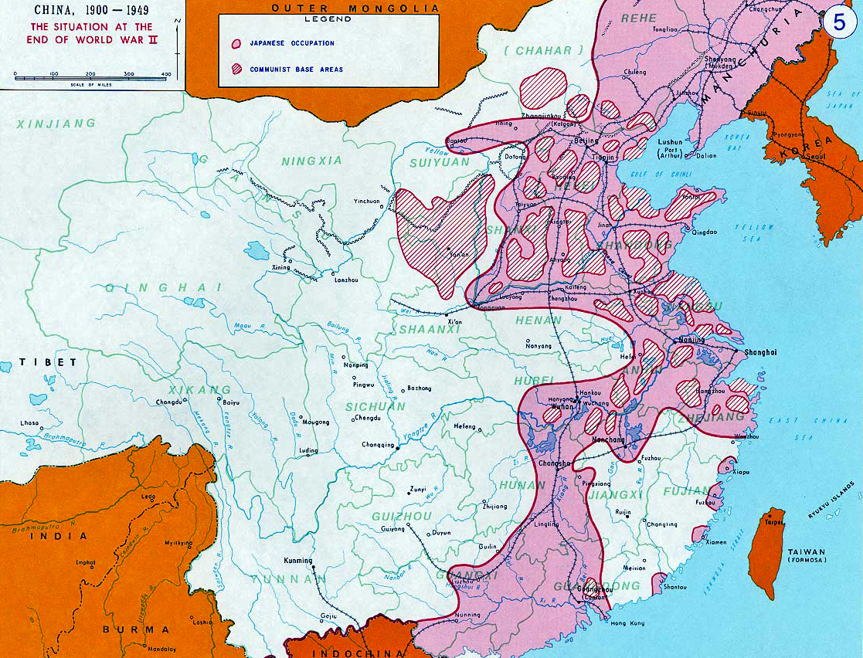
Notes:
Using the map ask students to consider the strengths of the CCP and the weaknesses of the GMD.

Slide 14
Activate 2: Why did the Communists win the Civil War, 1945-49?
Key Question: What circumstances favoured the rise of Mao Zedong?
Read through the next few slides and create a table to summarise the following.
See pp. 128-131 in Authoritarian Rulers as well.
Strengths of the CCP (reasons for victory in the Civil Wars) | Failures of the GMD/KMT

Slide 15
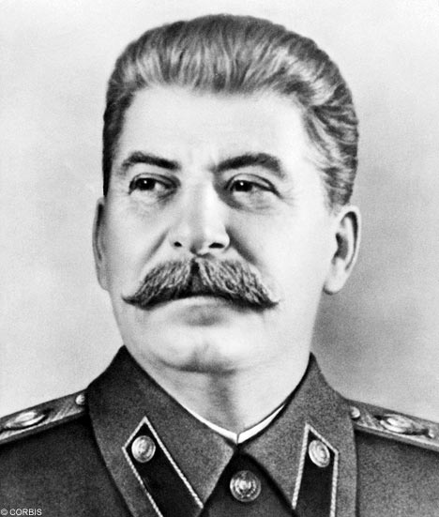
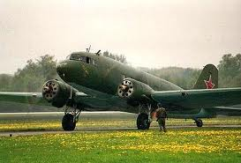
China in 1945
Why do you think Stalin agreed to reinstate Chiang rather than Mao as leader of China?
The Allies decided that Chiang should be reinstated as ruler of China. Even Stalin agreed to this.
US Dakota planes rushed 110,000 KMT troops to the cities and bases in the north to accept the surrender of Japanese troops & equipment before the Communists could do so.
In response the Communists moved into Manchuria and captured many ex-Japanese weapons.

Slide 16
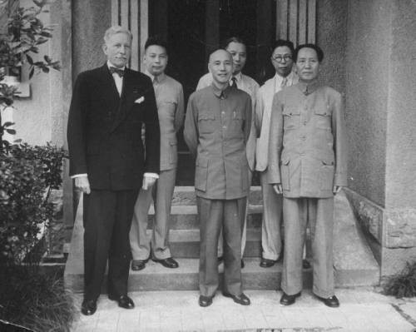
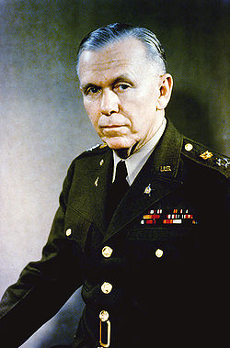
Ceasefire?
In Dec 1945, the USA sent General Marshall to try to prevent a civil war in China. He failed and war broke out in early 1946.
The Communists had 1.2m members, 900,000 soldiers, 19 base areas, 90m population but lacked heavy military equipment and only 600 artillery pieces.
KMT had 2.7m soldiers, 39 newly trained divisions, x10 artillery and large air force.
Was there any realistic prospect of peace cooperation between the CCP & KMT after the end of WW2?

Slide 17
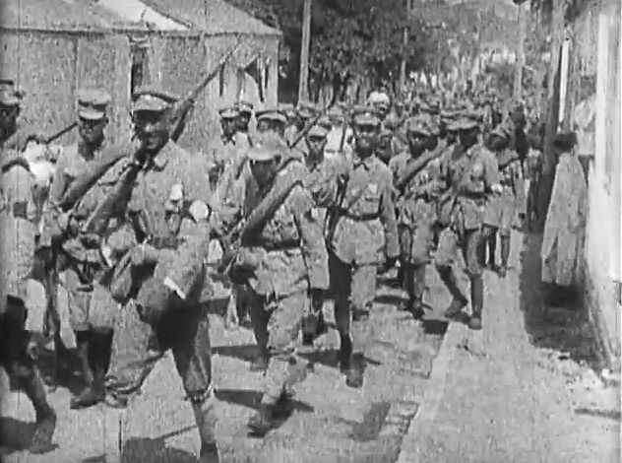
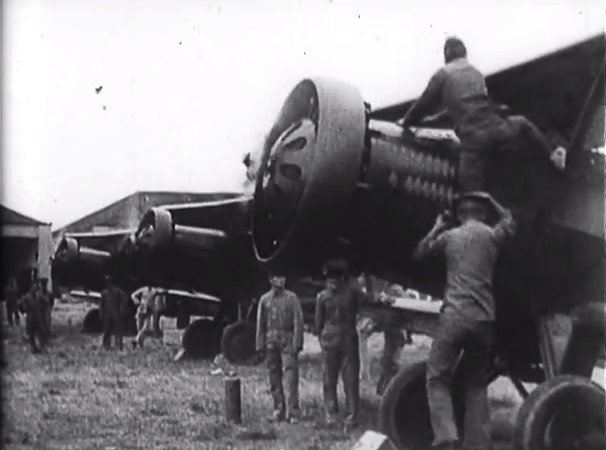
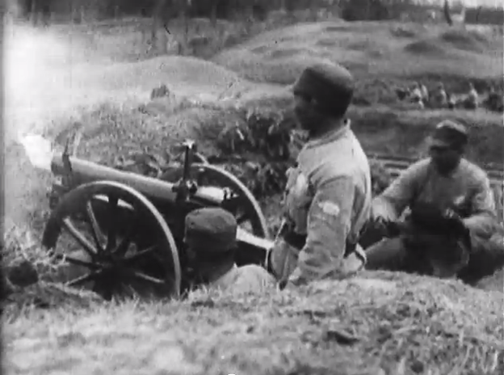
1.) Early Setbacks, July 1946-May 1947
The KMT immediately took the initiative by launching an offensive which captured most of the cities of Manchuria except for Harbin in the far north.
The CCP even lost their base at Yan’an. KMT numbers, resources and air power helped dramatically. Chiang committed ½ million of his best troops to capture Manchuria.
A renewed offensive by the KMT in Oct 1946 failed to break through PLA defences.

Slide 18
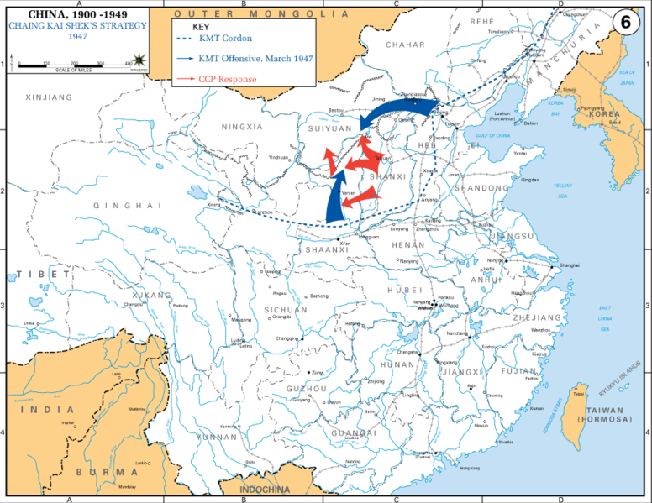

Slide 19
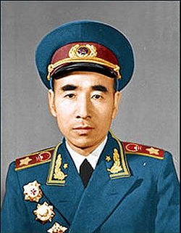
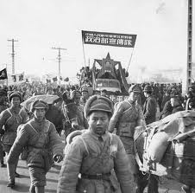
1.) Early Setbacks, July 1946-May 1947
After October 1946, the PLA led by Lin Biao, began to adopt an effective guerrilla warfare strategy against the KMT.
From rural bases, the PLA ambushed KMT units, forcing them to remain in the cities.
Railway lines were then blown up to cut the cities off from supplies and reinforcements.

Slide 20
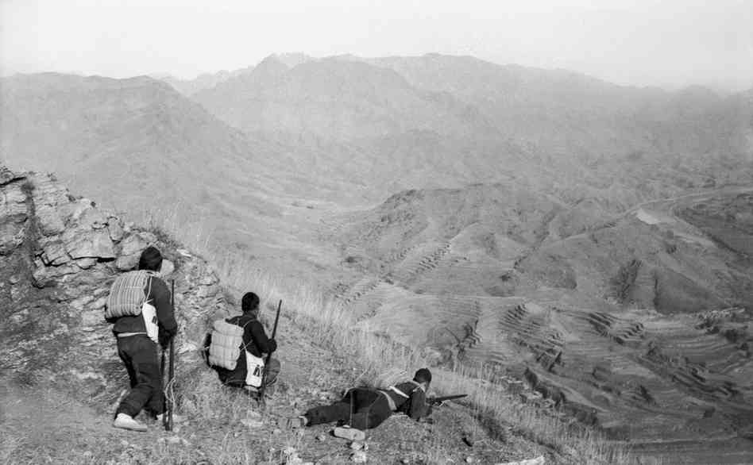

Slide 21
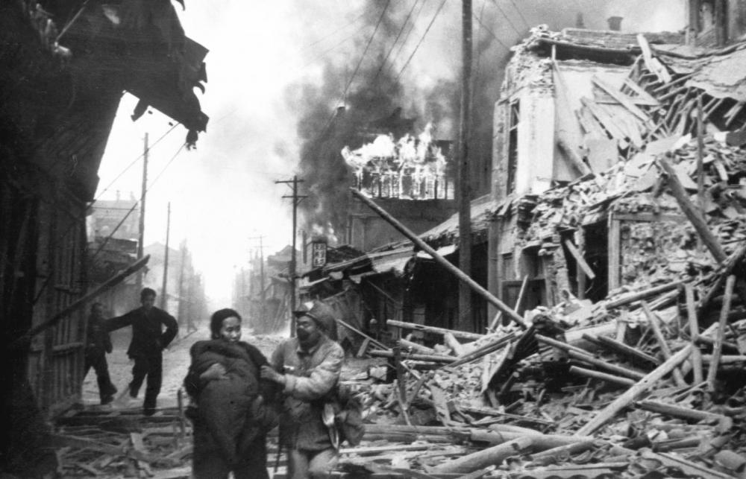
2.) Seizing the Initiative, May 1947-Nov 1948
During this period, the PLA moved from a strategy of guerrilla warfare to one of conventional battles with massed forces of infantry and artillery.
In June 1948, the PLA captured the Yellow River valley, Shandong Province and in October, Manchuria finally fell.
Chiang had lost over ½ million of his best troops and was now on the defensive.
Why was it important to move from guerrilla warfare to conventional warfare?

Slide 22
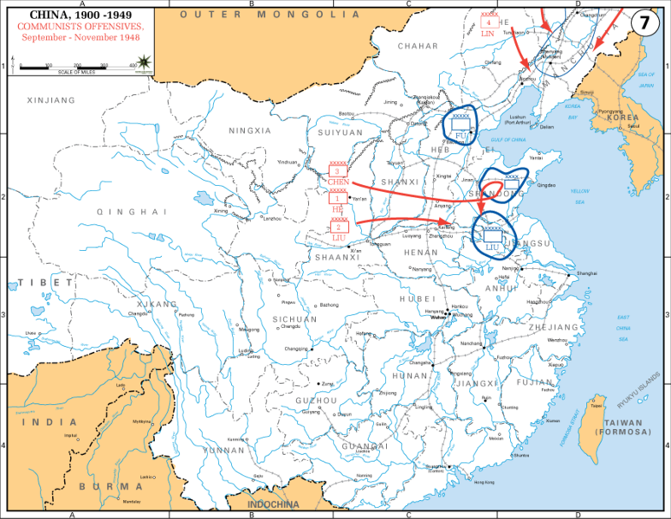

Slide 23
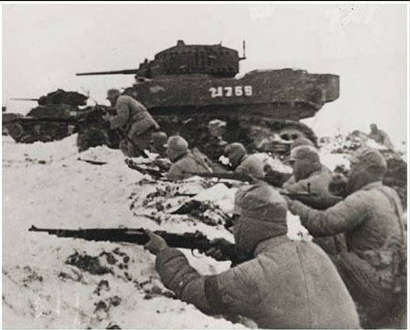
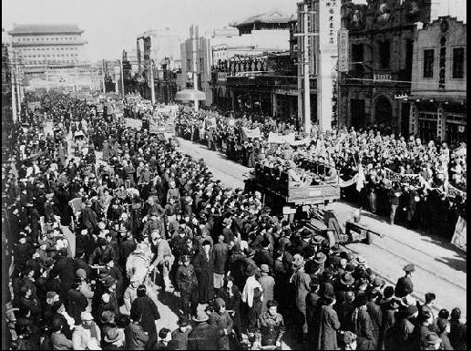
3. The Final Stages, Dec 1948-Oct 1949
Moving quickly to capitalise on successes, the PLA launched an offensive against the vital railway junction of Xuzhou.
The battle lasted 65 days with 600,000 on each side. Xuzhou was captured in Jan 1949 along with Beijing and Tianjin by Lin Biao in the same month.
By Feb 1949, the whole of northern China was controlled by the Communists.

Slide 24
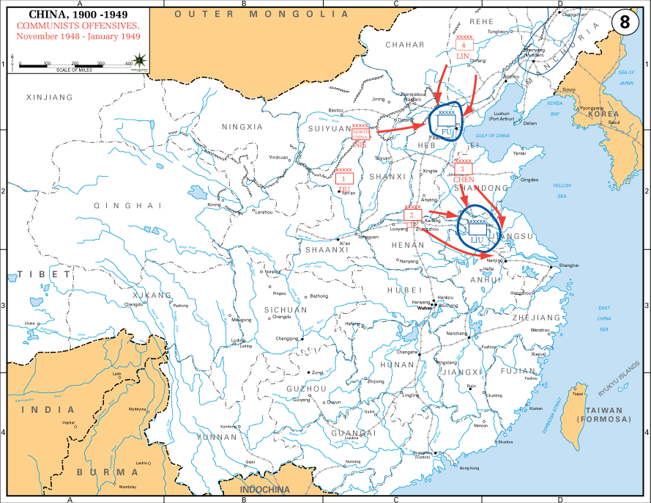

Slide 25
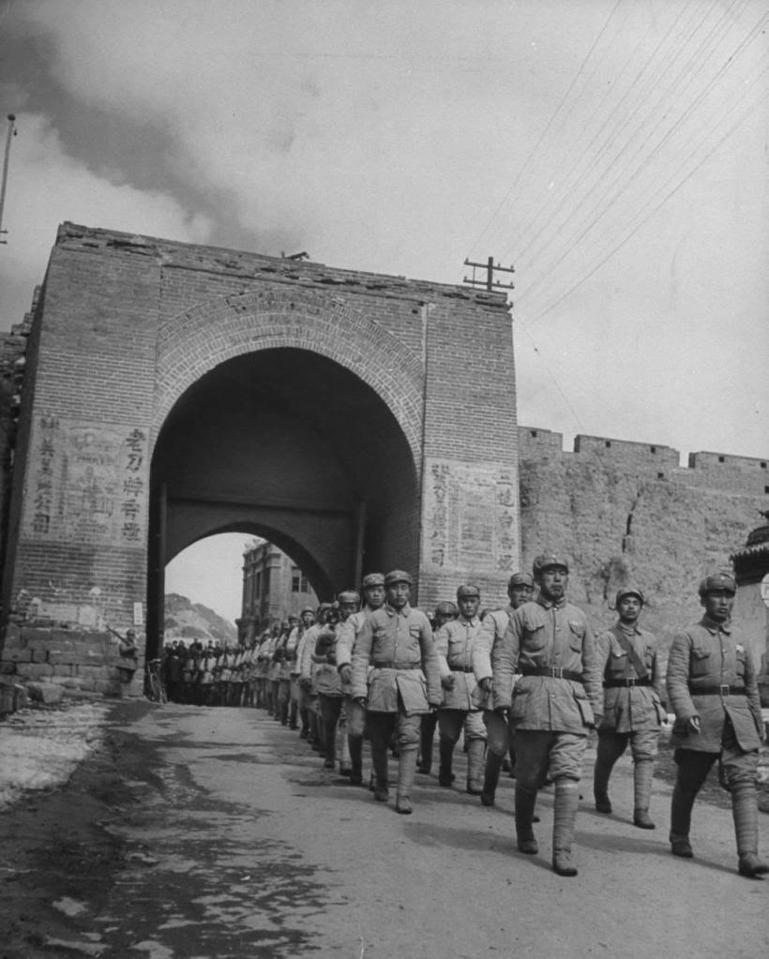
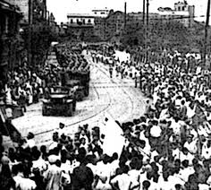
3. The Final Stages, Dec 1948-Oct 1949
After a rest, in April 1949, the PLA attacked key cities on the Yangtzi River, capturing Nanjing on 23rd April and Shanghai in late May.
Wuhan was captured in May and the way to the south was now open. The army then divided:
Xi’an & Lanzhou captured in August.
Guangzhou captured in October.
Chongqing captured in November.

Slide 26
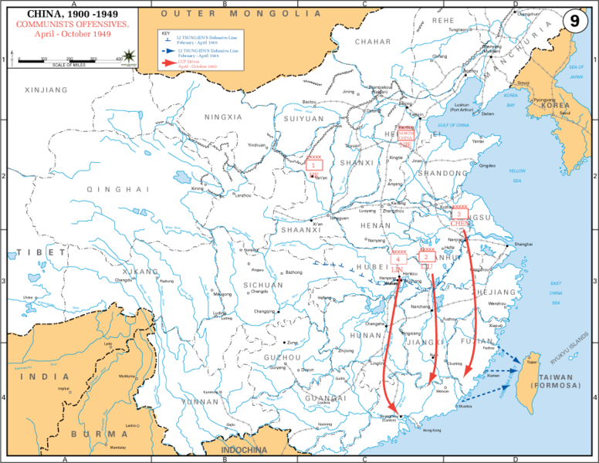

Slide 27
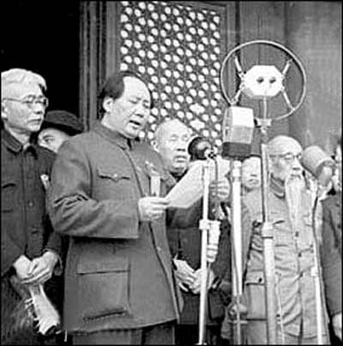
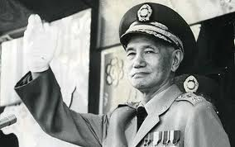
The People’s Republic of China (PRC)
By late Sep 1949, most of China was under Communist control.
Mao called a conference in Beijing. 14 political parties were represented and the conference elected members of the new central government of the People’s Republic of China (PRC).
On 1st Oct 1949, Mao proclaimed the founding of the PRC and he was elected Chairman.
Chiang Kai-Shek fled to the island of Taiwan and established a KMT government.

Slide 28
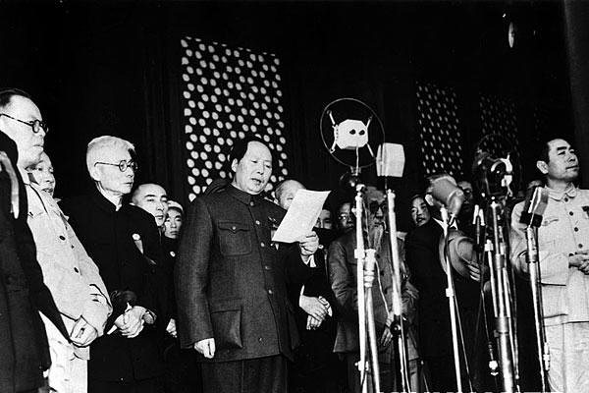

Slide 29
Key Question: What circumstances favoured the rise of Mao Zedong?
Learning Objective:
Critical Thinking
To explain how the war with Japan helped the Communist Party gain more support.
To explain why the communists won the Chinese Civil War.
6-7 Grade
You can analyse the different events and reach a judgement comparing different events to explain which is the most significant.
Learning Outcomes:
5 Grade
You can explain why some events are more significant than others in Mao’s rise to power.
4 Grade
You can identify why different events were significant in Mao’s rise to power.

Slide 30
Consolidate Activity
“The IB Learner profile represents 10 attributes valued by IB World Schools. We believe these attributes, and others like them, can help individuals become responsible members of local, national and global communities.” – The International Baccalaureate Organisation, 2016
REFLECTION: How has your learning in History helped you develop the IB learner profile attributes?
Choose one of the learner attributes in the Student Reflection section of your notebook.
Complete the Learner Attribute Reflection
Be honest, detailed and specific in your reflections!

