Slide 1
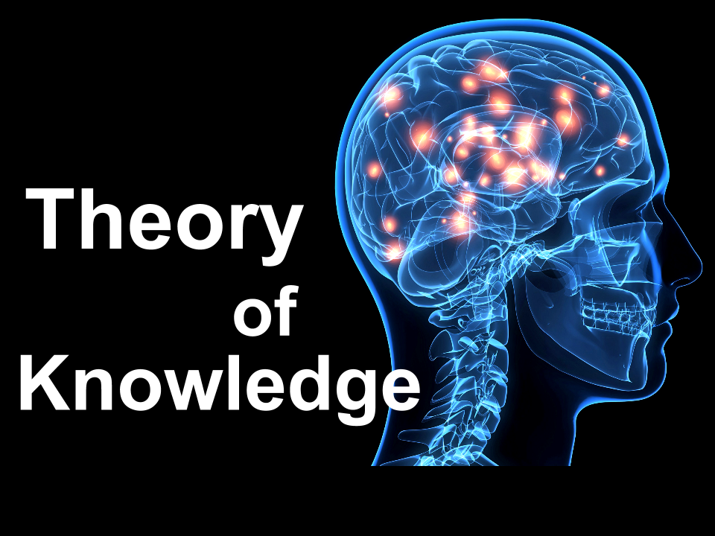
IB Links
IB Learner Profile
Thinkers – Today you will critically evaluate different perspectives on who and what was responsible for the development of the Cold War.
Communicators – Today you will collaborate to create a written evaluation of the big question.
TOK Link
Is historical truth really just opinion or can there be objective historical truth?
How does this idea link to your work as a historian making sense of the past? Our study of historiography?

Slide 2
Who was responsible for the development of the Cold War?
Thinkers
Communicators
Learning Objective:
COMMAND TERMS:
Discuss
Analyse
To judge which factors contributed the most to the development of the Cold War 1942-1949.
To develop your knowledge of how to answer a discuss essay.
Learning Outcomes:
Grade 6/7
You critically analyse 3 or more factors contributing to the development of the Cold War, presenting a consistent line of argument that also evaluates different historiographical interpretations.
Grade 4
You can start to critically analyse some of the factors that contributed to the development of the Cold War and support your response with appropriate and relevant examples.
Grade 5
You critically analyse 3 or more factors contributing to the development of the Cold War, making relevant links between them.

Slide 3
Demonstrate Activity
As a team you are going to write an answer to this essay question.
This is a full essay. You will need an introduction, body paragraphs and a clear conclusion.
Essay Title: Discuss the reasons for the emergence of superpower rivalry at the end of the Second World War (1942-1949)
Group 2
Anoushka
Amina
Hannah
Click here to access your Microsoft Word essay
Group 1
Nadini
Sofia
Shizah
Malaika
Click here to access your Microsoft Word essay
Group 3
Arlo
Ali
Martin
Click here to access your Microsoft Word essay
Each group has a personlised essay challenge.
I will be specifically looking at how well your group meets this challenge when I mark your essay

Slide 4
Connect Activity
A range of events and factors impacted the development of the early Cold War
Use the diamond 9 toolkit to compare, prioritise and critically anlayse the impact early events of the Cold War had on it’s development.
Return to the Conversation in Teams. Has your answer changed? How? Why? Revise your answer in a different colour OR author a second response.
Notes:
Season 1 episode 4 has the actual video as well, but cant find online.

Slide 5
Essay Title: Discuss the reasons for the emergence of superpower rivalry at the end of the Second World War (1942-1949)
Thinkers
Communicators
Learning Objective:
To judge which factors contributed the most to the development of the Cold War 1942-1949.
To develop your knowledge of how to answer a discuss essay.
COMMAND TERMS:
Discuss
Learning Outcomes:
Grade 6/7
You critically analyse 3 or more factors contributing to the development of the Cold War, presenting a consistent line of argument that also evaluates different historiographical interpretations.
Grade 4
You can start to critically analyse some of the factors that contributed to the development of the Cold War and support your response with appropriate and relevant examples.
Grade 5
You critically analyse 3 or more factors contributing to the development of the Cold War, making relevant links between them.

Slide 6
Demonstrate Activity
As a team you are going to write an answer to this essay question.
This is a full essay. You will need an introduction, body paragraphs and a clear conclusion.
Essay Title: Discuss the reasons for the emergence of superpower rivalry at the end of the Second World War (1942-1949)
Group 2
Anoushka
Amina
Hannah
Click here to access your Microsoft Word essay
Group 1
Nadini
Sofia
Shizah
Malaika
Click here to access your Microsoft Word essay
Group 3
Arlo
Ali
Martin
Click here to access your Microsoft Word essay
Each group has a personlised essay challenge.
I will be specifically looking at how well your group meets this challenge when I mark your essay

Slide 7
Consolidate Activity
TOK Link
Is historical truth really just opinion or can there be objective historical truth?
How does this idea link to your work as a historian making sense of the past? Our study of historiography?
GO back to the Conversation in Teams.
Has your answer changed? How? Why? Revise your answer in a different colour.

