Slide 1
Why did the Cold War begin? Key events 1946-47
Cornell Notes
Task 1
Read pages 18-19.
Create a side of Cornell method notes. They must contain no more than 200 words.

Slide 2
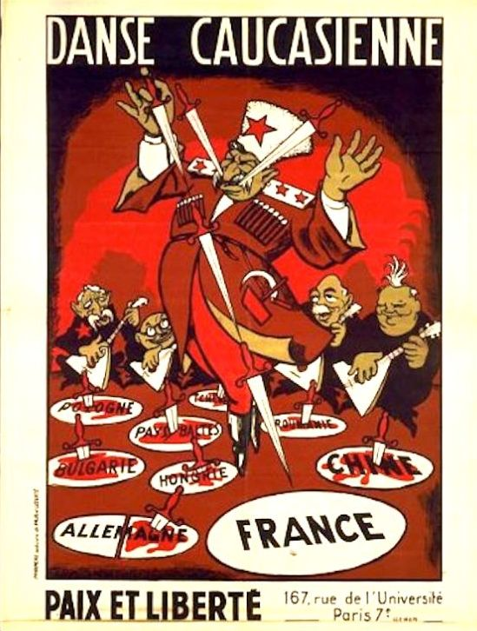
Why did the Cold War begin? 1946-47
Task 2
Complete the source analysis task on page 20.
Who is the dancer in the cartoon?
What do the daggers represent?
What is the message of the cartoon?
Use the iceberg diagram on the next slide to help you.

Slide 3
Iceberg
WHAT CAN WE SEE?
WHAT DON’T WE SEE?
Who made it?
Why was it made?
What is it trying to tell you?
Where does it come from?

Slide 4
Why did the Cold War begin? 1946-47
Task 3
Listen to the Iron Curtain speech. You can follow it on page 21.
https://www.youtube.com/watch?v=jvax5VUvjWQ
Answer the following questions (also on page 21)
Why did Churchill use the phrase, ‘iron curtain’ to describe events in Europe?
In what ways does Churchill allude to the idea of ‘salami tactics’ taking place in Eastern Europe?
Imagine that you are Stalin reading this speech. What might your reaction be?

Slide 5
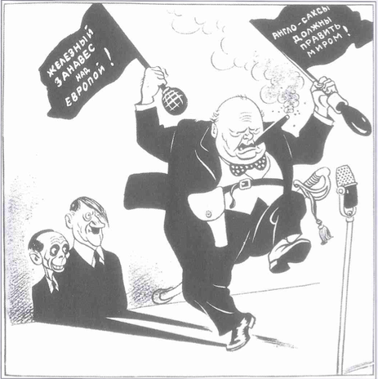
Why did the Cold War begin? 1946-47
Task 4
Complete the source analysis task on page 22.
Explain the message of the Soviet cartoon on page 22.
In what ways does the cartoon support the ideas expressed in Stalin’s speech?
Use the iceberg diagram on the previous slide to help you.

