Slide 1
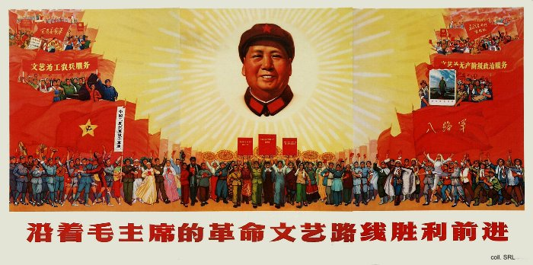
What was ‘Mao Zedong Thought’?
L/O – To identify the key features of Maoism and to explain how it influenced Mao’s rule in China

Slide 2
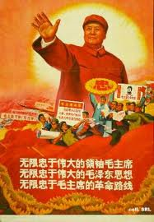
Key Elements of Mao Zedong Thought
1. Self-Reliance – Mao was determined China should not be reliant on foreign powers, including the USSR. He was a Chinese nationalist as well as a revolutionary Communist.
2. Continuing Revolution – Mao believed that each new generation had to be involved in revolutionary struggle, to prevent the threat of counter-revolution and to ensure continuing support for the regime. Revolutionary zeal was thus more important than stability.

Slide 3
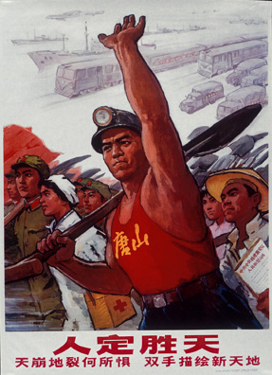
Key Elements of Mao Zedong Thought
3. Class Struggle – Revolution was a class struggle and to continue this struggle was the key to maintaining the revolution. Mao feared that the CCP would just become the new ruling class that would exploit people and become detached. Rectification Campaigns were necessary to avoid this.
4. Learning from the people – The CCP should ‘be the people’ and listen to their concerns. The masses should participate in policy, unlike in the USSR. The people could act as a check on the power of the Communist Party.

Slide 4
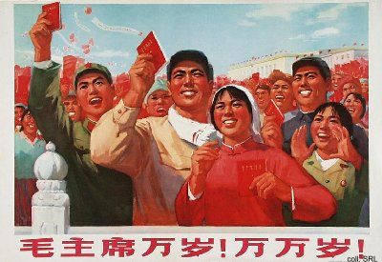
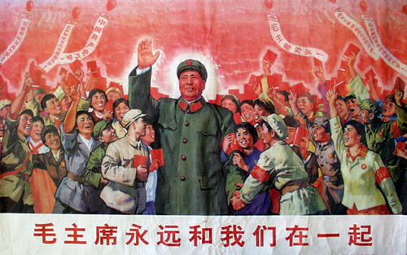
Key Elements of Mao Zedong Thought
5. Mass Mobilisation – Mao had a faith in the goodness of the Chinese people and their potential to achieve anything. He believed in voluntaryism, that the people would work willingly for the common good if persuaded.
Mass mobilisations of millions of peasants, enthused with revolutionary zeal, could then be used to speed up economic construction rather than managers and experts.

Slide 5
TASK: Read page 126-127 of the Todd and Walker textbook.
Use this information AND/OR this PowerPoint to:
Create a mind map OR complete the table attached WSO History to show the main ideas of “Mao Zedong Thought”

Slide 6
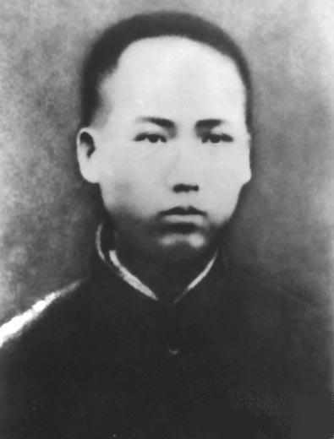
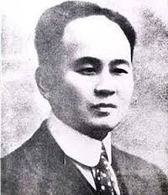
Origins of Mao Zedong Thought
Mao Zedong Thought or Maoism was shaped by Mao’s upbringing and early life.
Born into a rich peasant family in 1893 he experienced life as a volunteer soldier in 1911 and witnessed how the warlords used force to take over.
Between 1913-1919, Mao trained to be a teacher and was influenced by the anti-Confucian professor Yang Changji who urged him to read the radical magazine, New Youth (Xin Qingnian).

Slide 7
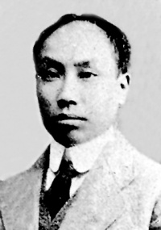
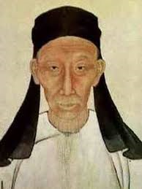
Origins of Mao Zedong Thought
New Youth was created by Chen Duxiu who would later found the Chinese Communist Party. Duxiu argued that China must look West to rid itself of superstition and autocracy.
Mao even published an article in New Youth in 1917, instructing readers to increase their physical strength to serve the revolution!
Yang also introduced Mao to the works of the philosopher Wang Fuzhi, who believed that ‘there is not a single part of human nature already shaped that cannot be modified’.

Slide 8
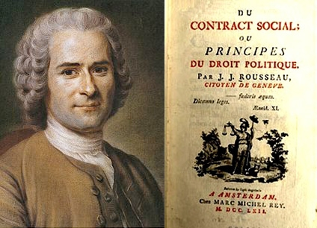
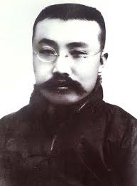
Origins of Mao Zedong Thought
Mao also spent time reading the works of western political philosophy and classical liberalism such as Adam Smith, Montesquieu, Charles Darwin, J.S. Mill, Rousseau and Herbert Spencer.
In 1919 he moved to Beijing where he worked under the Marxist scholar and librarian Li Dazhao who introduced him to communism with Mao joining his Marxist study group.

Slide 9
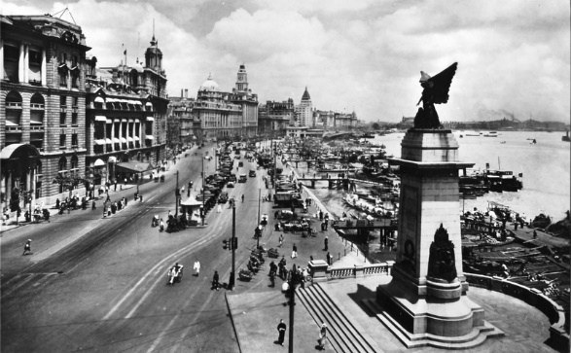
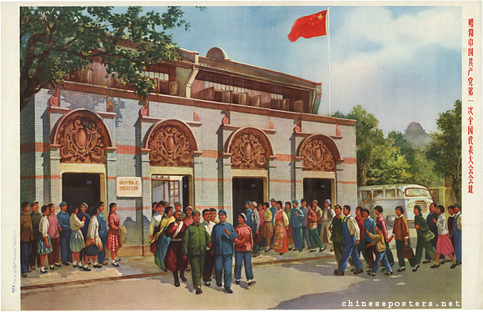
Origins of Mao Zedong Thought
In 1919 he also moved to Shanghai, again meeting Chen Duxiu and was impressed by his conversion to Marxism.
By 1920 Mao had established a Marxist study group in Changsha and organised student protests. He attended the first CCP congress in 1921 and was made Party Secretary for Hunan.
By 1923, Mao was elected to the Central Committee of the Party.

Slide 10
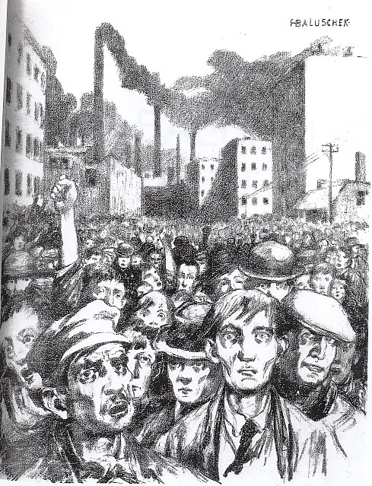
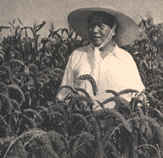
Origins of Mao Zedong Thought
Despite this, Mao didn’t share the views of the leadership of the Party. Chen Duxiu and Li Dazhao were orthodox Marxists who believed only the urban proletariat could lead a socialist revolution.
Mao on the other hand believed in the revolutionary potential of China’s peasants and in 1924 was appointed to run the KMT’s Peasant Movement Training Institute, designed to prepare peasants for military activity.

Slide 11
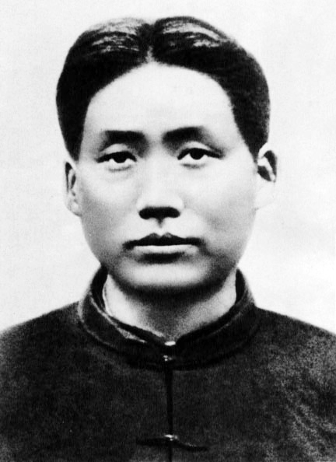
Origins of Mao Zedong Thought
After the split with the KMT in 1927, Mao spent most of the years between 1927-1934 as leader of a Red Army, operating in the countryside of south east China.
Here he developed his own ideology, focusing on organising the peasantry and land reform. He felt the revolution could be delayed to build up a base area and he also reorganised military forces, focusing on guerrilla warfare.

Slide 12
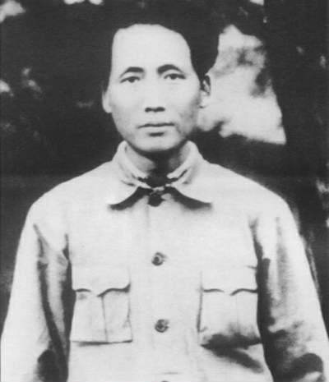
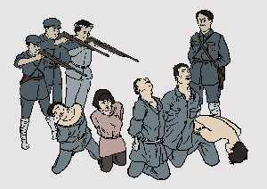
Origins of Mao Zedong Thought
Mao’s focus on the peasantry meant that the CCP expelled him from the Central Committee which was dominated by Soviet educated Chinese Communists known as the ‘28 Bolsheviks’.
Despite this, Mao established the Jiangxi Soviet Base Area in 1930 and used torture and executions to enforce his rule.
In the December 1930 ‘Futian Incident’, Mao executed between 2000-3000 dissenters. This was justified as being in the ‘interests of the masses’.

Slide 13
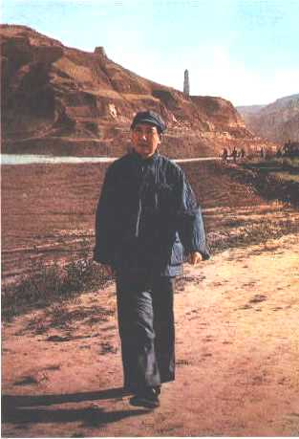
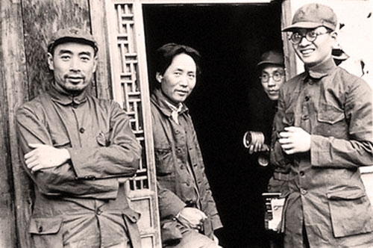
Origins of Mao Zedong Thought
By the 1934 Long March, Mao’s ideology was clearly developed. He had adapted Marxist-Leninism to focus on the peasantry, not urban workers.
Land reform, education programs and promotion of women’s rights also won him support whilst his disciplined guerrilla army earnt him respect.
He was even willing to use torture, executions, self criticism, voluntaryism and mass mobilisation to enforce his control – methods he perfected during his time at the Yan’an Soviet (1935-45).

Slide 14
Questions
Identify at least three key influences on the development of Mao Zedong’s thinking from his early years.
Why did Mao focus on the peasants rather than the proletariat?
Which elements of ‘Mao Zedong Thought’ do you think would be most effective in attracting support to get into power, and which in maintaining power?
What do you think would be the main strength of Mao’s political platform?

Slide 15
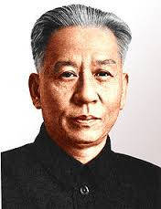
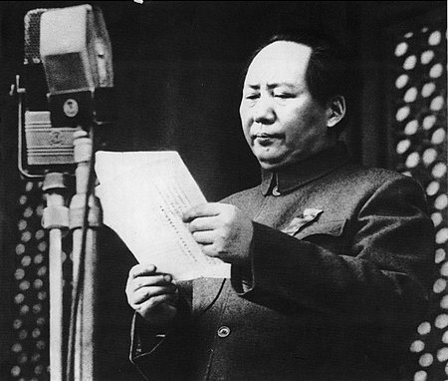
How did ideology influence his rule?
Maoism proved very popular and enabled him to assume control in 1949 however in power, ideology often conflicted with economic planning and Mao clashed often with Liu Shaoqi over planning issues.
Mao’s revolutionary zeal for mass mobilisation as way to construct socialism was apparent in his opening address to the Consultative Conference on 21st Sep 1949 stressing the importance of ‘determination’ and ‘the will to achieve’.

Slide 16
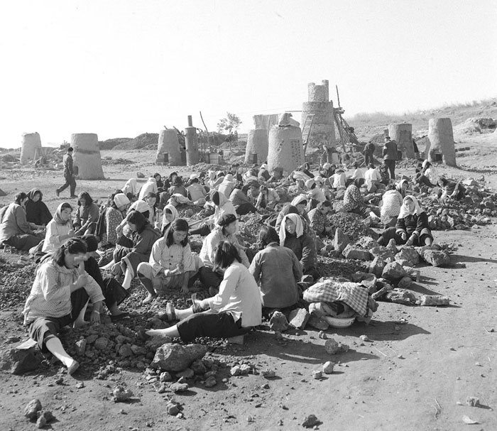
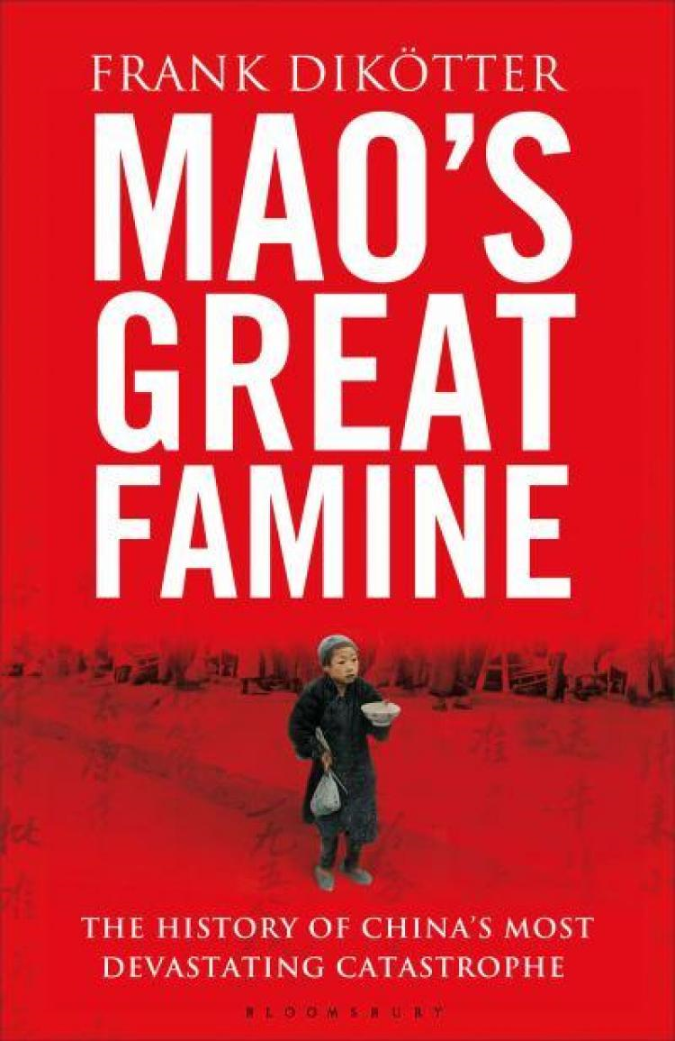
How did ideology influence his rule?
Mao’s ideological belief that willpower alone could bring economic growth was false as proved by the disaster of the Great Leap Forward 1958-1962.
Mao’s policies hindered proper industrial management, deprived China of trained experts, wasted natural and human resources and brought famine.
Deng Xiaoping and Liu Shaoqi actually had to restrict Maoist Collectivisation to prevent further famine.

Slide 17
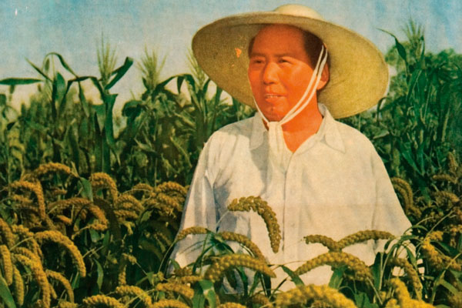
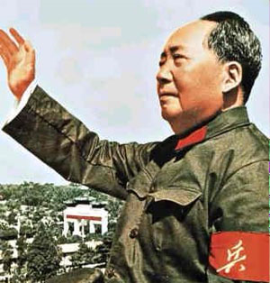
How did ideology influence his rule?
Mao’s own self-belief and the primacy of Mao Zedong Thought brought disaster to many.
He blamed economic problems on class enemies like ‘bourgeois elements’ or ‘capitalist roaders’.
Whilst Maoism called for self-criticism amongst the people and Party, he was unwilling to do it himself, ignoring evidence of a famine.

Slide 18
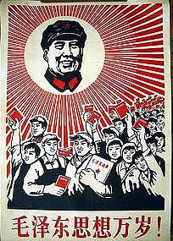
How did ideology influence his rule?
Despite stepping down from day-to-day government in 1959, he retained his commitment to ‘continuing revolution’.
In 1962 he launched the Socialist Education Movement to infuse a new sense of revolutionary fervour in the Party. He feared government was becoming a new ruling class.
This changed the school system and tried to intensify class struggle but was blocked by Deng Xiaoping and Liu Shaoqi who believed stability was more important.

Slide 19
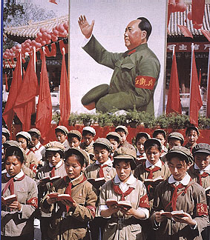
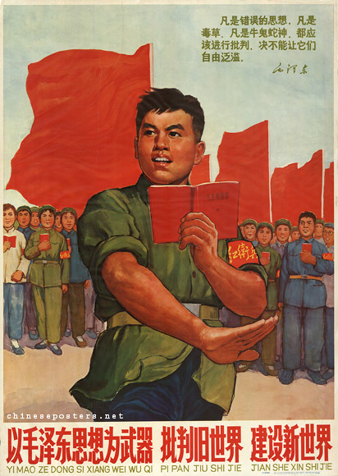
How did ideology influence his rule?
By 1966 Mao feared that the CCP has lapsed into corruption, bureaucratisation and elitism. A new revolution was needed to implement a rectification campaign against ‘revisionism and right-wing tendencies’.
The became known as the Cultural Revolution, and Mao encouraged young ‘Red Guards’ to attack the CCP itself.
Repression, brain-washing and violence were all used to enforce his control but this brought disaster to the economy.

Slide 20
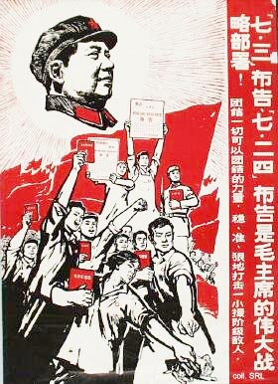
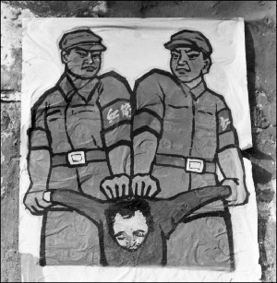
Conclusion
Mao Zedong Thought was a revolutionary rebranding of Communism towards Chinese conditions and helped Mao gained power.
However as a ruling ideology it seemed incompatible with economic development and was full of contradictions.
Mao’s view that unless the CCP was regularly purified it would cease to be a revolutionary force, and China would cease to be truly socialist, threatened to defeat his own objective of making China strong and prosperous.

Slide 21
Questions
To what extent did Mao attempt to instigate the main principles of communism during his rule in China?
How successful was Mao in fulfilling his ideological aims in the years 1949-1976?
Overall, was Maoist ideology constructive or destructive?
Draw a diagram to show the differences between the communisms of Mao, Stalin and Marx. Home Learning. (Consider create a table with 3 columns)

