Slide 1
Mao’s Zedong’s rise to power
Key Events - 1911-1934

Slide 2
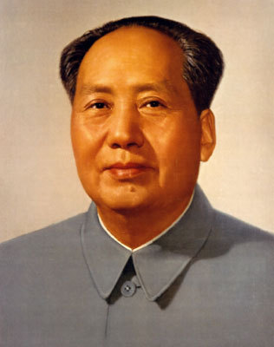
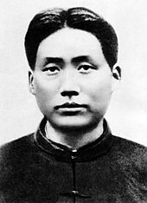
Mao’s Early Years
Born into rich peasant family. Father worked hard, mother was religious Buddhist.
Often fell out with father, refused to show him respect. He didn’t like working, always wanted to read.
Volunteered in anti-Qing army during 1911.
Introduced to Marxism at Beijing University, where he worked as a librarian in 1919.

Slide 3
Mao as a Chinese Revolutionary 1911-1927
Mao came to believe in the dialectic as the explanation of life. i.e. the Marxist notion that historical development occurs through a progressive series of conflicts between social classes.
He held the belief that all change, all progress, resulted from suppression of the weaker by the stronger.
During the Warlord Period, he saw first hand how force could be used:
‘All power grows out of the barrel of a gun’.
‘A revolution is not a tea party; it is an act of violence, by which one class overthrows another’.

Slide 4
Mao as a Chinese Revolutionary 1911-1927
‘During my student days in Hunan, the city was overrun by the forces of rival war lords – not once but half a dozen times. Twice the school was occupied by troops and all the school funds confiscated. The brutal punishments inflicted on the peasants included such things as gouging out eyes, ripping out tongues, disembowelling and decapitation, slashing with knives and grinding with sand, burning with kerosene and branding with red-hot irons.’
Mao realised that it was the strongest and most ruthless who always won. The only way to gain power was through violence.
The rise to power of the Bolsheviks in the 1917 Russian Revolution seemed to confirm his beliefs.

Slide 5
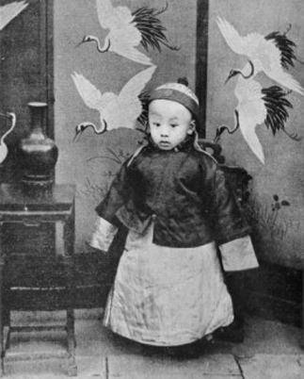
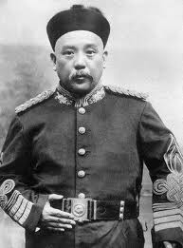
The 1911 Revolution
On 10th Oct 1911, the city of Wuchang exploded in revolt which quickly spread to all major cities in China.
On 12th February 1912, the 6-Year-Old Emperor, Puyi, was forced to abdicate by Yuan Shikai, the leader of the army.
It was the end of not only the Qing Dynasty which had ruled since 1644 but of Imperial China itself. China was now a Republic.

Slide 6
After the Revolution
In 1912, Yuan Shikai became the President of the Chinese Republic. He was the leader of the Beiyang Army, the best fighting force in China. Its commanders all owed him loyalty.
Sun Yat-Sen had no choice but to surrender the Presidency to him. They hoped he would rule as a constitutional president with a parliament modelled on the US Congress.
Yuan Shikai
Yuan Shikai

Slide 7
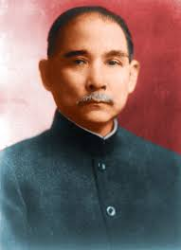
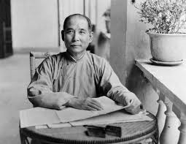
December 1912 Elections
There was to be a senate elected by the different provincial assemblies and a house of representatives.
Four main political parties emerged in China with over 300 local parties. The National People’s Party (GMD/KMT) was created by Sun Yatsen.
The GMD won 43% vote and 259/596 seats.
Sun Yat-sen

Slide 8
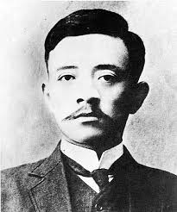
Yuan Shikai takes over
The KMT expected to form a new government and they appointed Song Jiaoren as prime minister.
He was assassinated on 20th March 1913 as he was about to board a train to Beijing.
In May, KMT military governors were dismissed and Nanjing was occupied by Yuan Shikai’s troops. The new assembly was forced to elect Yuan as president for five years and the KMT was banned!
Song Jiaoren

Slide 9
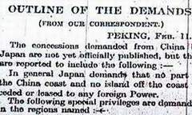
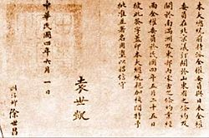
The Twenty-One Demands
Yuan had become leader of a China facing serious problems. The regime he led relied on foreign loans. Tax income was declining.
Luckily, WW1 had distracted many foreign governments but Japan took advantage of China’s weakness and in January 1915, presented the 21 Demands.
Yuan was forced to sign these demands, further undermining his authority.

Slide 10
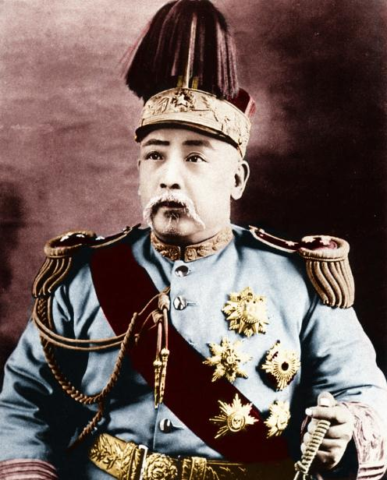
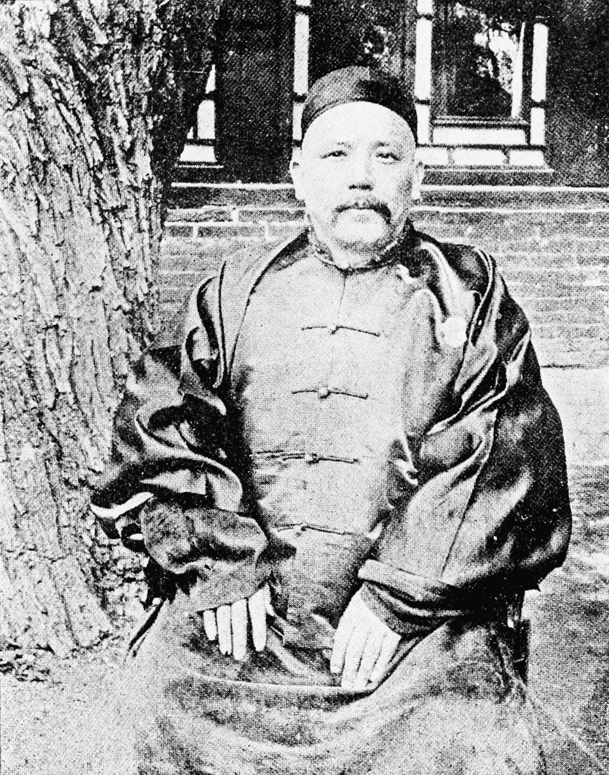
The Twenty-One Demands
Despite this humiliation by the Japanese, Yuan pressed ahead with his plans. He declared himself emperor of China but this just triggered revolts. Yunnan declared independence.
Yuan reluctantly back-peddled and dropped the plans in March 1916. In June, he died aged 56. He was replaced by the vice president but in July 1917, he fell victim to a coup by Yuan’s commanders. The era of the warlords had begun.
Yuan Shikai

Slide 11
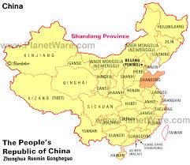
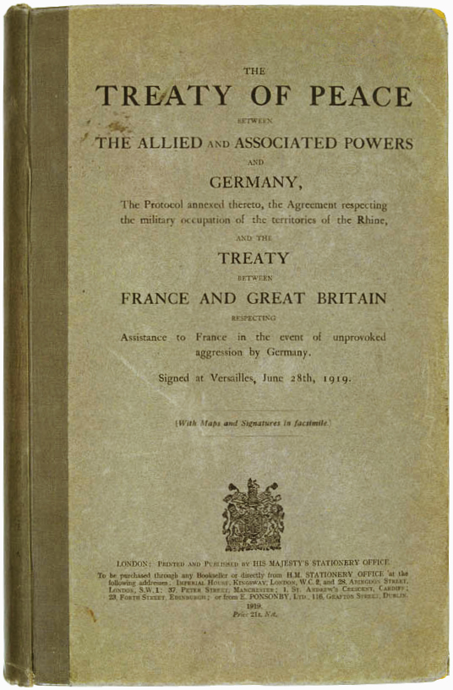
Era of the Warlords
China now descended into anarchy. In 1917, China declared war on Germany, hoping to gain control of German concessions in Shandong province.
This was not to be. In the Treaty of Versailles, Japan was given control of the German concessions, not China.
This fresh humiliation sparked off the 4th May demonstrations.

Slide 12
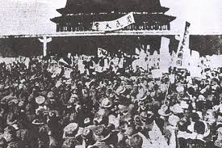
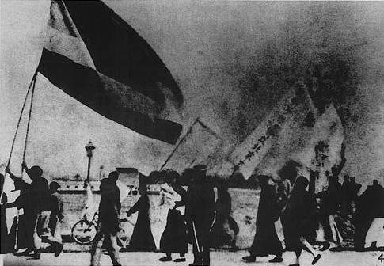
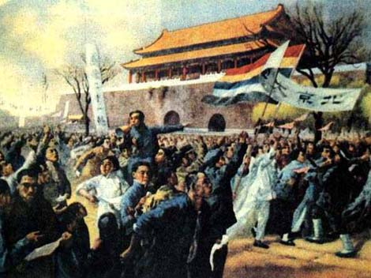
4th May Movement 1919
An explosive protest from the students of Beijing university took place in Tiananmen Square. 3000 students from 13 colleges assembled.
They protested at the humiliation of China and demanded their government confront Japan.
A student union was established – the May 4th movement. This was replicated across China. A general strike was held which prevented the Chinese delegation from signing the treaty.

Slide 13
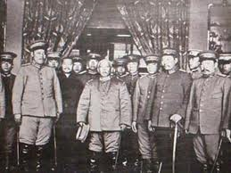
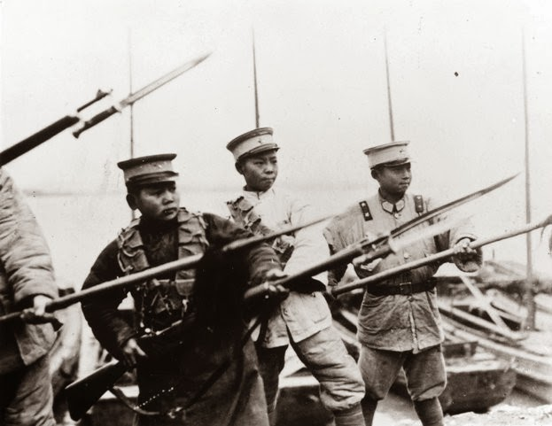
The Warlord Period
Despite the 4th May protests movement by young students, most people in China faced tragic consequences as Yuan Shikai’s generals vied with one another for control of a particular region.
They also fought for the ultimate prize – control of Beijing and the central government that in theory still functioned there.

Slide 14
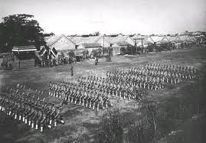
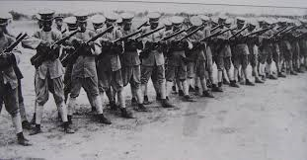
The Warlord Period
Between 1920-1928, competing groups of warlords fought battles all over China. They all needed money to do this. Troops needed feeding and paying.
Everything was taxed and cash squeezed from a suffering peasantry. Many warlords just printed money – resulting in severe inflation. Money lost its value.

Slide 15
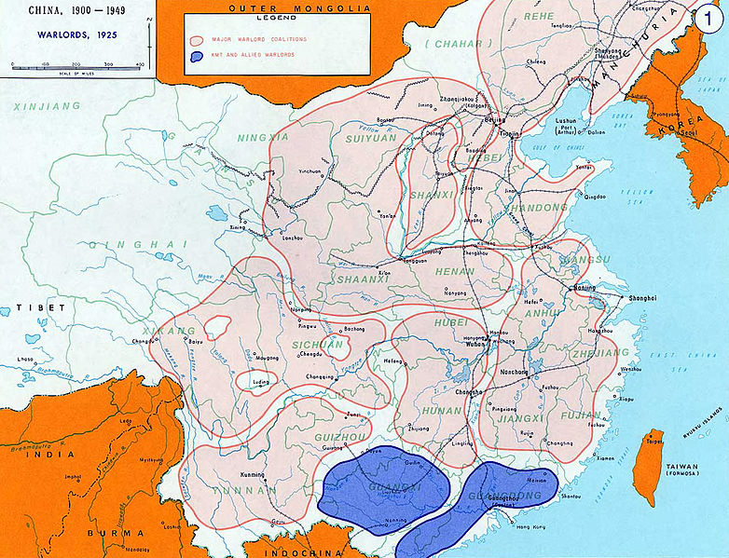

Slide 16
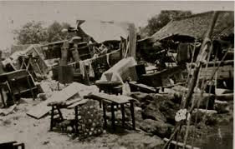
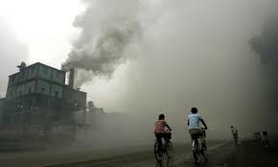
The Warlord Period
To make matters worse, there was a drought in northern China in 1918 and famines in 1920-21. 1923-25 also saw more flooding.
However there was a growth in industry at this time – WW1 meant European products couldn’t get to China – giving China’s producers an open market.

Slide 17
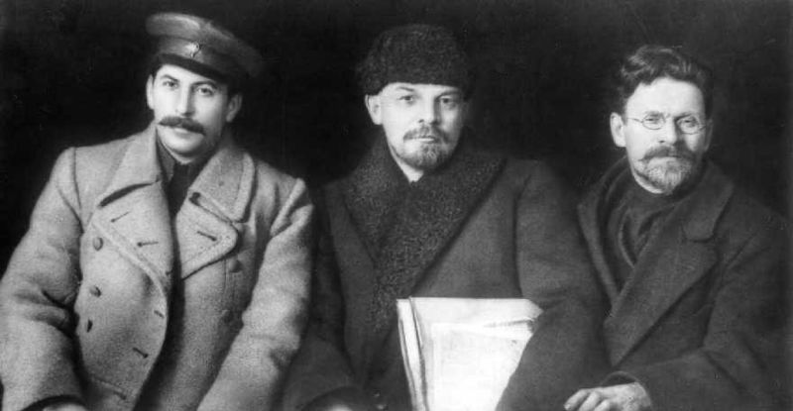
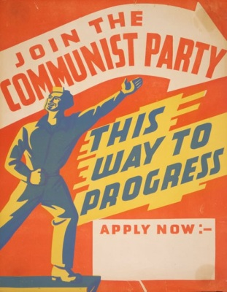
The Chinese Communist Party (CCP)
Two groups came together in the 1920s to defeat the warlords. One was the CCP.
Many Chinese revolutionaries looked to Russia for support. In 1917, the Bolsheviks had taken control in Russia and offered to give back all areas of China back to the Chinese.
Communism seemed to offer a solution to the warlord problem.

Slide 18
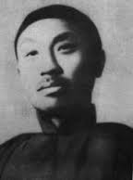
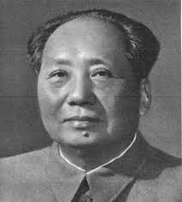
The Chinese Communist Party (CCP)
Revolutionaries like Chen Duxiu, leader of the 4th May Movement, increasingly became interested in Marxism.
Small Marxists study groups were founded in Shanghai and Beijing. Mao Zedong founded a group in Changsha.
Numbers were small but the USSR sent COMINTERN agents to help support these groups.
Chen Duxui
Mao Zedong

Slide 19
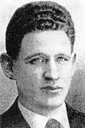
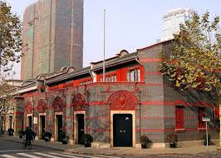
The Chinese Communist Party (CCP)
Agent Gregory Voitinski made contact with Chen Duxui in May 1920. A translation of the Communist Manifesto was arranged.
The founding congress of the party was held in a classroom at a girls school in the French concession of Shanghai, July 1921. Mao Zedong was one of the delegates but Chen Duxiu was elected secretary general.
Gregory Voitinski

Slide 20
The Chinese Communist Party (CCP)
The COMINTERN provided $5000 USD a year to keep the party alive however there were constant disagreement over whether to work with the GMD (The Guomingdang – People’s Party also known as the nationalists) or not.
The USSR wanted the CCP to work with the GMD, who they viewed as the stronger party.
In the 1922 congress of the CCP it was agree to seek an alliance with the GMD to fight the warlords. In the third congress of 1923, they actually agreed to let communists join the GMD.

Slide 21
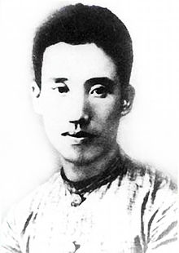
The Chinese Communist Party (CCP)
Mao joined the GMD as well in 1923 and won membership of the CCP central committee. From 1923-26 he worked within the United Front as a KMT official.
He did not get on with the CCP leadership circle around Chen Duxiu. He disliked their intellectualism and their focus on city workers.
In 1925, he was excluded from the central committee and was attracted to the ideas of Peng Pai, who he joined at a training institute for rural militants.
Chen Duxui
Peng Pai

Slide 22
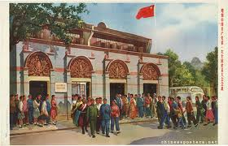
The Chinese Communist Party (CCP)
Despite the low expectations of the USSR, the CCP expanded rapidly from 200 members in 1922 to 7000 in 1926 and 30,000 by the end of that year.
By 1927, membership reached about 58,000 making it the 3rd largest communist party in the world and a major force in China.
The GMD slowly became concerned with this growth, despite their alliance.

Slide 23
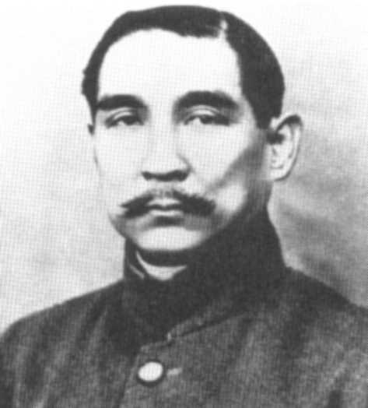
The Guomindang (GMD) Also known as the Kuomintang (KMT)
This was the People’s National Party and was formed to unite China.
It was set up by Sun Yatsen and was based on his 3 principles.
He was determined to rid China of foreign influence and to remove the power of the warlords.
The 3 Principles of the Guomindang
1.) Nationalism: to rid China of foreign influence and exploitation
2.) Democracy: to create a more modern system of government acceptable to the people of China
3.) Social Advance: to bring about reforms in industry and everyday life and particularly to improve the position of Chinese peasants

Slide 24
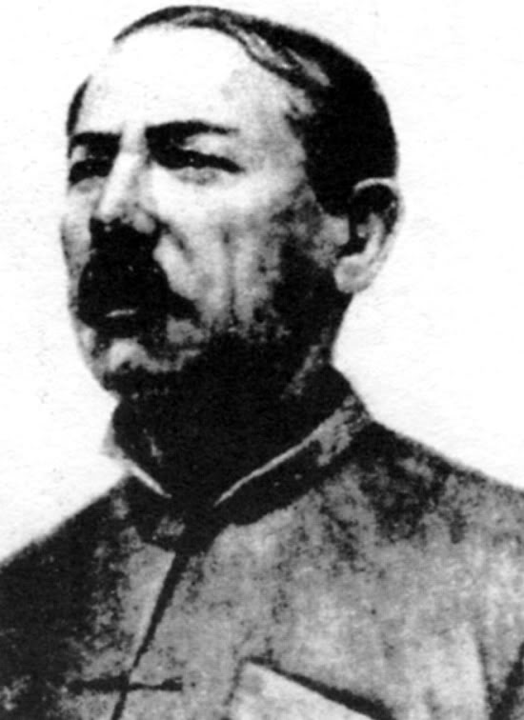
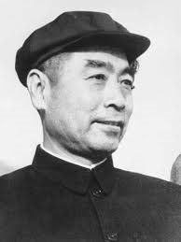
The Guomindang
The USSR made contact with the GMD in January 1923 through their representative, Mikhail Borodin. Borodin helped Sun Yatsen to reform the KMT.
Sun realised that he would need an army to deal with the warlords and regain China. The USSR offered the KMT money and advisors to support a new military academy at Canton.
The Whampoa Military Academy was founded by the USSR with Chiang KaiShek as it commandant and Zhou Enlai as its political commissar.
Mikhail Borodin
Zhou Enlai

Slide 25
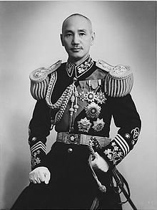
Sun Yatsen Dies…
In 1925 Sun Yatsen died of cancer. Chiang KaiShek, who was the leader of the GMD army, became leader.
Chiang K-S was alarmed at the growing power of the CCP. Most GMD officers were landlords or came from the business classes. They were afraid of the Communists.
Sun Yatsen
Chiang Kaishek

Slide 26
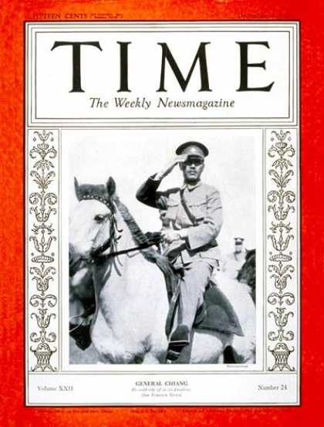
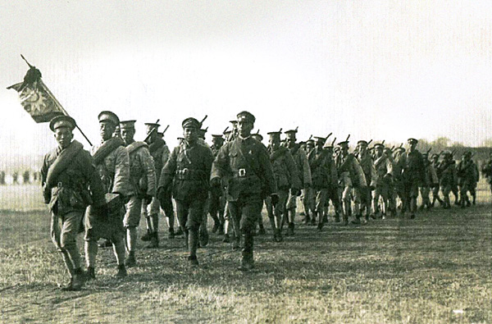
The Northern Expedition 1926-1928
The attack on the warlords began in 1926, in a combined operation amongst the KMT and CCP.
Peasants & workers welcomed Chiang’s armies & there was little resistance from the warlords.
China was now reunified and Chiang’s government was recognised by foreign powers.

Slide 27
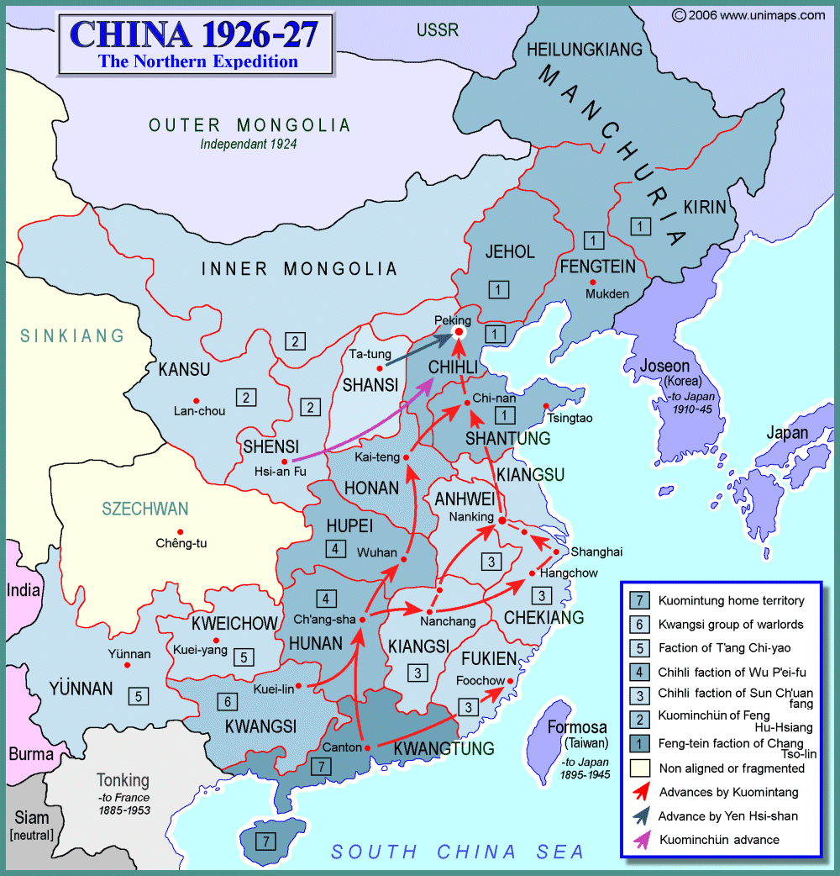

Slide 28
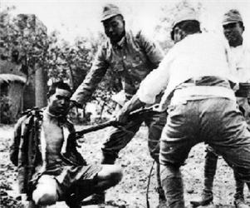
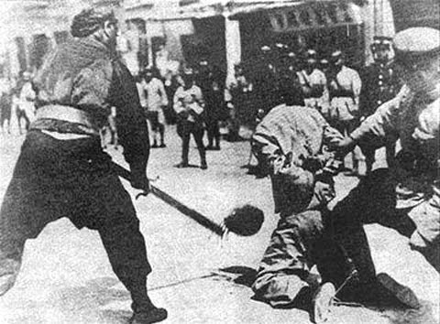
The Shanghai Massacres - 1927
Chiang feared the growing influence of the CCP, especially in Shanghai.
In 1927 the workers of Shanghai rebelled against the warlord in the area. The GMD army and the triad ‘green gang’ executed all the Communists they could find.

Slide 29
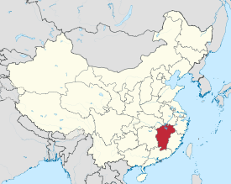
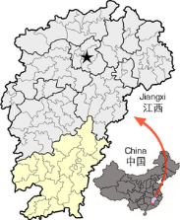
Mao at Jiangxi 1927-34
After the 1927 Shanghai Massacre, Mao led his CCP forces to the mountains of Jiangxi province and organised guerrilla resistance.
He spent 7 years developing the Jiangxi Soviet, dedicated to peasant revolution. He clashed with the COMINTERN who wanted him to focus on urban workers.
It was at Jiangxi where Mao developed his taste for using torture and purges to gain control.

Slide 30
Mao at Jiangxi 1927-34
‘They were brought out to be tortured, women as well as men… they were tortured to make them speak and they were tortured on Mao’s orders. These is a document in the party archives which Mao approved which says, ‘do not kill the important leaders too quickly, but squeeze out of them the maximum information; then from the clues they give you can go on to unearth others.’
In 1930, he had no qualms in torturing & executing some 4000 Red Army troops, accused of being KMT spies. Some estimate over 10,000!
This incident became known as the ‘Futian incident’. It strengthened Mao’s control until the CCP leadership arrived in 1932.
Zhou Enlai and Bo Gu ousted Mao from his military positions.

