Slide 1
History Internal Assessment
Historical investigation
Duration: 20 hours
Weighting: 25% SL, 20% HL
Both SL and HL students are required to complete a historical investigation into a topic of their choice.
AIMS:
1. To demonstrate the application of skills and knowledge.
2. To pursue your personal interest without the time limitations of exams.

Slide 2
History Internal Assessment
The investigation is made up of 3 sections.
1. Identification and evaluation of sources
2. Investigation
3. Reflection
Your formal work MUST be presented in these 3 sections.

Slide 3
History Internal Assessment
Section 1: Identification and evaluation of sources | 500 words | 6 marks
Section 2: Investigation | 1,300 words | 15 marks
Section 3: Reflection | 400 words | 4 marks
Bibliography | N/A | 0 marks
TOTAL | 2,200 words | 25 marks
Notes;
The IA must be a written piece.
No group work is allowed.
A bibliography and referencing MUST be included. If you fail to do this there is a potential academic honesty infringement.

Slide 4
History Internal Assessment
Choosing a Topic
The topic must be historical. Therefore it cannot be on an event that has happened in the last 10 years.
The topic must a topic of your choice.
Choose a topic which lends itself to analysis – a topic which is arguable or controversial is recommended.
Make sure there are plenty of resources available to you before you settle on a topic. This also means you need to avoid dependence on the internet sites.

Slide 5
Section 1: Internal Assessment
Section 1: Identification and evaluation of sources
This section requires you to;
Clearly state the question you have chosen to investigate (this must be stated as a question).
Include a brief explanation of the nature of the two sources you have selected for detailed analysis, including an explanation of their relevance to the investigation.
Analyse two sources in detail. With reference to the origins, purpose and content, the student should analyse the value and limitations of the two sources in relation to the investigation.

Slide 6
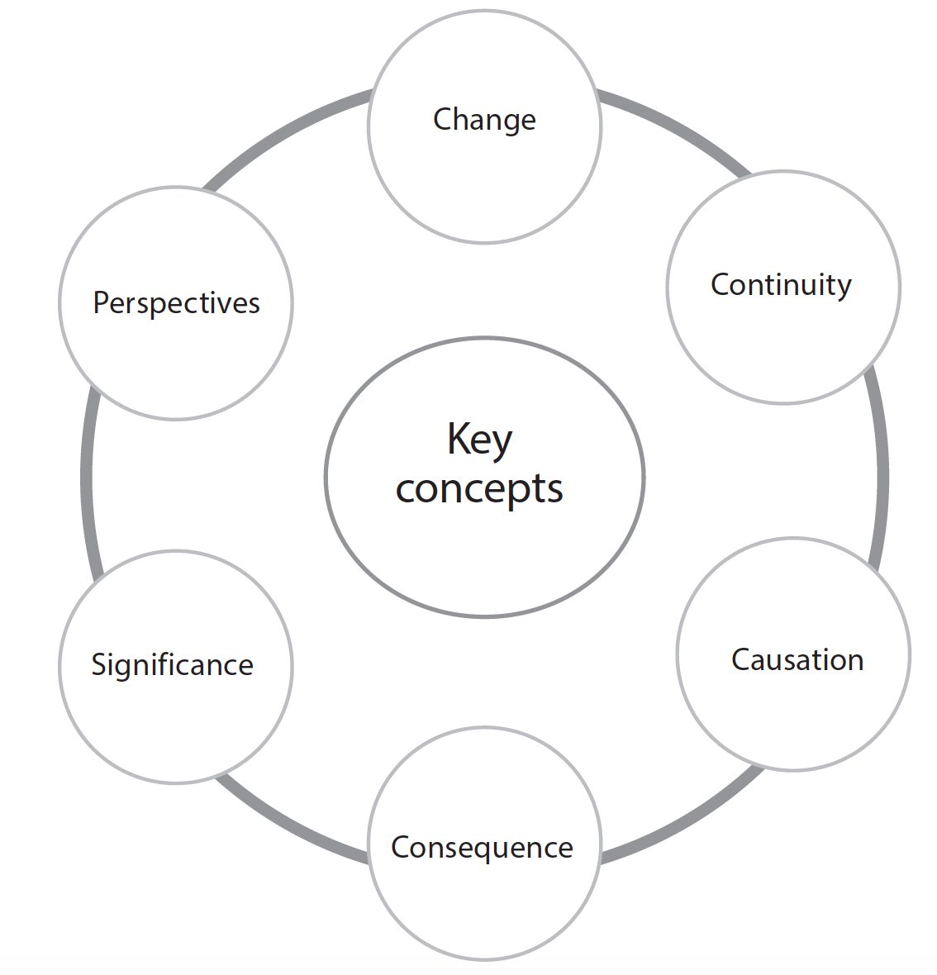
Section 1: Formulating a Question
History Internal Assessment
Concepts
There are six key concepts that have particular prominence throughout the DP history course.
A crucial element of the IA is coming up with an appropriate question.
The 6 concepts should be used a starting point for helping you create your question.

Slide 7
Section 1: Formulating a Question
Change: To investigate why and how far people and events bring about change.
Continuity: To understand that there are times of continuity in the past or times when change is slow. There are also times when there has been considerable continuity in the midst of great historical change.
Causation: To recognise that most historical events are caused by an interplay of diverse and multiple factors. High level thinking is required to consider the importance of different factors.
Consequence: To understand and explain how significant events and people have led to both short-term and long-lasting effects.
Significance: Ask questions about how history has been recorded. Why has some evidence been recorded and why or what has been excluded from our historical narrative of the world.
Perspectives: Challenge and critique multiple perspectives of the past, to compare them and corroborate them with historical evidence. You should recognise that for every event recorded in the past, there may be multiple contrasting or differing perspectives. Using primary-source accounts and historians’ interpretations, students may also investigate and compare how people, including specific groups such as minorities or women, may have experienced events differently in the past.

Slide 8
History Internal Assessment
The command terms for history can be used for help in structuring your question.
Analyse | Break down in order to bring out the essential elements or structure.
Compare | Give an account of the similarities between two (or more) items or situations, referring to both (all) of them throughout.
Compare and contrast | Give an account of similarities and differences between two (or more) items or situations, referring to both (all) of them throughout.
Contrast | Give an account of the differences between two (or more) items or situations, referring to both (all) of them throughout.
Discuss | Offer a considered and balanced review that includes a range of arguments, factors or hypotheses. Opinions or conclusions should be presented clearly and supported by appropriate evidence.
Evaluate | Make an appraisal by weighing up the strengths and limitations.
Examine | Consider an argument or concept in a way that uncovers the assumptions and interrelationships of the issue.
To what extent | Consider the merits or otherwise of an argument or concept. Opinions and conclusions should be presented clearly and supported with appropriate evidence and sound argument.

Slide 9
Section 1: Formulating a Question
ADVICE ON HOW TO APPROACH YOUR QUESTION
1. IA’s should start out with the general topic: “An investigation….”
Titles should be a more specific Research Question.
3. You should consider the History Command Words. (However not all questions will use command terms)
4. You should base your IA on one of the History Key Concepts.
Examples of IA titles;
An investigation into the success of the Civil Right Movement:
How did the NAACP contribute to the Civil Rights Movement?
Key Concept: causation
An investigation into Castro’s foreign policy:
How did Castro’s foreign policy towards France differ from his foreign policy towards Italy between 1962 and 2000?
Command Term: Compare & Contrast

Slide 10
Section 1: IA Titles
Topic Idea | Research Question | Command Word | Key Concept
Supreme Court Decisions in the Civil Rights Movement | To what extent did the Supreme Court Decision in Sweatt v. Painter (1950) influence Brown v. Board of Education (1954)? | To what extent | Causation
Activity: Create a table like the one above. Look at the examples of IA questions on the next slide. For each consider the Topic idea, command words and key concepts.
Notes:
Students can divide up the title into the 6 historical concepts – answers on the next slide.

Slide 11
Section 1: IA Titles
To what extent were the first Five Year Plans of Stalin and Mao successfully implemented?
Why did Trotsky leave the Menshevik party and become a Bolshevik, and how important was his role in the Bolshevik Revolution of October 1917?
How did the Red Guards carry out their role in the development of the Chinese 1966 Cultural Revolution?
How did the Alliance system lead to the outbreak of the First World War?
How did newspaper reports on the death of Kennedy vary, and how reliable were they?
How can our understanding of the origins of the Cold War be aided by a study of different schools of thought on it’s origins?
What impact did the Greensboro sit-in in 1960 have on segregated restaurants?
Why did the American Indian Movement seize and occupy the town of Wounded Knee?
Notes:
Students can divide up the title into the 6 historical concepts – answers on the next slide.

Slide 12
Section 1: Types of Sources
Section 1: Identification and evaluation of sources
This section requires you to;
Analyse two sources in detail.
The sources can be either primary OR secondary.
A primary source is:
An object or information created during the period of history that the historian is studying.
A secondary source is:
An object or information created after the period of history that the historian is studying.

Slide 13
Section 1: Key Terms for source analysis
Nature
This means the type of source. Is it a letter, diary, newspaper report, political cartoon, government report, speech, telegram, etc.? A cartoon often reflects the popular view of the time – an ‘in joke’. However they are an exaggerated and often distorted view of an event.
Origin
Who produced the source. How knowledgeable are they? When did they create it? Was it at the time or after? Where did they produce it? What were the circumstances like at the time? For example in WWI the British government censored newspapers.
Purpose
Why was the source was made? Political cartoons are made to turn you against a person or event by ridicule and exaggeration. They are referred to as political satire.
Content
What information does the source tell me about the topic being investigated.
Value and Limitations
How valuable is this source for helping you answer your question or investigation? You must consider the NOP to reach decisions on the value of a source.
http://www.islandschoolhistory.com/source-evaluation.html

Slide 14
Section 1: Mark Scheme
Mark | Description
0 | The work does not reach a standard described by the descriptors below.
1-2 | The question for investigation has been stated. The student has identified and selected appropriate sources, but there is little or no explanation of the relevance of the sources to the investigation. The response describes, but does not analyse or evaluate, two of the sources.
3-4 | An appropriate question for investigation has been stated. The student has identified and selected appropriate sources, and there is some explanation of the relevance of the sources to the investigation. There is some analysis and evaluation of two sources, but reference to their value and limitations is limited.
5-6 | An appropriate question for investigation has been clearly stated. The student has identified and selected appropriate and relevant sources, and there is a clear explanation of the relevance of the sources to the investigation. There is a detailed analysis and evaluation of two sources with explicit discussion of the value and limitations of two of the sources for the investigation, with reference to the origins, purpose and content of the two

Slide 15
Section 1: Examples
Read through the examples you have been given and the markers comments.
What can you learn about how to achieve 6 marks on section 1?

Slide 16
Section 2: Investigation
This section of the internal assessment task consists of the actual investigation.
Your investigation may be;
a historical topic or theme using a variety of written sources or a variety of written and non-written sources
a historical topic based on fieldwork, for example, a museum, archeological site, battlefields, places of worship such as mosques or churches, historic buildings
a local history study.
The investigation must be clearly and effectively organized. While there is no prescribed format for how this section must be structured, it must contain critical analysis that is focused clearly on the question being investigated, and must also include the conclusion that the student draws from their analysis.
In this section, students must use a range of evidence to support their argument. Please note that students can use primary sources, secondary sources, or a mixture of the two.

Slide 17
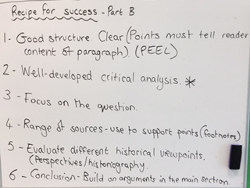
Section 2: Investigation
See copy of the mark scheme from page 91 of the History Specification.

Slide 18
Section 2: Investigation
Read through the examples you have been given and the markers comments.
What can you learn about how to achieve 15 marks on section 2?

Slide 19
Section 3: Reflection
This section requires you to reflect on what your investigation has highlighted to you about the methods used by and the challenges faced by historians.
Here are examples of discussion questions that may help you in your reflection;
What methods used by historians did you use in your investigation?
What did your investigation highlight to you about the limitations of those methods?
What are the challenges facing the historian? How do they differ from the challenges facing a scientist or a mathematician?
What challenges in particular does archive-based history present?
How can the reliability of sources be evaluated?
What is the difference between bias and selection?
What constitutes a historical event?

Slide 20
Section 3: Reflection
Questions to consider continued…
Who decides which events are historically significant?
Is it possible to describe historical events in an unbiased way?
What is the role of the historian?
Should terms such as “atrocity” be used when writing about history, or should value judgments be avoided?
If it is difficult to establish proof in history, does that mean that all versions are equally acceptable?

Slide 21
Section 3: Mark Scheme
Mark | Description
0 | The work does not reach a standard described by the descriptors below.
1-2 | The reflection contains some discussion of what the investigation highlighted to the student about the methods used by the historian. The reflection demonstrates little awareness of the challenges facing the historian and/or the limitations of the methods used by the historian. The connection between the reflection and the rest of the investigation is implied, but is not explicit.
3-4 | The reflection is clearly focused on what the investigation highlighted to the student about the methods used by the historian The reflection demonstrates clear awareness of challenges facing the historian and/or limitations of the methods used by the historian. There is a clear and explicit connection between the reflection and the rest of the investigation.

Slide 22
Section 3: Reflection
Read through the examples you have been given and the markers comments.
What can you learn about how to achieve 4 marks on section 3?

