Slide 1
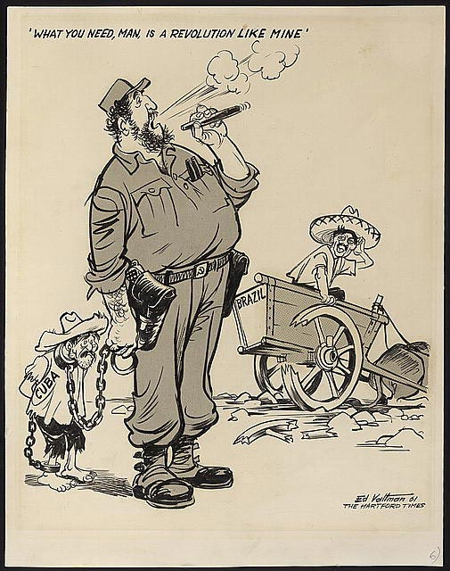
Task on Entry
What is the message conveyed by this picture? (2 marks – Paper 2 Q1b)
An Edmund Valtman political cartoon, published in the American newspaper, The Hartford Times, 31st August 1961.

Slide 2
Cuba in the Cold War
Communication
Balanced
Learning Objective:
KEY TERMS:
command economy
militia
Mariel boatlift
Non-aligned nations
To know how Cuba’s domestic and foreign policies were affected by the Cold War.
To consider how successful the Cuban Revolution was.
Learning Outcomes:
Grade 4
You can describe the domestic and foreign policies implemented in Castro’s Cuba.
Grade 5
You can assess the consequences of Fidel Castro’s domestic and foreign policies.
Grade 6/7
You can judge to what extent the Cuban revolution can be considered successful.

Slide 3
Connect Activity: Think, Pair, Share
QUESTION
What was the relationship between Cuba
and the Cold War?
THINK about the question for ONE minute.
PAIR up and discuss your ideas with the person next to you.
SHARE your ideas with the rest of your table.
Notes:
Get feedback. Draw out similarities. Maybe put up on whiteboard?

Slide 4
Activate Activity – Cuba in the Cold War
You are members of an editorial panel for the Brookings Institution’s Latin America Initiative, a prestigious American political think tank.
You have been tasked with producing a one page research outline assessing the impact the Cold War and Castro’s policies have had on Cuba.
The outline will be used to begin planning an upcoming Brooking’s Institution research article titled Cuba, the US and international relaitons moving forward.

Slide 5
Activate Activity – Cuba in the Cold War
Each team will assess a different aspect of Castro’s domestic and forging policies.
Team 1: The causes and consequences of Castor’s domestic policies– p. 200-206
Team 2: Cuban foreign policy: Relations with the USA and USSR 1959-1960; Soviet-Cuban relations 1962-1968; US-Cuban relation post-Cuban missile crisis– p.207-214
Team 3: Cuban foreign policy: Cuba, Latin America and Africa; Castro’s international standing, 1975-80. p.214-221
Please complete your report in a format that is shareable with other team members.
You have forty-five minutes to prepare you research outline.

Slide 6
Demonstrate Activity – Cuba in the Cold War
Each team will verbally present their findings to the rest of the editorial panel.
The focus of this meeting is to consider this question:
‘To what extent can the Cuban Revolution and Fidel Castro’s subsequent policies be considered successful?”
Once the findings have been reported and shared, all members of the editorial team will be expected to contribute to the debate on this question.

Slide 7
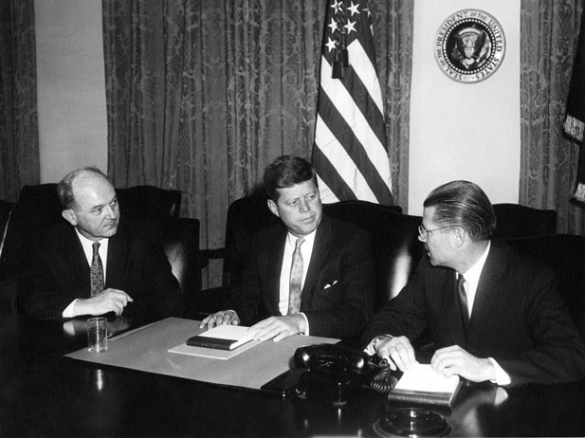
Consolidate
As a result of the lesson today I:
Know…
Understand…
Can use the information to….

Slide 8
Cuba in the Cold War
Communication
Balanced
Learning Objective:
KEY TERMS:
command economy
militia
Mariel boatlift
Non-aligned nations
To know how Cuba’s domestic and foreign policies were affected by the Cold War.
To consider how successful the Cuban Revolution was.
Learning Outcomes:
Grade 4
You can describe the domestic and foreign policies implemented in Castro’s Cuba.
Grade 5
You can assess the consequences of Fidel Castro’s domestic and foreign policies.
Grade 6/7
You can judge to what extent the Cuban revolution can be considered successful.

