Slide 1
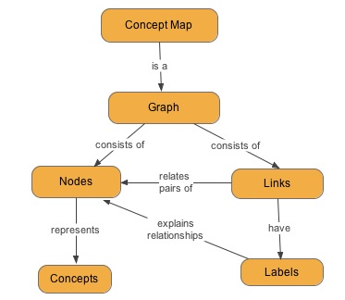
Key Question: What circumstances favoured the rise of Mao Zedong?
Activity Three:
Create a concept map to show why Mao came to power by 1949. Try using the diagram at the end of the chapter as a starting point.

