Slide 1
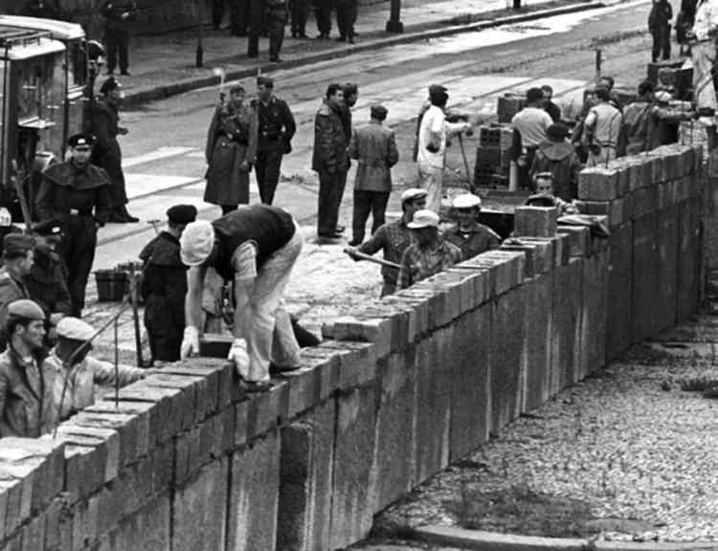
Task on Entry
Quick Fire Quiz
After WWII which countries controlled Germany?
In what year was Germany divided into two countries?
State 3 key differences between East and West Germany. (Consider social, political and economic differences)

Slide 2
The Berlin Wall
Learning Objective:
To know why the wall was put up.
To consider the significance of the wall and if it helped to uphold communism.
Learning Outcomes:
Grade 6-7
You have considered how the wall helped to maintain communism within the GDR.
Grade 4
You can summarise why the wall was created and can describe some of the consequences.
Grade 5
You can confidently explain the consequences of the construction of the wall.

Slide 3
Connect Activity
The Berlin Wall
What do I already Know?
What do I Want to find out?
What did I Learn?
KWL Chart

Slide 4
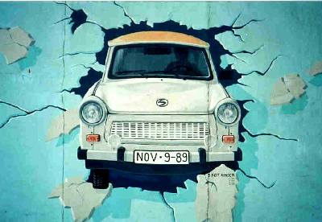
The building of the Berlin Wall What do you need to know?
Activate Activity
What were the background causes to the building of the wall?
What were the short-term causes?
What were the immediate reasons for the wall being built?
How was it built?
What were the results of the wall being built for:
(a) The Western allies?
(b) The DDR
(c) West Germany?
Pretty soon the wall on the western side was covered in graffiti. Some of it was extremely good. This iconic section showed a Trabant car breaking through from the East.

Slide 5
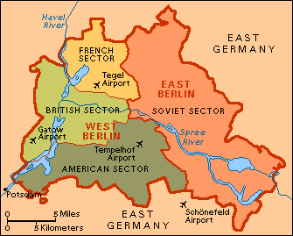
Berlin after 1945

Slide 6
Watch the video and joy down any information which helps to answer your key questions.
What were the background causes to the building of the wall?
What were the short-term causes?
What were the immediate reasons for the wall being built?
How was it built?
What were the results of the wall being built for:
(a) The Western allies?
(b) The DDR
(c) West Germany?

Slide 7
The Berlin Wall
What do I already Know?
What do I Want to find out?
What did I Learn?
KWL Chart

Slide 8
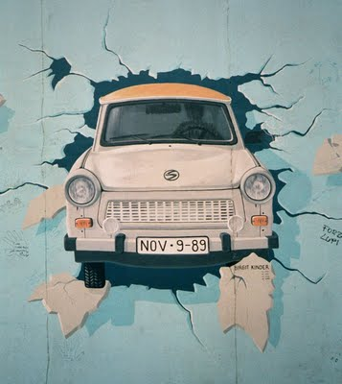
The Berlin Wall: What was it?
Use the information on the next slides to add to your notes.
A wall built by the DDR on 13th August 1961 that divided the eastern side of the city (the Russian zone) from the western zone and which lasted until 1989 when its destruction signalled the end of communism and the reunification of Germany. It became the symbol of a divided Germany.
A painting on the Berlin Wall showing a Trabant car breaking through into the west.

Slide 9
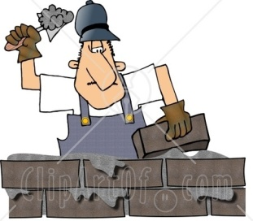
Why was it built?
The division of the city into different zones meant that different political, social & military traditions grew up which emphasised the ‘freedoms’ of the west to the disadvantage of the communist east.
Although the Berlin air-lift had shown that the west would not give up their parts of the city, the communists were annoyed that West Berlin remained an island of capitalism in the middle of their communist state.
Skilled personnel from the East kept escaping to the West & this undermined the economy of the East
The East complained of Western spies being able to use Berlin to gather information about what their bloc was doing.
Background causes

Slide 10
Why was it built?
Adenauer’s (BRD Leader) attitude towards the East was very dismissive & provocative – e.g. he referred to it as the ‘Soviet Occupation Zone’ or ‘over there’.
He also deliberately set about developing the BRD so that it would become more attractive than communism & eventually the East would have to give in to capitalism. He called it the ‘magnet theory’.
In 1952 and afterwards, when Khrushchev, the Russian leader, had suggested talks about the reunification of Germany, the offer had been rejected by the West & the East had become offended.
In 1955, following a visit to Moscow, Adenauer came out with the Hallstein Doctrine which said that the BRD would not have diplomatic relations with any state which recognised the DDR.
More recent causes

Slide 11
Why was it built?
In 1958 Khrushchev sent an ultimatum demanding that the 3 western powers leave Berlin. They refused.
In 1959 an American spy plane, a U2, was brought down in Russian air space.
The number of refugees from East to West increased to 30,000 in April, 1961, many of whom were fleeing from the economic pressures of Ulbricht’s 7 Year Plan & Collectivisation.
In the summer of 1961, US President Kennedy visited Berlin & pledged US guarantees to protect the status of West Berlin & access to it.
Immediate causes

Slide 12
How was it built?
Following Kennedy’s visit, the DDR, along with the USSR, decided they had no option but to isolate West Berlin in order to end the danger to their state.
In great secrecy on the night of 12-13 August 1961, the NVA & the police sealed off the western sectors of Berlin with barbed wire & barricades
Over the next months they erected a 45 km long wall along the border between the eastern sector & the west and then built similar barricades which stretched 160 km around the whole of the western sector.

Slide 13
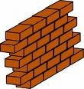
What were the results of the Wall?
The Western powers were taken by surprise but could do nothing. The DDR had built the wall in their sector of Berlin.
The DDR said it was an anti-fascist wall. In some ways the East undermined themselves because the wall made them look weak. Although quite a lot of people died trying to get across it, the wall did stop the refugee problem and this helped the DDR to make an economic recovery in the late 1960s.
Clearly reunification was not going to happen for the time being & although Adenauer had only wanted reunification on his terms he was clearly thrown by the building of the wall. He didn’t visit Berlin until August 1961 which produced a lot of criticism from those who claimed he didn’t care about the fate of Berliners. Thus the wall probably contributed to his downfall two years later.

Slide 14
Discussion Questions
Demonstrate
Activity
Which factor was the most significant in the building of the Berlin Wall?
How did the Berlin Wall help to uphold Communism?
How does Kennedy use the Berlin Wall as a propaganda weapon against the USSR?
To what extent was the US affected by the Berlin Crisis, 1958-61?

Slide 15
Assessing the quality of your notes
Consolidate Activity
Task
Toolkits for Communication
Once you have completed your notes.
Assess all the information you have learned by using the toolkit on the right.

