Slide 1

Connect Activity
Theory of Knowledge
What, if anything do you know about Fidel Castro? To what extent do you think your previous knowledge and opinions of Castro will influence your study of his rise to power?

Slide 2

Key Question: What circumstances favoured the rise of Fidel Castro?
Learning Objective:
Critical Thinking
To assess the key events between 1926-59 that led to Castro’s rise to power.
To begin to judge the significance of each event.
6-7 Grade
You can analyse the different events and reach a judgement comparing different events to explain which is the most significant.
Learning Outcomes:
5 Grade
You can explain why some events are more significant than others in Castro’s rise to power.
4 Grade
You can identify why different events were significant in Castro’s rise to power.

Slide 3
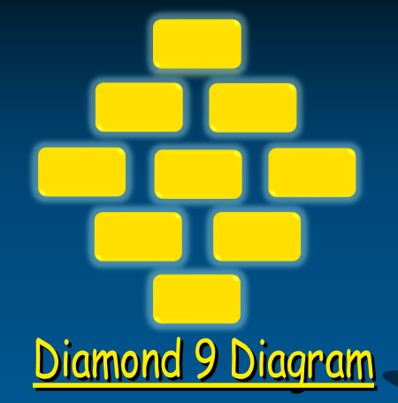
Key Question: What circumstances favoured the rise of Fidel Castro?
Create a diamond 9 activity to judge which event was the most significance in Castro’s rise to power. You must be able to explain your most important factor.
Most important
Least important
Activate Activity

Slide 4
Summary Questions
Demonstrate Activity
Why was the Platt Amendment of 1901 a disappointment for those Cubans wanting complete independence for their country?
Why was Castro’s movement known as the 26 July movement?
How did Castro use propaganda in his rise to power?
What was the significance of the Pact of Caracas of July 1958?

Slide 5
Consolidate Activity

