Slide 1
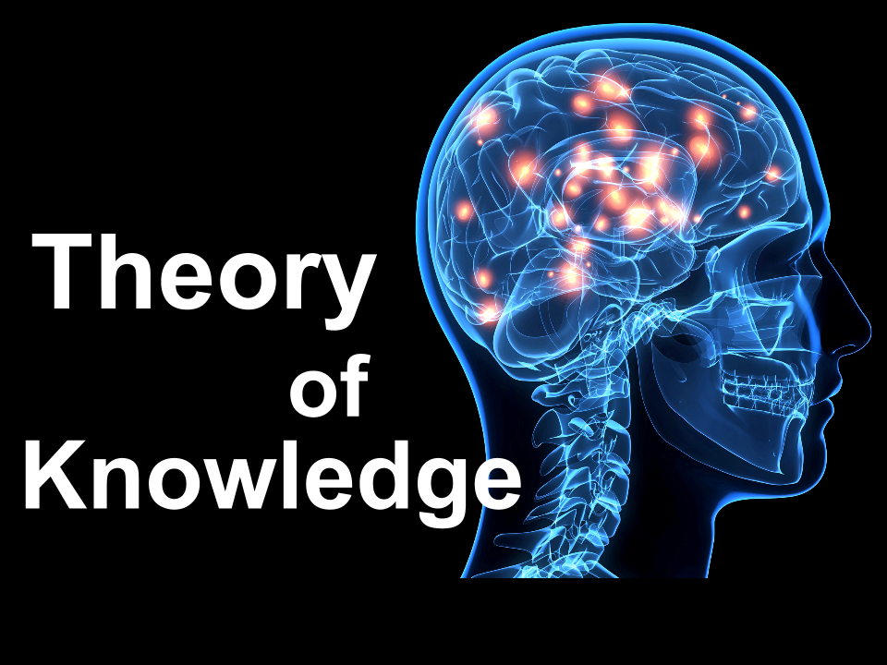
Theory of Knowledge
According to Harrison Salisbury: ‘I don’t think that there was much natural cruelty in Mao’s make-up. He didn’t exercise cruelty for the sake of cruelty. He didn’t mind using it if it was necessary, but he was not a man who got his kicks that way. He was a man who saw life as being very cruel.’
Was the way Mao ruled in Jiangxi and Yan’an cruel? From what standpoint should a historian judge Mao’s behaviour?

Slide 2
Key Question: What circumstances favoured the rise of Mao Zedong?
Learning Objective:
Critical Thinking
To explain why the communists won the Civil War.
To understand how Mao’s ideology helped him gain power.
6-7 Grade
You can analyse the different events and reach a judgement comparing different events to explain which is the most significant.
Learning Outcomes:
5 Grade
You can explain why some events are more significant than others in Mao’s rise to power.
4 Grade
You can identify why different events were significant in Mao’s rise to power.

Slide 3
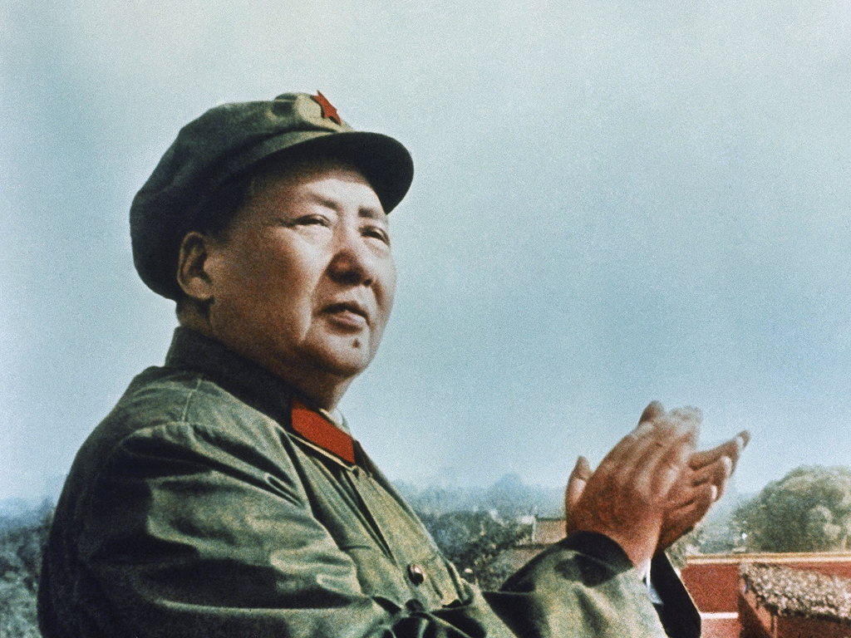
Key Question: What circumstances favoured the rise of Mao Zedong?
Station One:
Create a tree diagram to show;
why Mao needed rectification campaigns.
What the campaigns were
What the consequences were.
Station Two:
Create a diagram of your choice to show why the CCP won the Chinese Civil War (1945-49)
You must be able to show the weaknesses of the Nationalists and the strengths of the Communists.
Challenge: Could you diagram also show themes e.g. political, economic, social, military factors?

Slide 4
Tree diagram: Useful for causes and consequences
Consequences?
What are the effects of the campaign and do they help Mao rise to power?
Mao’s rectification campaigns
Identification
Briefly summarise the key topic.
Root Causes?
Why does Mao have rectification campaigns?

Slide 5
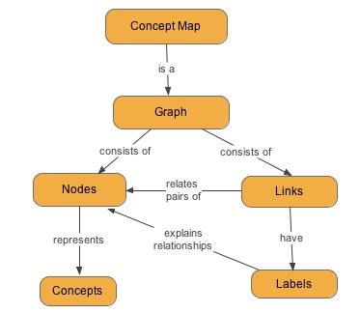
Key Question: What circumstances favoured the rise of Mao Zedong?
Station Three:
Create a concept map to show why Mao came to power by 1949. Try using the diagram at the end of the chapter as a starting point.

Slide 6
Key Question: What circumstances favoured the rise of Mao Zedong?
Discussion Questions:
Why had Mao emerged as the unchallenged leader of the CCP by 1945?
Which side was more responsible for the outbreak of civil war in 1946?
Which event was the most significant in Mao’s rise to power?

Slide 7
Key Question: What circumstances favoured the rise of Mao Zedong?
Consequences?
What are the effects of the campaign and do they help Mao rise to power?
Mao’s rectification campaigns
Identification
Briefly summarise the key topic.
Root Causes?
Why does Mao have rectification campaigns?
Key Term: Democratic centralism

