Slide 1
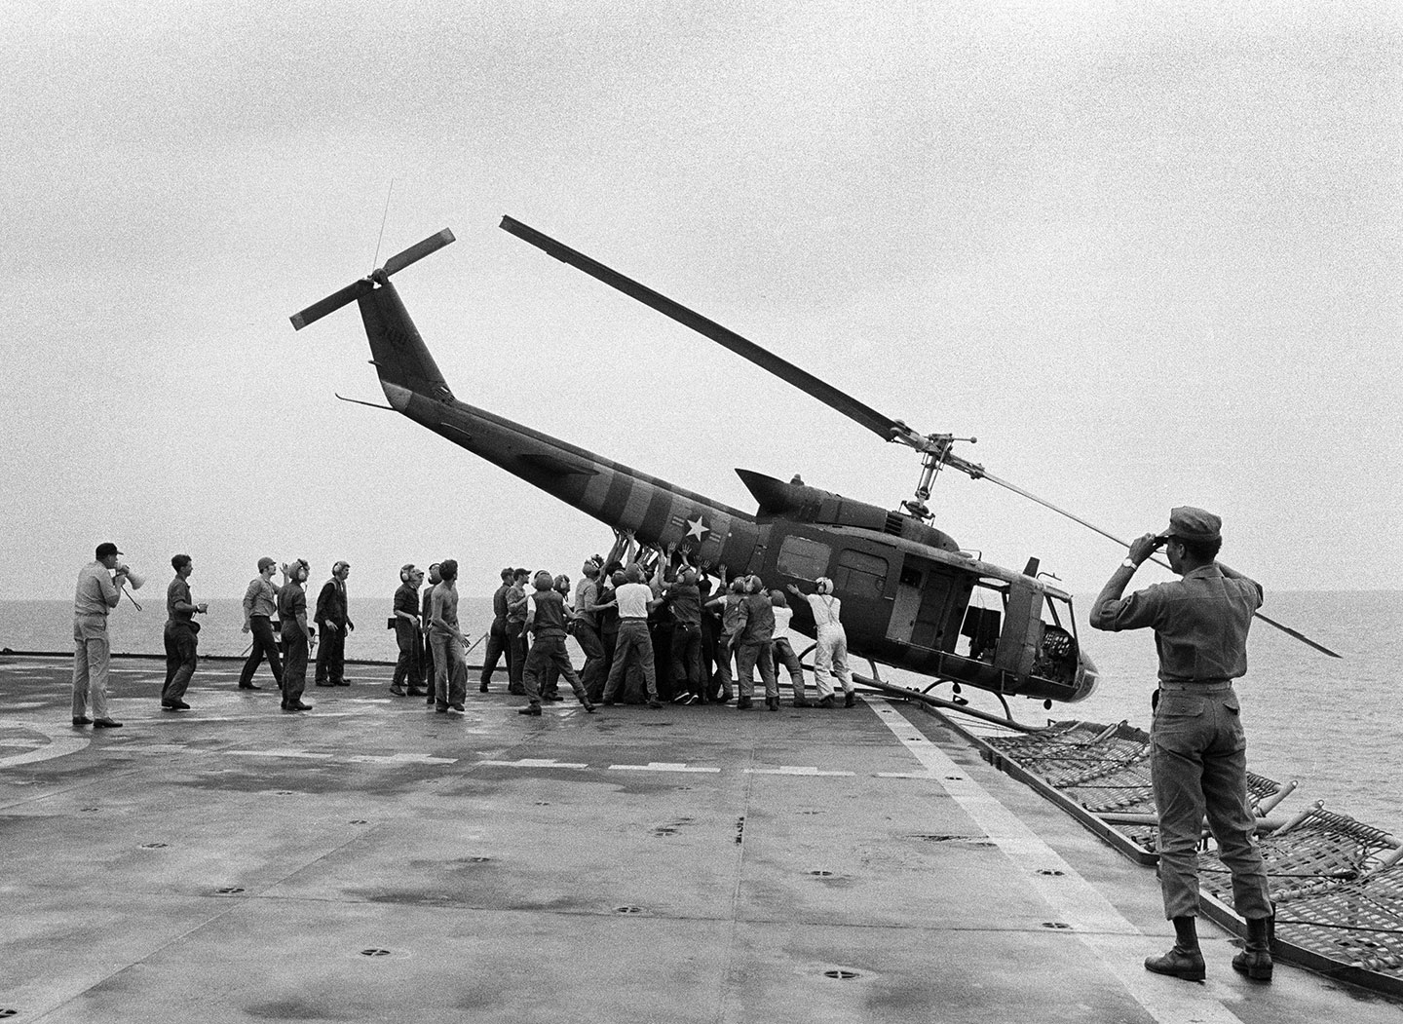
Task on Entry
https://www.youtube.com/watch?v=zWN6XGUAhZU
What can you learn from the video about the Fall of Saigon in 1975

Slide 2
Canadian & Latin American reactions to the Vietnam War
Communication
Inquirer
Learning Objective:
KEY TERMS:
External Affairs
Conservative
Liberal
Branch Plants
NDP
To explain how Canada and Latin America reacted to the Vietnam War.
Learning Outcomes:
Grade 4
You can describe both positive and negative ways in which Canada and Latin America reacted.
Grade 5
You can give specific examples to support your statements.
Grade 6/7
You have considered the historical perspectives about the way Canada reacted to the US involvement in Vietnam.

Slide 3
Connect Activity
Canada
Provided 27,000 soldiers, sailors and airmen to support the US in the Korean war. The third largest contributor of troops.
During the Korean War Canada coordinated defence planning with the US.
The Korean War led to closer defence planning between the US and Canada.
Latin America
Latin American nations supported all US resolutions on Korea at the UN and the OAS (Organisation of American States).
Chile, Cuba, Ecuador, Nicaragua, Venezuela sent food and economic aid to the US during the Korean War. Panama provided transportation.
Bolivia, Uruguay, Argentina, Chile and Mexico all promised troops to the US during the Korean War, but reversed their decisions in face of public outcry.
Colombia provided 6200 troops during the Korean War.
Using the information about the Canadian and Latin American response to the US involvement in Korea can you predict how they will react to the US involvement in Vietnam?

Slide 4
Activate Activity 1 – The ‘New Look’
Work in groups of three to find out about the reaction of both Canada and Latin America to the US involvement in Vietnam.
Student 1: Focus on the positive reaction of Canada
Student 2: Focus on the negative reaction of Canada
Student 3: Focus on the negative reaction of Latin America
1. Use the textbook pages 124-130 to gather information filling in the worksheet.
2. Now teach the other members in the group your findings.

Slide 5
Demonstrate Activity
Explain how Canada and Latin America reacted to the Vietnam War.
Write your findings as an analytical paragraph
Point / Opening sentence | 1-2 sentences that outline the main point or points of the paragraph. This MUST link to the essay question directly.
Examples | Use your contextual knowledge to give examples that support your opening sentence.
Explanation of examples | What do your specific examples mean? Expand your examples by providing additional detail.
Critical analysis | How do your examples prove your main point from the opening sentence? Why are these examples important?
Conclusion | Sum up the main arguments of your paragraph. Make sure these link back to the overall essay question.
You can repeat stages 2-4 with a maximum of 3 different examples.

Slide 6
Consolidate
As a result of the lesson today I:
Know…
Understand…
Can use the information to….

