Slide 1
Task on Entry
What do you already know about the conflict in Vietnam?
Write down 7 facts that begin with letters from the word Vietnam.
Example
V = Viet Minh were Vietnamese nationalists led by Ho Chi Minh.

Slide 2
US involvement in Vietnam
Communication
Inquirer
Learning Objective:
KEY TERMS:
Viet Minh
Geneva Accords
SEATO
ARVN
Commitment Trap
Quagmire Theory
To consider the nature and extent of US involvement in Vietnam between 1945-1969.
To assess the motives behind each Presidents involvement in the Vietnam conflict.
Learning Outcomes:
Grade 4
You can describe the nature and extent of US involvement in Vietnam under 4 different Presidents.
Grade 5
You can explain the different reasons why each President was involved in the conflict.
Grade 6/7
You can explain the different interpretations around US involvement in the Vietnam conflict.

Slide 3
Connect Activity - Background
An extract from a 1961 speech by French President de Gaulle warning US President Kennedy.
The more you become involved out there against Communism, the more the Communists will appear as the champions of national independence…You will sink step by step into a bottomless military and political quagmire, however much you spend in men and money.
What can you learn from this source about attitude towards the Conflict in Vietnam?
What value would you put upon the assessment in Source B?
What is a political quagmire?

Slide 4
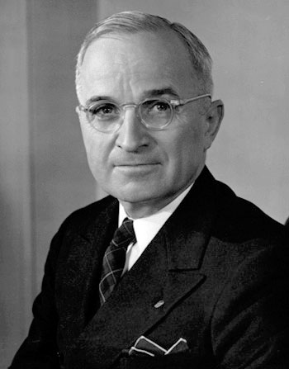
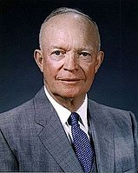
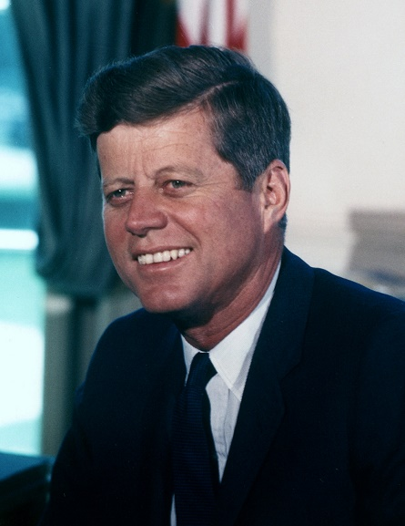
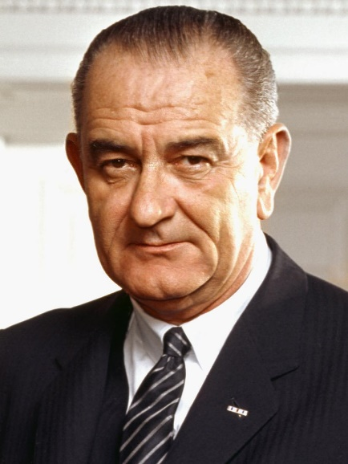
Activate Activity 1 – The ‘New Look’
Use the textbook pages 93-108 to create a table showing the nature and extent of US involvement in Vietnam under four Presidents. Use the template on WSOhistory.com to help you.

Slide 5
Demonstrate Activity
Answer the following questions
How did Truman support French colonial rule in Vietnam?
How did Eisenhower increase the US commitment in Vietnam?
How far did US policy change under Kennedy?
Why did Kennedy and Eisenhower support Diem?
How did Johnson change the nature of the war?
Why did Johnson continue and escalate the US involvement in Vietnam?

Slide 6
Consolidate
Agree
Disagree
“If President Kennedy had not been assassinated he would have removed the US from the conflict in Vietnam.”
How far do you agree with this statement?

