Slide 1
Why the US failed in Vietnam
Communicator
Balanced
Learning Objective:
KEY TERMS:
ARVN
search and destroy
fragging
Tet offensive
Ho Chi Minh tail
Vietnamization
‘Peace with honour’
To know the range of factors that contributed to US failure in Vietnam.
To assess how successful President Nixon’s policies in Vietnam were.
Learning Outcomes:
Grade 4
You can describe the main factors that contributed to US failure in Vietnam.
Grade 5
You can explain which factors had the most significant impact on the outcome of the conflict.
Grade 6/7
You can judge to what extent President Nixon’s policies in Vietnam were successful.

Slide 2
Connect Activity - Background
Source F: In 1965, an assistant to Defense Secretary Robert McNamara outlined American aims in Vietnam:
Seventy per cent to avoid a humiliating U.S. defeat (to our reputation as a guarantor). Twenty percent to keep South Vietnamese (and the adjacent) territory from Chinese hands. Ten per cent to permit the people of South Vietnam to enjoy a better, freer way of life.
How inspiring would you consider the aims ?
What can you learn from this source about governmental attitudes towards the war in Vietnam?
What value would you put upon the assessment in Source F?

Slide 3
Activate Activity: Why was the Us unable to defeat the Communists in Vietnam?
Use the textbook pages 108-114 and the video clips at WSOhistory.com to create a graphic organiser explaining the most significant factors leading to American failure in Vietnam.
Add connectives where you can to show links between the factors and examples

Slide 4
Why the US failed in Vietnam
Knowledgeable
Inquirer
Learning Objective:
KEY TERMS:
ARVN
search and destroy
fragging
Tet offensive
Ho Chi Minh tail
Vietnamization
‘Peace with honour’
To know the range of factors that contributed to US failure in Vietnam.
To assess how successful President Nixon’s policies in Vietnam were.
Learning Outcomes:
Grade 4
You can describe the main factors that contributed to US failure in Vietnam.
Grade 5
You can explain which factors had the most significant impact on the outcome of the conflict.
Grade 6/7
You can judge to what extent President Nixon’s policies in Vietnam were successful.

Slide 5
Consolidate Activity: Think, Pair, Share
Ho Chi Minh and the Viet Minh did not win the Vietnam war, America lost it. How far do you agree with this interpretation?
THINK about the question for ONE minute.
PAIR discuss your ideas with the person next to you.
SHARE your ideas with the rest of your table.

Slide 6
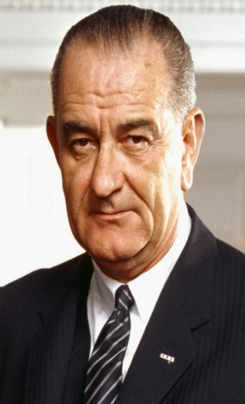
Activate 2: The End of Escalation.
Re-thinking US policy.
The Tet offensive came as a shock. It showed how far the Us and South Vietnam were from winning.
The resignation of Robert McNamara shook the Johnson administration’s confidence.
The political polls were discouraging:
LBJ’s approval ratings plummeted from 48% to 36%.
78% of Americans believed the US was making no progress.
74% believed LBJ was mishandling the war.
The cost of the war skyrocketed in just 3 years:
Government debt in 1963 was $1.6bn.
By 1965 it was $25.3bn.
This led to domestic tax increases, inflation and a weakening dollar.

Slide 7
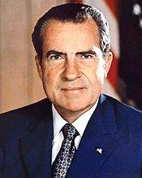
Demonstrate: Peace with honour?
Re-thinking US Policy: Nixon in Vietnam.
In his inaugural address in 1969, President Richard Nixon said ‘The greatest honour history can bestow is the title of peacemaker.”
We are going to assess to what extent President Nixon achieved his aim of ‘peace with honour’ in Vietnam.
Instructions: Download the 20 Questions worksheet. Answer each question in full sentences.

Slide 8
Why the US failed in Vietnam
Knowledgeable
Inquirer
Learning Objective:
KEY TERMS:
ARVN
search and destroy
fragging
Tet offensive
Ho Chi Minh tail
Vietnamization
‘Peace with honour’
To know the range of factors that contributed to US failure in Vietnam.
To assess how successful President Nixon’s policies in Vietnam were.
Learning Outcomes:
Grade 4
You can describe the main factors that contributed to US failure in Vietnam.
Grade 5
You can explain which factors had the most significant impact on the outcome of the conflict.
Grade 6/7
You can judge to what extent President Nixon’s policies in Vietnam were successful.

Slide 9
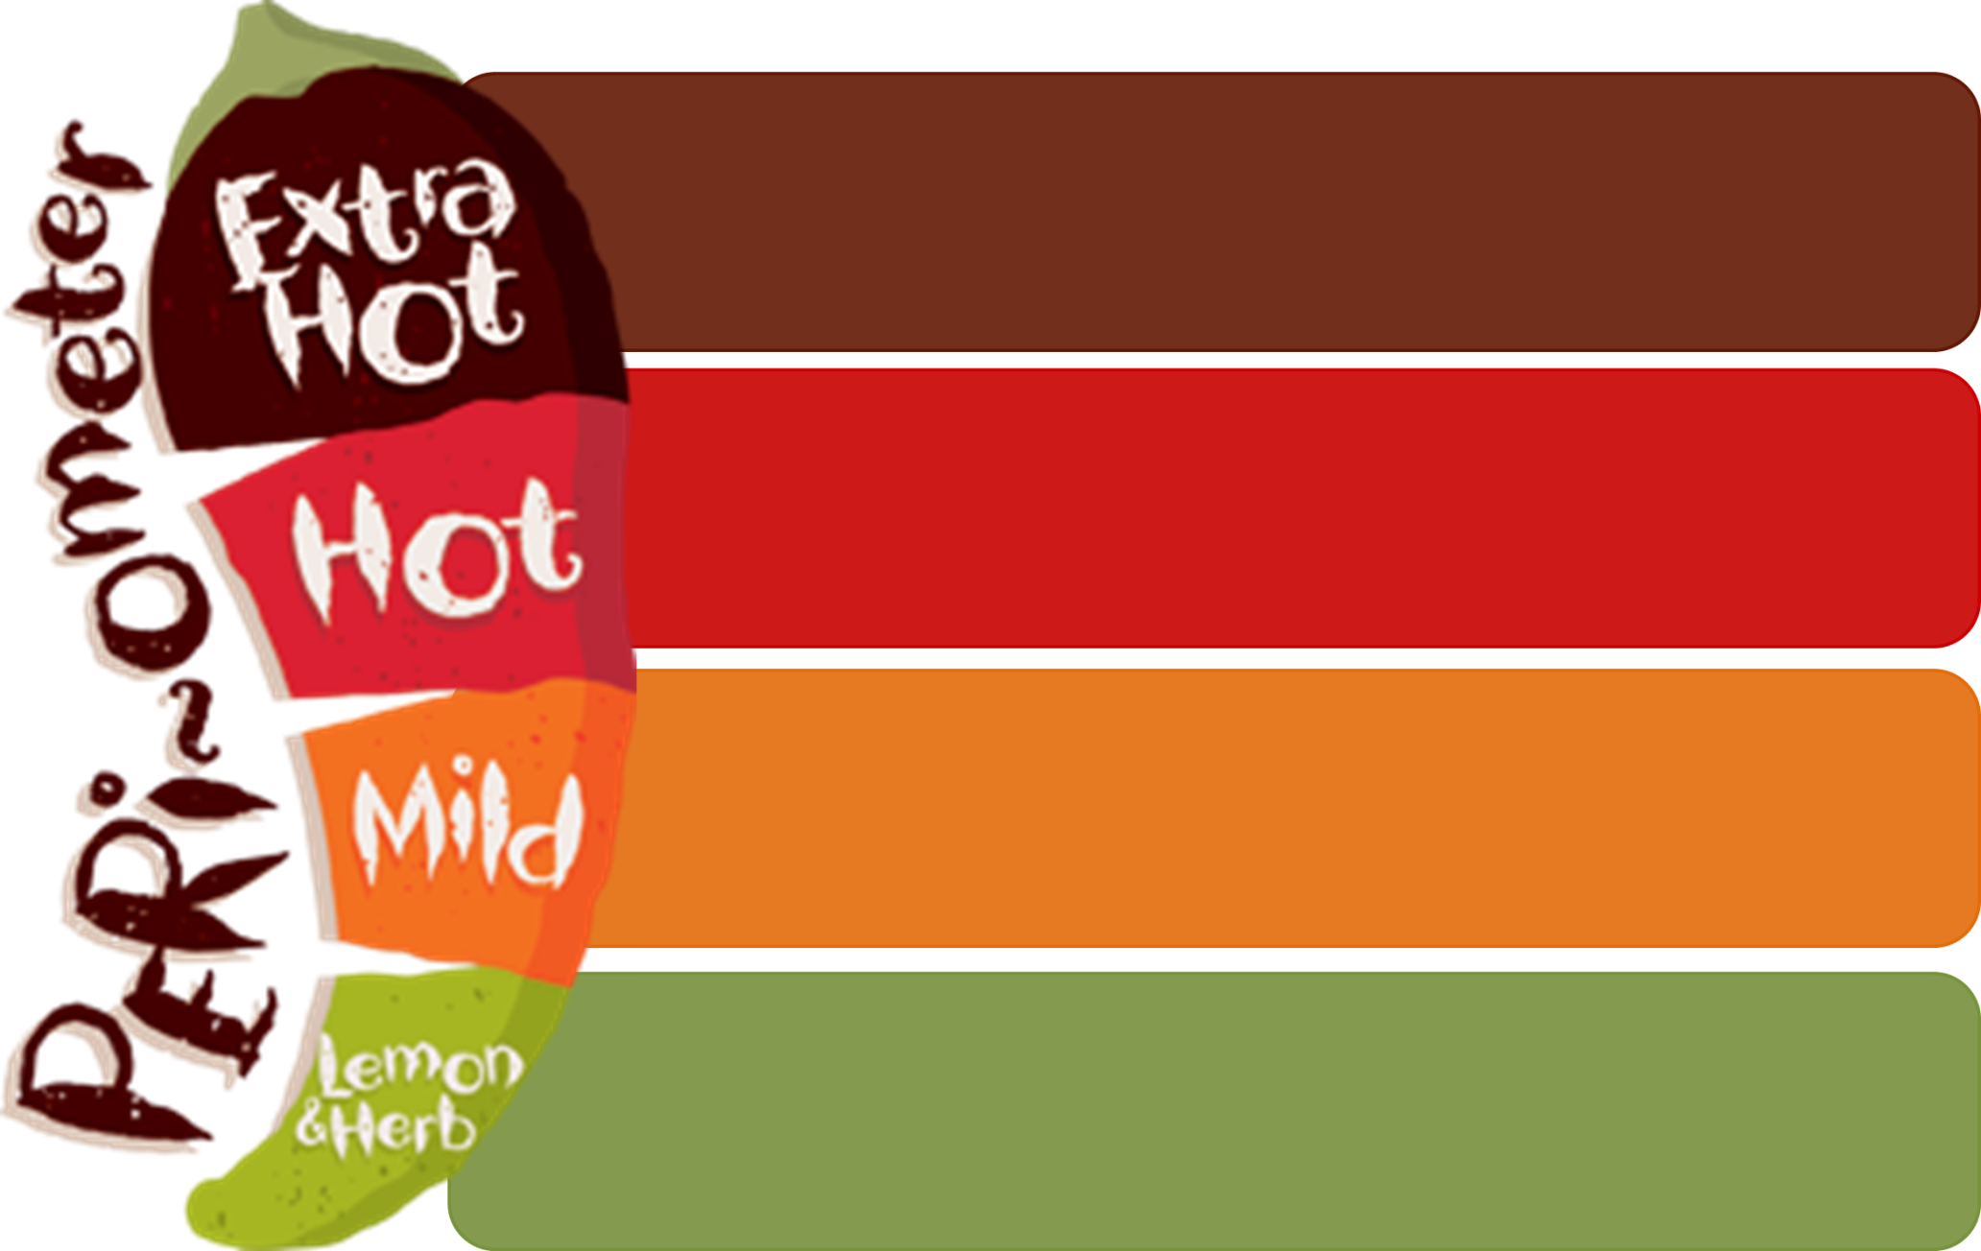
Consolidate Activity: What and how have you learned today?
I feel confident about my progress in this lesson because…
The most important thing I’ve learned is…
A question that I have about today’s lesson is…
The thing I have found most difficult in this lesson is…

