Slide 1
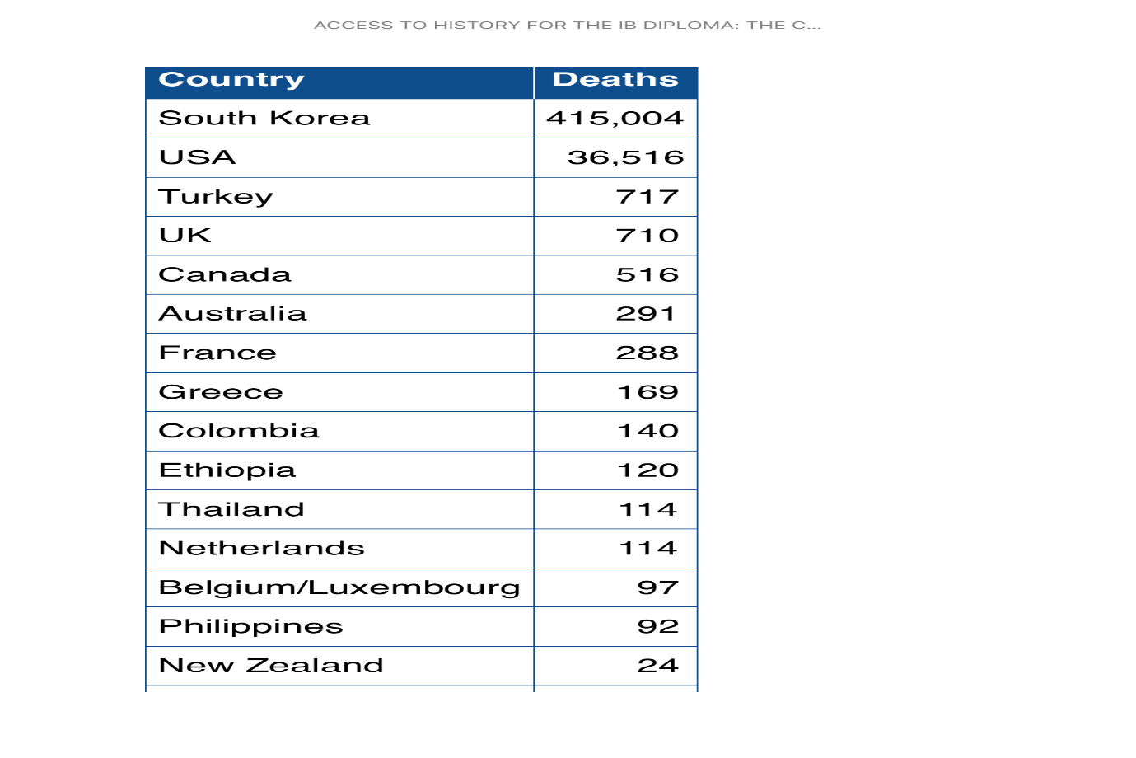
Task on Entry
Key question: How far can the Korean War be considered a UN war?
US/UN/ROK deaths in the Korean War.
Thinking about your own answer to the key question, what can you infer from Source E?

Slide 2
The Korean War 1950-3
Communication
Inquirer
Learning Objective:
KEY TERMS:
armistice
diplomatic
foreign policy
Sino-American relations
To explain the main reasons why the Korean War came to an end.
To evaluate the extent to which US involvement in the war can be considered successful.
Grade 6/7
You can judge how far the Korean War can be considered a UN war AND assess to what extent US involvement in he conflict was successful.
Learning Outcomes:
Grade 4
You can describe the key reasons why the Korean War ended.
Grade 5
You can explain how each reason contributed to the end of the Korean War and prioritise their significance in ending the conflict.

Slide 3
Connect Activity – A UN War?
How far do you agree…?
Key Question: How far can the Korean War be considered a UN war?
Place yourself on the line, indicating how far you consider the Korean war to be a UN or US war.
Fact Change: Skim read p. 55-56.
Fact Change: Skim read p.57-58.

Slide 4
Ending the Korean War 1951-1953.
A January 1951 poll revealed that 49% of Americans felt sending troops to Korea has been a mistake. 66 % believed that the US should abandon Korea. Yet the armistice ending the war was not signed until 1953.
Instructions
Complete key question investigation to help you develop a balanced answer to the key question:
2. Why did the Korean war come to an end?
Open this Word Document.
Read p. 62.
Pick one section of the document to complete.
Save a copy for yourself at the end of the lesson.
Extension
Rank the causes of the end of the Korean war in order of importance.
1. Why was MacArthur’s dismissal important?
Read p.59-60.
In 100 words, summarise why General MacArthur was dismissed and why the impact of this dismissal was significant.
Read Source G and H, p. 61.
Answer ONE of the source questions on p.61. Challenge yourself!
3. How did the Korean War affect US politics and foreign policy?
a. Create Cornell Method notes on p. 63-65
b. Notes must be max. 1 side A4 and incorporate at least 2 questions
Extension
Use a highlighter or key to identify positive and negative consequences of US intervention in Korea.
To what extent was US involvement in Korea a success?
Activate Activity

Slide 5
The Korean War 1950-3
Communication
Inquirer
Learning Objective:
KEY TERMS:
armistice
diplomatic
foreign policy
Sino-American relations
To explain the main reasons why the Korean War came to an end.
To evaluate the extent to which US involvement in the war can be considered successful.
Grade 6/7
You can judge how far the Korean War can be considered a UN war AND assess to what extent US involvement in he conflict was successful.
Learning Outcomes:
Grade 4
You can describe the key reasons why the Korean War ended.
Grade 5
You can explain how each reason contributed to the end of the Korean War and prioritise their significance in ending the conflict.

Slide 6
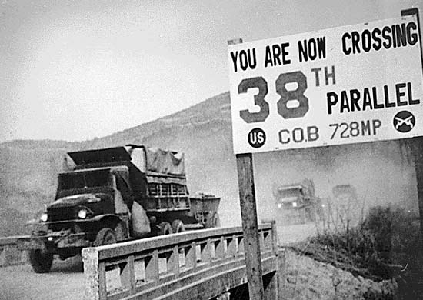
Demonstrate – A US Success?
Go to Teams
Click on Paper 2: the Cold War
Post your answer to the question below.
To what extent was the US involvement in the Korean War a success? Explain your answer in 100 words or less.

