Slide 1
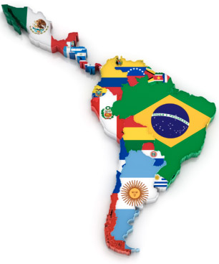
Task on Entry / Connect Activity
How much do you know about Bolivia?
What is the capital city of Bolivia?
How many languages are officially spoken in Bolivia?
What is the name of the World’s highest lake on the border of Peru & Bolivia?
Name one other Latin America country other than Bolivia which is land locked.
Which small animal is traditionally eaten in the Andes highlands?
Who is the current President of Bolivia?

Slide 2
Task on Entry / Connect Activity
How much do you know about Bolivia?
What is the capital city of Bolivia?
Sucre
37
How many languages are officially spoken in Bolivia?
What is the name of the World’s highest lake on the border of Peru & Bolivia?
Lake Titicaca
Name one other Latin America country other than Bolivia which is land locked.
Paraguay
Guinea Pig
Which small animal is traditionally eaten in the Andes highlands?
Who is the current President of Bolivia?
Evo Morales

Slide 3
The Bolivian Government & Civil Rights
Communication
Inquirer
Learning Objective:
KEY TERMS:
Mestizos – European & indigenous decent.
Indigenismo – Latin American movt. That revered indigenous culture.
Haciendas – Great landed estates
Caciques – Native tribe leader
Affirmative Action
To know the role of the Bolivian government played in relation to the civil rights of the indigenous majority.
Learning Outcomes:
Grade 4
You can describe examples of how government action led to improved civil rights for indigenous people.
Grade 5
You can consider how significant the role of the government was in guaranteeing equal civil rights.
Grade 6/7
You can explain the significance of the government in guaranteeing civil rights and compare this to other important factors.

Slide 4
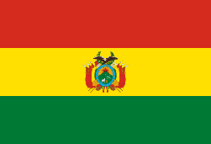
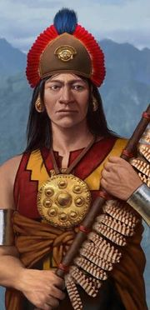
Background on Bolivia
Indigenous languages dominate NOT Spanish.
1899 revolt
The indigenous population rise up massacre, ritually sacrificed and ate government soldiers.
INDIGENOUS POPULATION
The two largest indigenous groups are;
AYMARA: Make up 20-25% of the population and live in the La Paz Province
QUECHUA: Make up 35-40% of the population and live in Cochabamba & Sucre Province
MESTIZO
(Europeans & Native decent)
Cholos the largest group who make up 30-40%
WHITES
Make up 5-15% of the population. In appearance similar to the indigenous population, but are upper-class, speak Spanish, westernized and eat non-indigenous food.
BEFORE 1945
Indigenous Bolivians did not accept Spanish conquest.
1780, 100,000 rebelled to restore the Inca monarchy, but failed.
The newly independent republic was dominated by whites and denied non-whites any power. In fact life did not improve for the indigenous as;
Deprived of communal lands
Thousands were killed by the Spanish army
Faced heavy taxation
Forced to hard labour
Their land was lost

Slide 5
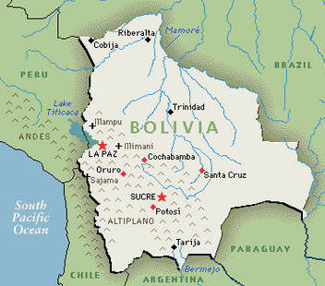
Background on Bolivia
EARLY 20TH CENTURY
The indigenous population remain impoverished and exploited.
1927 & 1929 – violent indigenous uprisings in Andean highlands.
1932-5: Chaco War between Bolivia & Paraguay led to tens of thousands of indigenous deaths.
No public education was available before 1930s. This led to the survival of indigenous culture in rural areas.
SIGNS OF CHANGE
1928: Teachers trained at teacher training school at Warisata encouraged natives to fight for land reform & their rights. Centre of indigenismo
1936-9 military reformist government under Colonel German Busch: propsed laws to protect indigenous communities & communal lands & abolish forced labour on haciendas. This gained little support. Did approve an educational reform law which opened rural education centres for the indigenous highland population.
Revolutionary parties: After the Chaco War (1932-5) several new parties were established.
1934 – The Revolutionary Workers’ Party (POR)
1941 - Nationalist Revolutionary Movement (MNR)
1940s – Party of the Revolutionary Left (PIR)
PIR and POR put indigenous problems & rights firmly on the political agenda

Slide 6
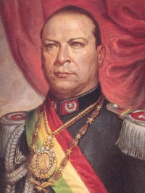
The National Indigenous Congress 1945-52
Long term foundations for indigenous self-help are laid
President Villarroel promised the following in his speech to Congress;
Better educational facilities
Abolition of the hated labour service obligations
Better housing, clothing, food and healthcare.
Congress participants demanded;
The end of discriminatory laws
The end of compulsory labour service
Indigenous access to segregated public places
MNR activist Hernan Siles campaign for land reform which he believed was Bolivia’s greatest challenge. “The land should belong to those who work it.”
Villarroel
Positives
Sense of unity created among the many different indigenous groups. Organised mass meetings & regional congresses to prepare for the National Congress.
Villaroel’s decree’s seen as a ‘truly revolutionary act’ – historian Herbert Klein, 2003
Limitations
Villaroel was overthrown in 1946 & the army reintroduced forced indigenous labour.
1947 - Raised indigenous expectations led to the great uprising of Ayopaya. Several thousand people attacked haciendas. Crushed by the army.

Slide 7
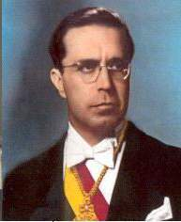
The National Revolution 1952
Land in Bolivia belonged to a few great landowners. During the 18th & 19th centuries indigenous communities struggled to keep communal land. By 1950, 6% of landowners had 92% of cultivatable land. 1952 – Victor Paz Estenssoro became Bolivia’s first revolutionary president (MNR). His new government introduced political social and economic reforms that decrease the exploitation of the indigenous population.
Universal Suffrage
Literacy tests & discriminatory property restrictions abolished. Electorate raised from 200,000 to 1 million.
4. Educational reform
1953 educational reform: established the right to universal education. This was extended to the indigenous population.
2. Peasant initiative & land reform
Spontaneous indigenous land reform movement broke out. Peasants bgan to seize the land. This led the MNR to seek more radical land reform.
Paz Estenssoro
5. Ministry of Peasant Affairs & MNR peasant unions
MNR created Ministry of Peasant Affairs – set up the first national rural union, the Bolivian National Confederation CNTCB. Within months there were over 1000 peasant unions with 20,000 members in Cochabamba alone. By 1961, 7500 peasant unions in Bolivia, all affiliated to the MNR. The MNR works through the unions to keep loyalty. MNR abolished the word ‘Indian’ from official language.
3. The Agrarian Reform Law 1953
Legalised peasant land seizures. Confiscated & redistributed the largest estates, abolished compulsory labour & unpaid transport of hacienda produce to urban markets by peasants’ animals. By 1955 24 million acres given to 237,000 people. By 1970, 29 million to 289,000.

Slide 8
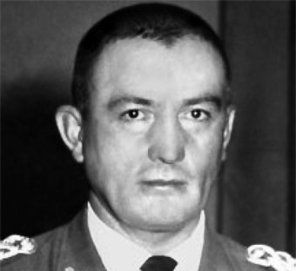
Military governments 1964-82
By 1964 MNR’s local leaders had become corrupt. From 1964 to 1982 Bolivia was dominated by counter-revolutionary military governments. Under the MNR the army had supported national developments and it had been tasked with the incorporation of the indigenous population into national life. Literate indigenous people had been encouraged to join the army. Military governments between 1964-82 were sometimes sympathetic to the ‘original peoples’.
1964 General René Barrientos Ortuño comes to power.
Quencua-speaker and nicknamed the ‘peasant president’.
Promised to help peasants.
Visited many remote villages by helicopter winning over local leaders.
1966 – Military-Peasant Pact redistributed land to peasants, who in turn promised to defend military against leftists (communists/socialists).
Barrientos continued the policy of co-opting, controlling and mobilizing peasants. Gained personal ties with the indigenous leaders (caciques). Who recognized him as sole ‘maximum leader’.
1967 – Peasants in the Guarani tribe betrayed Che Guevara to the authorities as they were so loyal to Barrientos.

Slide 9
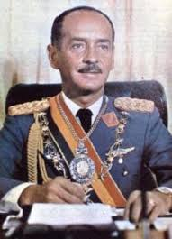
Military government 1964-82
Hugo Bánzer Suárez
1971 – Became president and then dictator.
Massacre of Tolata - Repressed indigenous population killing over 100 peasants. Was a peasant protest over food prices.
Worked to renew the Military-Peasant Pact. Replaced peasant leaders with pro-government ciciques. Redistributed over 15 million hectares of land to peasants.
Military dictators had to take the interests of the majority indigenous population into account due to their sheer number. Some were also members of the army.
Military governments 1964-82
Student Movements & Unions
1970s – Students of Aymara descent found the Katarismo movement.
1973 – publish the Tiwanaku Manifesto. Describe themselves as ‘foreigners in their own fatherland.’ Later publish a biography of Tupac Katari, who rebelled against the Spanish in 1781. Used leaflets & radio to spread the message and create his iconic status.
A women’s movement was also set up which organise congress & mobilized women to demand better working conditions, unionization and better treatment by politicians and male family members.
By 1981 the Kataristas controlled Aymara peasant unions and gained representation on the national labour union, the Bolivian Labour Central COB.

Slide 10
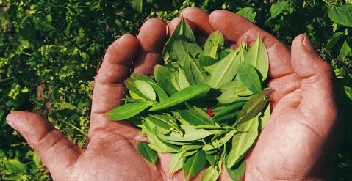
The return of civilian government 1982
After 1982 Bolivia returned to democracy but suffered successive economic crises which caused unemployed miners and peasants into coca cultivation and some to the drug trade.
Aymara & Quechua cultivate and sell coca which is very easy to grow. Traditionally miners chewed leaves between shifts to calm stomachs and ease pain.
1961 the UN called for the outlawing of coca tea and traditional coca leaf chewing.
1964 onwards, drug cartels paid poor indigenous peasants to grow coca. 1980s production triples when cocaine becomes popular.
1985-89: Paz Estenssoro’s coalition criminalized coca leaf cultivation and used military force against growers. (helped by 150 special US troops).
1980’s & 1990’s indigenous peasant associations opposed the government’s coca eradication programme. Peasant tactics included; strategic roadblocks; hunger strikes; mass rallies with ‘chew-ins’; marches & occupations. The government were forced to compromise.
1988 Evo Morales headed the biggest coca growers’ federation. The Peasant Coca Growers Union.
The cocaine problem and policies of the USA helped to politicize the indigenous population of Bolivia

Slide 11
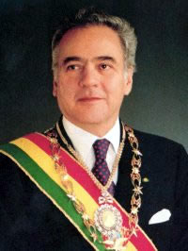
The return of civilian government 1993
1993 - Gonzalo Sánchez de Lozada of the MNR came to power.
Allied with several parties including the indigenous Tupac Katari Party. Vice president was Victor Hugo Aymara leader of Tupac Katari.
Constitutional Ammendments Law 1994 – Bolivia defined as multi-ethnic and pluricultural society.
An independent ombudsman was set up to monitor ethnic & gender issues.
Law of Popular Participation devolved power to the localities. Many local villages now had traditional governing units recognized.
New constitution guaranteed traditional land rights.
“Transformed the political landscape” historian Waltrund Morales (2010)
1997 election – 1% of the presidential candidates of the main parties had an indigenous background. The indigenous population felt poorly represented. President Banzer’s zero coca policy increased their sense of alienation.
Water Wars 1999-2002
40% of Bolivians lacked proper sanitation.
15-30% did not have access to drinkable water.
2001 water utility was privatized & prices rocketed.
2001, 30,000 people took to the streets to protest.
President Banzer sent in troops, which aroused international condemnation of human rights violations.
A good example of when popular protest & publicity can improve a situation.

Slide 12
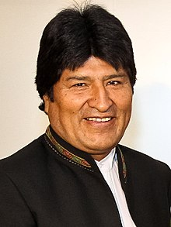
Evo Morales
December 2005 Evo Morales became Bolivia’s first indigenous president.
Reforms of 1994-5
These reforms devolved power to new governmental units that empowered the indigenous population by giving them more experience, responsibility and political awareness. This contributed to renewed militancy and grassroots activism.
2. Alienation
After 1952 governments had increased the poverty of the mestizo & indigenous populations through the privatization of major state-owned enterprises, which led to high unemployment. Despite the redistribution of land after 1952 ownership had become narrowly focused again as impoverished peasants left the countryside to look for work in the cities. Here they suffered unemployment, overcrowding, exploitation & poverty. This led to grassroots activism. Despite their poverty they could produce a high voter turnout when mobilized.
3. Leadership & Policies
Inspirational leader, promised policies were popular.
Nationalisation of Bolivia’s oil & gas reserves.
An assembly to rewrite the constitution to give more rights to the ‘orginal people’
A national referendum on regional autonomy.
Land redistribution.
Why did Morales come to power in 2005?
4. Water & Gas Wars 2004-5
Large scale protests over the privatization of water and natural gas severely damaged 3 presidents.
2004-5 second great Water War. Protest in city of El Alto led by Aymara population. Connections fees were $400, which was more than some families earned in a year. Police used tear gas and guns.
Internationally there was great sympathy for people demanding water rights.
2005 – Similar protest encouraged by Morales led to the government call for the 2005 election.

Slide 13
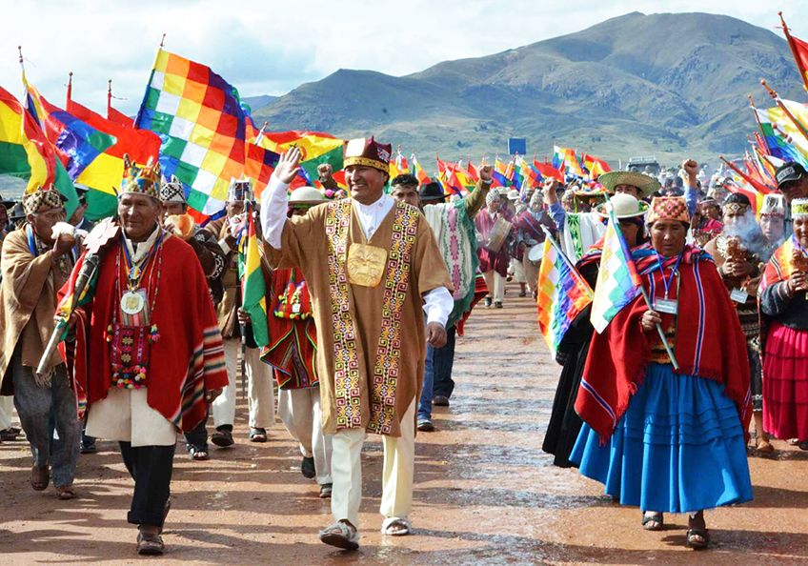
Evo Morales – New Constitution
Faced with significant problems such as racism and economic & social inequality Morales passed a new constitution in 2007.
Enshrined the principles of the UN Declaration of Human Rights of Indigenous Peoples.
Reiterated Bolivia was a plurinational states (two or more national groups within a country).
Increased indigenous rights in relation to land and cultivation.
Gave the indigenous population more seats in the legislature.
Gave a judicial system based on customary law equal status to the established legal system.
Established self-governing homelands for 36 indigenous nations,
Introduced affirmative action in order to provide more jobs for the indigenous population.

Slide 14
Demonstrate Activity: Exam Question
Evaluate the role of the Bolivian government in guaranteeing equal civil rights for its citizens.
A question like this is asking you to do several tasks. You are to discuss both the ways the government acted and how it helped to achieve equal civil rights for its citizens. You must provide supporting evidence that discusses the two. You can also bring into this question how other factors also helped to play a role in guaranteeing civil rights. For example the role of the trade unions, grassroots activism or international pressure.
ACTIVITY
In groups create a detailed essay plan showing the main argument for each paragraph the contextual knowledge you will use to support your argument as well as the key points your will cover in your conclusion.
What about the historians?
Use pages 150-151 to find out more about the historiography of this topic.

Slide 15
Consolidate
As a result of the lesson today I:
Know…
Understand…
Can use the information to….

