Slide 1
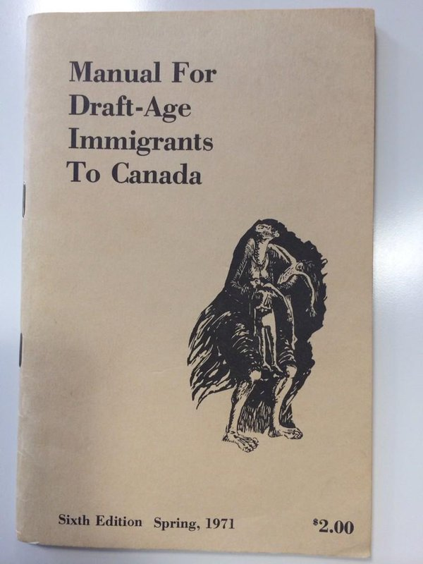
Task on Entry
Look at source A and…
…THINK about your answers to the questions.
What is the value of source A to a historian studying Canadian attitudes to the Vietnam War?
What are the limitations of source A to a historian studying Canadian attitudes to the Vietnam War?
Source A: the manual was published by the Toronto Anti-Draft Programme from 1967 until the end of the Vietnam War.

Slide 2
Task on Entry
PAIR… and discuss your responses with the person next to you.
What is the value of source A to a historian studying Canadian attitudes to the Vietnam War?
What are the limitations of source A to a historian studying Canadian attitudes to the Vietnam War?
Source A: the manual was published by the Toronto Anti-Draft Programme from 1967 until the end of the Vietnam War.

Slide 3
Task on Entry
SHARE...your responses with your group or the class.
What is the value of source A to a historian studying Canadian attitudes to the Vietnam War?
What are the limitations of source A to a historian studying Canadian attitudes to the Vietnam War?
Source A: the manual was published by the Toronto Anti-Draft Programme from 1967 until the end of the Vietnam War.

Slide 4
How significant was Vietnam in the development of the Cold War?
Communicators
Open-minded
Learning Objective:
KEY TERMS:
SEATO
Moratorium
Great Society
Alliance for Progress
To know the domestic effects of the Vietnam war.
To judge how significantly the Vietnam war contributed to the development of the Cold War.
Learning Outcomes:
Grade 4
You can describe the main effects of the Vietnam war on the US economy, politics and society.
Grade 5
You can explain the main effects of the Vietnam war on the US economy, politics and society.
Grade 6/7
You can judge to what extent the Vietnam war significantly contributed to the development of the Cold War.

Slide 5
Activate Activity
Politics
Society
Pair up. Research one area each. Find the key facts, dates specific examples of the Vietnam War’s effects. Pages 122-123.
Economy
The war caused deficits in federal government budget and balance of payments.
$120 Billion spent on the war, 1965-1973.
Resulted in inflation and tax rises.

Slide 6
Demonstrate Activity - Debate
“The Vietnam war did not significantly contribute to the development of the Cold War between 1949 and 1973.”

Slide 7
MOTION: “This house believes the Vietnam war did not significantly contribute to the development of the Cold War between 1949 and 1973.”
PROPOSITION: Agrees.
OPPOSITION: Disagrees.
Speaker 1
Introduce yourself
Define the motion.
Introduce your team’s main arguments.
Go into detail about the first 2 arguments. LENGTH: 4 minutes.
Speaker 1
Introduce your team’s main arguments.
Rebut prop speaker 1.
Go into detail about the first 2 arguments for your team. LENGTH: 4 minutes.
Speaker 2
Rebut (disagree with) opposition speaker 1’s points.
Go into detail about your team’s 3rd and 4th arguments. LENGTH: 4 minutes.
Speaker 2
Rebut (disagree with) proposition speaker 2’s points.
Go into detail about your team’s 3rd and 4th arguments. LENGTH : 4 minutes.
Speaker 3
Rebut (disagree with) opposition speaker 2.
Rebuild your team’s case. LENGTH : 4 minutes.
Speaker 3
Rebut (disagree with) proposition speaker 3.
Rebuild your team’s case. LENGTH : 4 minutes.
Notes:
Leave this on screen for the rest of the lesson. Teams have the rest of Lesson 1 to prepare. Set them off preparing using the RESOURCES.
RESOURCES: Debate script for Speaker 1, 2 and 3 to help students structure debate. Topic Guides to help students research arguments.
JUDGES: Separate them from their group. They need to create a table in their books briefly summarizing the arguments for AND against the motion. Use the TOPIC GUIDE.
You also need to take them through the DEABTE SCORING WORKSHEET. The debate sheet is double sided. One side explains the categories, the other scores each individual. Each category is marked out of ten for each speaker. Each speaker receives an overall mark out of thirty. The winning team is the one that scores the most points. THEN: Onto the debate.
EXTENSION: (Judges only) Write a paragraph explaining your answer to the question: “To what extent do you believe the government is responsible for a persons health?”

Slide 8
Consolidate
Agree
Disagree
“The Vietnam war did not significantly contribute to the development of the Cold War between 1949 and 1973.”

Slide 9
How significant was Vietnam in the development of the Cold War?
Communicators
Open-minded
Learning Objective:
KEY TERMS:
SEATO
Moratorium
Great Society
Alliance for Progress
To know the domestic effects of the Vietnam war.
To judge how significantly the Vietnam war contributed to the development of the Cold War.
Learning Outcomes:
Grade 4
You can describe the main effects of the Vietnam war on the US economy, politics and society.
Grade 5
You can explain the main effects of the Vietnam war on the US economy, politics and society.
Grade 6/7
You can judge to what extent the Vietnam war significantly contributed to the development of the Cold War.

Slide 10
History Command Terms
Compare | Give an account of the similarities between two (or more) items or situations, referring to both (all) of them throughout.
Compare & contrast | Give an account of similarities and differences between two (or more) items or situations, referring to both (all) of them throughout.
Contrast | Give an account of the differences between two (or more) items or situations, referring to both (all) of them throughout.
Discuss | Offer a considered and balanced review that includes a range of arguments, factors or hypotheses. Opinions or conclusions should be presented clearly and supported by appropriate evidence.
Evaluate | Make an appraisal by weighing up the strengths and limitations.
Examine | Consider an argument or concept in a way that uncovers the assumptions and interrelationships of the issue.
To what extent | Consider the merits or otherwise of an argument or concept. Opinions and conclusions should be presented clearly and supported with appropriate evidence and sound argument.
See page 10 of your IB History Course Guide for Students. You can find this in the files section of your class on ManageBac.
Notes:
Discuss with student what the question is asking them

Slide 11
Essay Title: Compare and contrast Lyndon Johnson’s policies in Vietnam with Richard Nixon’s.
The best way to tackle this is to think about dividing your essay into themes or in this case polices. What were the main policies each President implemented in order to win the Vietnam war?
Make sure the policies complement each other. This is a comparison, so there needs to be both similarities and differences.
Presidential goals/war aims
Conducting the ground war
Peace talks
Conducting the air war
Support for South Vietnamese regime

Slide 12
Essay Title: Compare and contrast Lyndon Johnson’s policies in Vietnam with Richard Nixon’s.
Use your own notes and the examination guide on p.136-138 to help you complete your plan.
HOME LEARNING: Hand-write a timed answer to this exam question.
Try not to rely on your plan. You won’t have it in the exam.
You will have 45 mins to answer in the exam.
Before you start writing, spend 5 mins planning out your answer.

