Slide 1
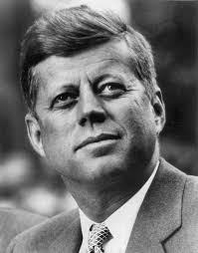
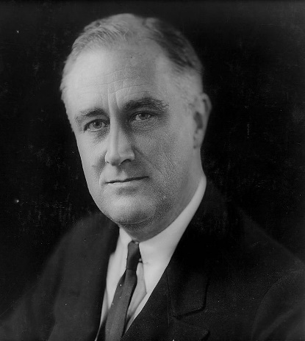
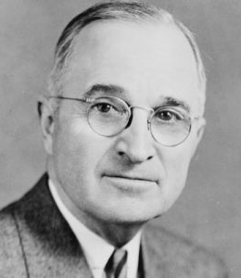
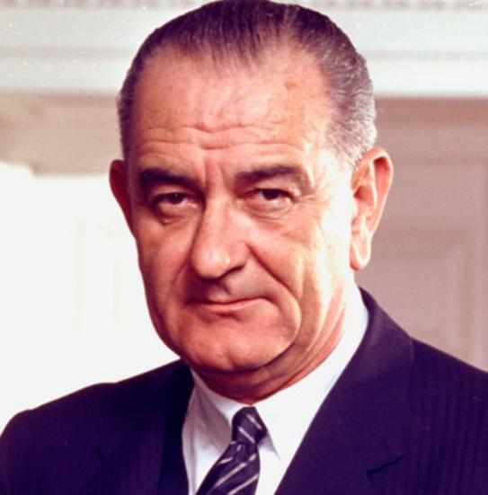
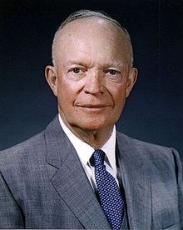
Task on Entry / Connect – US Presidents 1933-1969
TASKS
1. Can you name each US President?
2. Can you place them into chronological order?
Which President had the most significant impact on Civil Rights?

Slide 2
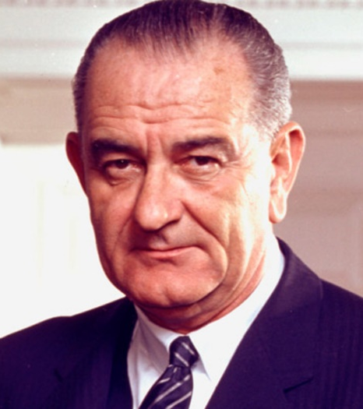
Task on Entry – US Presidents 1933-1969
Roosevelt
Eisenhower
Johnson
1933-1945
1953-1961
1963-1969
1945-1953
1961-1963
Truman
Kennedy

Slide 3
The role of governments in Civil Rights Movements in the USA
Communication
Inquirer
Learning Objective:
To consider the role each US president played in relation to the civil rights of non-white minorities.
To judge how significant each administration was.
KEY TERMS:
Founding Fathers
Dixiecrat
Affirmative action
De jure segregation
De facto segregation
Learning Outcomes:
Grade 4
You can describe examples of government actions under each President between 1933-69.
Grade 5
You can consider the different factors that led to change in civil rights under each president between 1933-69.
Grade 6/7
You can judge the significance each president had in relation to the civil rights of non-white minorities between 1933-69.

Slide 4
Activate Activity
Create a timeline to show the different civil rights events, presidential actions and other factors that contributed to changes in civil rights for non-whites between the years 1933-69.
Use the worksheet provided and pages 124-132 of the textbook.
Black activism
Wars & Conflict
Changing
Public opinion
Media influence

Slide 5
Demonstrate Activity - Debate
Which President had the most significant impact on Civil Rights?
Roosevelt
Eisenhower
Johnson
1933-1945
1953-1961
1963-1969
Truman
Kennedy
1945-1953
1961-1963

Slide 6
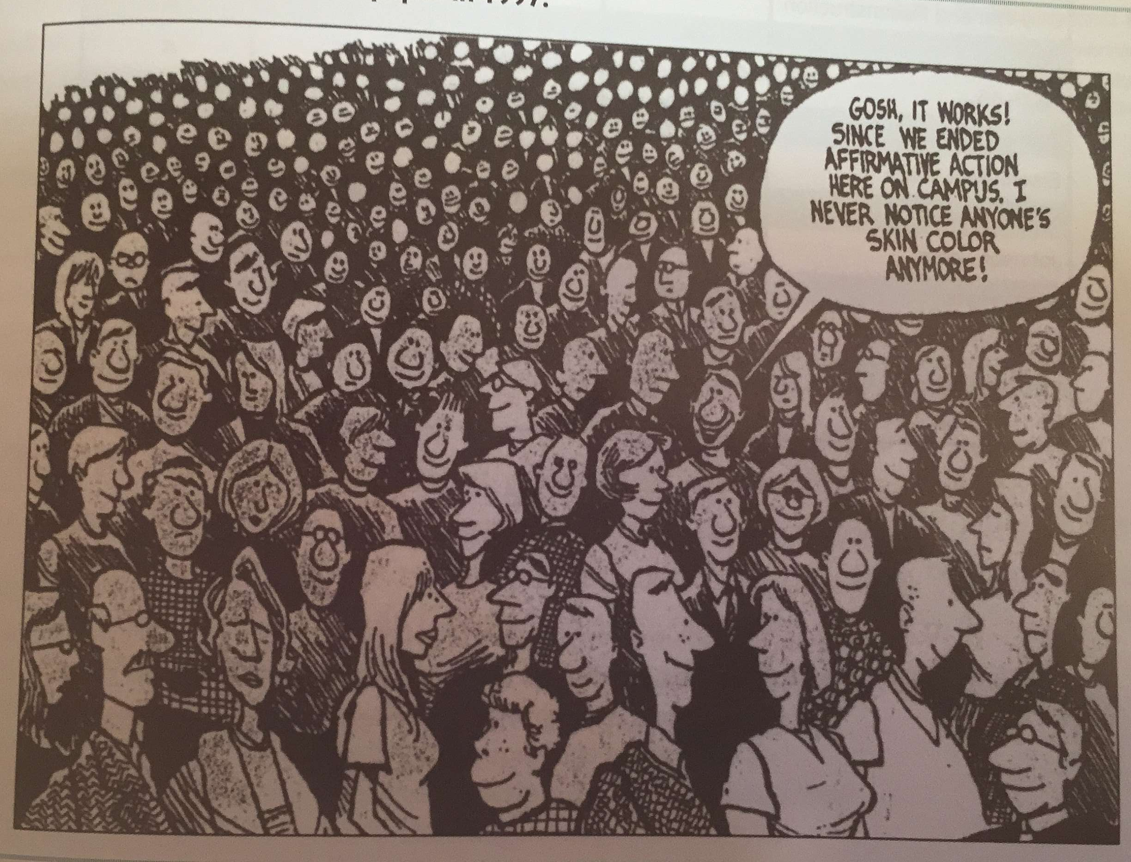
Consolidate
What is the message of this source?
Do you think affirmative action was a good idea from the late 1970s?

