Slide 1
The March on Washington, August 1963
Communication
Inquirer
Learning Objective:
To assess how successful the March on Washington was in the summer of 1963.
Learning Outcomes:
Grade 4
You can describe the key events of the March on Washington.
Grade 5
You can explain both successes and failures of the March.
Grade 6/7
You have considered if the impact of the March on Washington to the Civil Rights Movement.

Slide 2
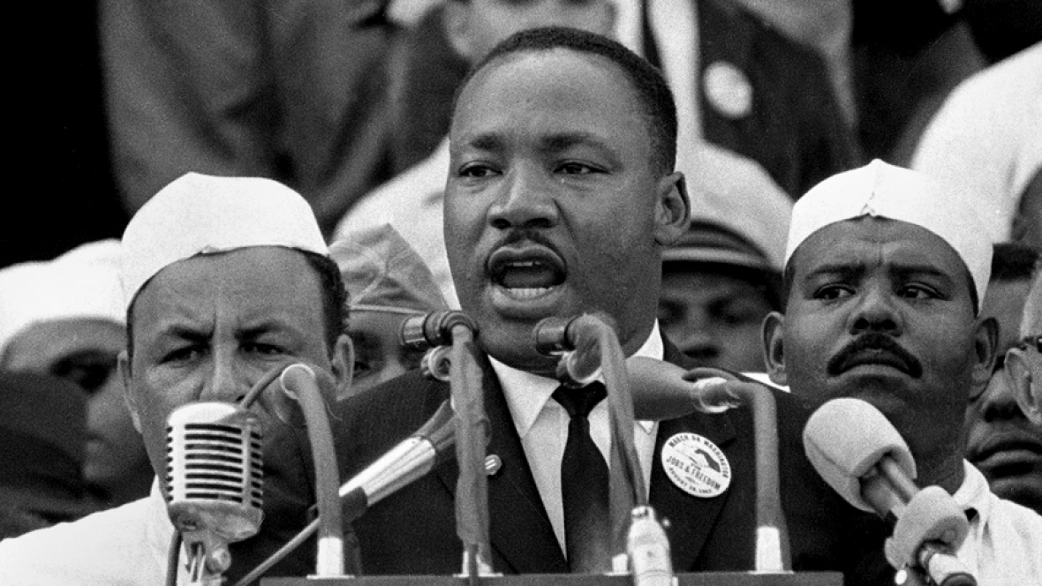
Connect Activity – Source analysis
http://www.americanrhetoric.com/speeches/mlkihaveadream.htm
Listen or watch the famous ‘I have a dream speech’. Consider the questions below.
What are the key messages from Martin Luther King Jr’s speech?
What techniques does he use to get his message across?
Why do you think this speech is so well remembered in the course of History?

Slide 3
Activate Activity
Activity: How successful was the March on Washington in 1963?
In pairs consider the success of the March.
Number 1 find evidence that the March was a success.
Number 2 find evidence of the limitations or failures of the March.
Successful | Limited

Slide 4
Demonstrate – Speed Dating
Create two rows, so you are sitting face to face Number 1’s down one side and number 2’s down the other.
You have 1 minute to tell your partner one fact that agrees/disagrees with the statement.
Number 1’s then move left down the line. You then tell your new partner a different fact.
You are not allowed to tell the same piece of information more than once.
Record new information in your table.

