Slide 1
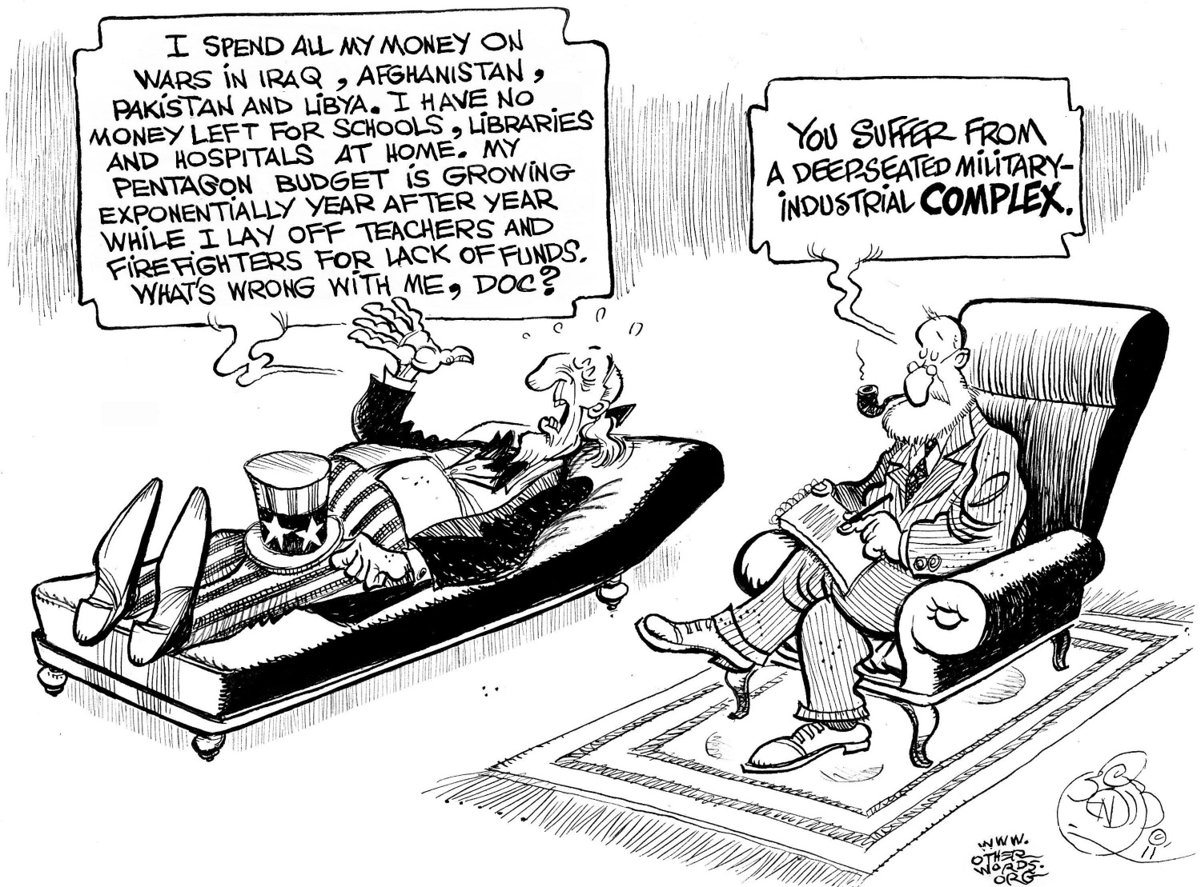
Task on Entry
What is the message of the source?
What do you think the phrase ‘military-industrial complex’ means?

Slide 2
President Eisenhower and the ‘New Look’
Communication
Inquirer
Learning Objective:
KEY TERMS:
Military-industrial complex
Brinkmanship
OAS (Organisation for American States)
To know what the key aims of the ‘New Look’ policy were and how they were carried out.
To consider the significance of the ‘New Look’ policy in Guatemala.
Learning Outcomes:
Grade 4
You can describe the ‘New Look’ policy and know how it affected US foreign policy.
Grade 5
You can describe how Eisenhower’s policies affected Guatemala.
Grade 6/7
You can explain the different interpretations of the significance of US intervention in Guatemala.

Slide 3
Connect Activity - Background
Memory exercise
You will get 30 seconds to look at the diagram on the next slide which summarises the ‘New Look’ policy. During this time you cannot make any notes.
After the 30 seconds you will need to recreate the diagram.

Slide 4
What was the ‘New Look’
What?
Reconcile demands of the military with the treasury.
Spend less on the military without compromising US military power.
How?
Fewer conventional forces.
Rely instead on nuclear weapons & massive retaliation.
Brinkmanship: Creating the impression that one is willing to push events to the point of war rather than concede.

Slide 5
Activate Activity 1 – The ‘New Look’
Use the textbook pages 71-73 to create a table assessing how far the ‘New Look’ policy actually led to change in US foreign policy.
New | Not New
 | Nuclear weapons were not used to support the French in Vietnam. Nuclear weapons were not used to support Taiwan’s claim for the islands of Quemoy & Matsu.

Slide 6
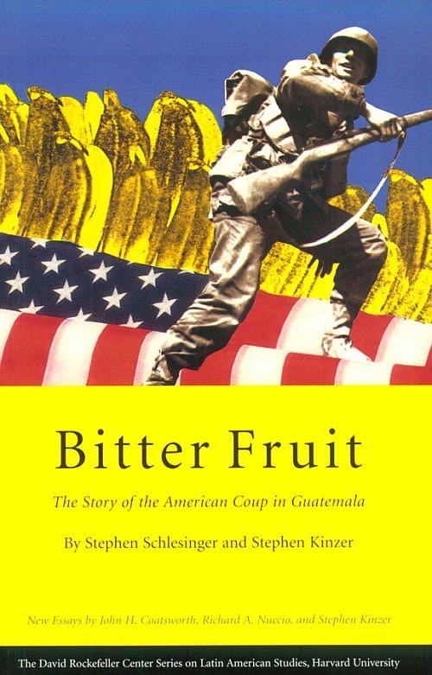
Activate Activity 2 – Latin America
The USA was suspicious of most 20th century revolutions due to their fear of Communism. Communist parties were founded in many Latin American republics in the late 1920s. When the Cold War broke out the party was banned by several countries, including Brazil (1948) & Costa Rica. In 1953 Dulles admitted that the Truman administration ‘had taken South America too much for granted’. He feared that the poverty and inequality in wealth in Latin America could lead to a Communist Revolution, as in China.
The Eisenhower administration felt that ‘strongmen’ (dictators) were the best guarantee in internal stability. However the economic investment in Latin America would be left to private capital. However Private capital prefers to invest in stable areas. From 1953 to 1956 $1.4 billion was invested in Latin America while $3.4 billion was invested in Western Europe.

Slide 7
Activate Activity 2 – Latin America
Case Study: Guatemala
Quick fire Questions: Who can find the answers the fastest to the following questions?
Who was Guatemala’s first democratically elected president?
What does the term expropriated mean?
How much did the US fruit company claim its land was worth in their 1950 tax return?
Who was Jacobo Árbenz Guzman?
How much did the CIA spend in their efforts to overthrow Árbenz?
Who did Árbenz turn to for military support?
When did the CIA trained Castillo Armas attack Guatemala?
Why did Árbenz flee Guatemala?

Slide 8
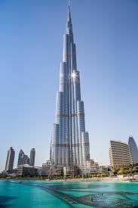
Demonstrate
How significant was US intervention in Guatemala?
What motivated the USA to carry out a covert CIA operation to remove Árbenz from power in Guatemala?
How successful was the covert CIA operation in Guatemala in June 1954?

Slide 9
Consolidate
Agree
Disagree
“US intervention in Guatemala was justified.”
How far do you agree with this statement?

