Slide 1
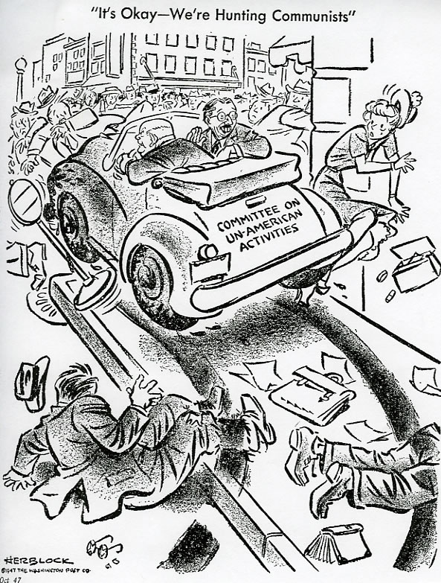
Task on Entry
A 1947 cartoon on HUAC (The House of Representatives Committee on Un-American Activities)– Published in the Washington Post by Herb Lock

Slide 2
The Cold War and American Politics, Society and Culture.
Inquirer
Learning Objective:
KEY TERMS:
Red Scare
HUAC
McCarthyism
socialism
Left-Wingers
To understand the significance of Senator McCarthy and McCarthyism in Cold War America.
To consider the impact of the Cold War on American politics, society and culture.
Grade 6/7
You can use detailed knowledge to reach conclusions about the impact of the Cold War on US politics, society and culture.
Learning Outcomes:
Grade 4
You can describe the key reasons why Senator McCarthy and McCarthyism developed during the early 1950s.
Grade 5
You can explain the impact of Senator McCarthy and McCarthyism on American politics.

Slide 3
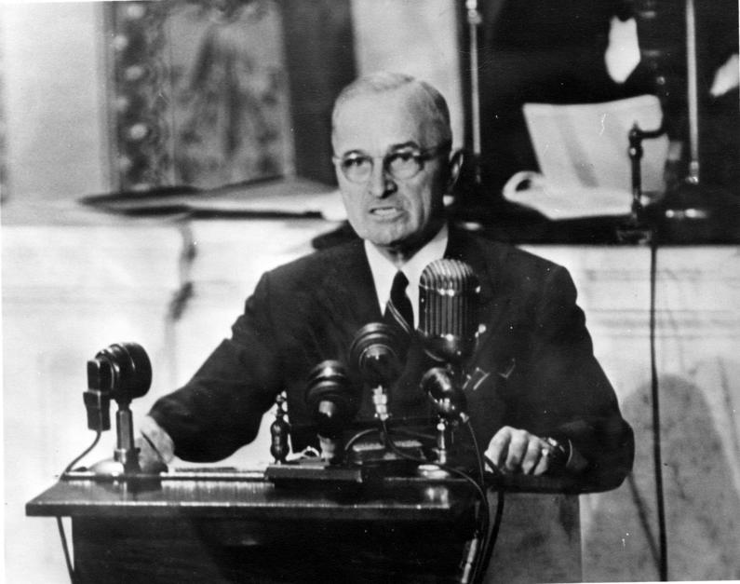
Activate Activity: HUAC, the new Red Scare and Truman.
The Red Scare: an outburst of anti-Communist hysteria in which communists, real or imagined, were seen everywhere.
The first Red Scare in America followed the Russian Revolution of 1917.
During the 1930s right-wing American politician feared socialism and Communism might gain popularity during the poverty-stricken Great Depression.
HUAC (The House of Representatives Committee on Un-American Activites) was set-up to investigate left-wingers sympathetic to socialism and Communist ideas in politics and government.
Under FDR, FBI director J. Edgar Hoover initiated programmes in 1942 to seek out those who posed a security risk because of their socialist and Communist ideas.
Between 1947 and 1952 there were 3,000 investigations, 14,000 inquiries, over 1,000 dismissals and several thousand resignations as a result.
At the end of the Second World War, traditional opposition to Communist ideology, a surge of patriotism generated by the war and the fear of Soviet military strength led to a second Red Scare.

Slide 4
Activate Activity: HUAC, the new Red Scare and Truman.
The new Red Scare had a number of significant impacts on US politics:
In 1945 HUAC became permanent. It was given broader powers to deal with suspected American Communists.
In 1947, Republicans won control of Congress and expanded investigations.
The ‘Hollywood 10’ a group of writers and directors who had members of the American Communist Party were given one-year jail sentences.
In 1948, the US courts moved against Communist Party officials.
President Truman added to the hysteria of the new Red Scare:
In 1950, the McCarran or Internal Security Act said members of Communist or socialist organisations had to register with the government or face jail or fines.
Those who registered could lose passports or face deportation.
President Truman failed to veto the Act, due to fears of being seen as weak on Communism.
The Truman Doctrine scared the American government, Congress.
Executive Order 9835 signed by President Truman ordered ‘loyalty investigations’ into all federal government employees.

Slide 5
Activate Activity – McCarthyism
PART 1: In groups, find out about one aspect of McCarthyism and collaborate to complete the McCarthyism Fact Sheet in the conversations tab of The Cold War and The Americas channel.
Group 1: Investigations during the 1950s.
Group 2: McCarthy and the 1952 Presidential election.
Group 3: How did McCarthy “get away with it?”
Group 4: The Fall of McCarthy.
REMEMBER: Save your own copy once you have completed it.
Use p.34-36 of your text book to help you.

Slide 6
Consolidate
QUESTION
How significant was the impact of McCarthy’s actions and McCarthyism on American attitudes and politics?
Explain your
answer using
this Thinking
Routine.
Inquirer
Notes:
Get feedback. Draw out similarities. Maybe put up on whiteboard?

Slide 7
Activate Activity 2 – The Impact of the Cold War on American Life
Part 2: Read pages 36-38 and create a summary diagram about the impact of the Cold War on American life.
Mind map
Cornell method
Other note taking method
You must include the following in your notes;
Examples of specific changes caused by the Cold War.
Consequences of the Red Scare for each of the four sub-headings.
Key dates where they are mentioned.

Slide 8
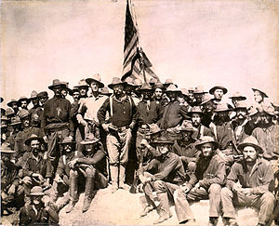
Consolidate
As a result of the lesson today I:
Know…
Understand…
Can use the information to….

