Slide 1
Task on Entry – The first protest song!
Southern trees bear a strange fruit Blood on the leaves and blood at the root Black bodies swinging in the southern breeze Strange fruit hanging from the poplar trees
Pastoral scene of the gallant south The bulging eyes and the twisted mouth The scent of magnolias sweet and fresh Then the sudden smell of burning flesh
Here is a fruit for the crows to pluck For the rain to gather, for the wind to suck For the sun to rot, for the tree to drop Here is a strange and bitter crop
Listen to the lyrics of this song:
What do you think they mean?
Challenge Question: When was this song written and by whom? How useful is this source for telling us about the Civil Rights Movement?

Slide 2
The NAACP
Communication
Inquirer
Learning Objective:
KEY TERMS:
NAACP
Ghetto
Grassroots
Electoral register
Desegregation
To consider the importance of the NAACP in the development of the Civil Rights Movement.
Learning Outcomes:
Grade 4
You can describe the key events in the Civil Rights Movement between 1909-1950.
Grade 5
You can explain the role of the NAACP in the emergence of the Civil Rights Movement.
Grade 6/7
You can compare the role of the NAACP with the significance of other factors in the changes to the treatment of Black Americans.

Slide 3
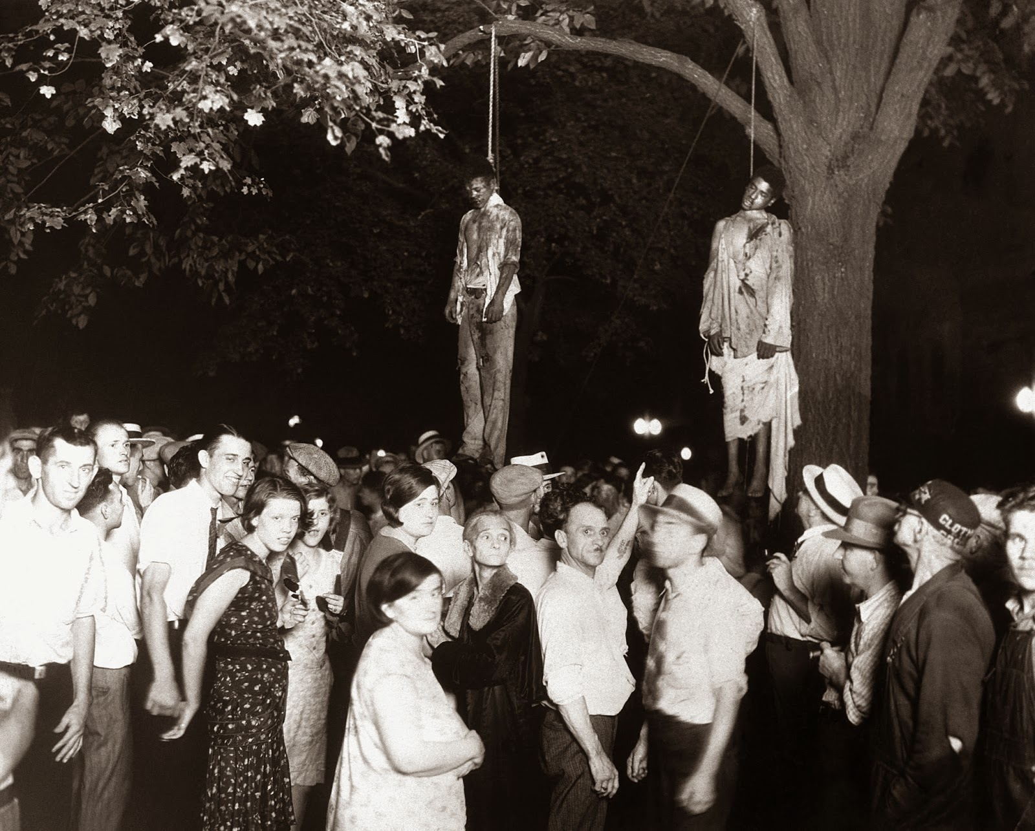
Connect Activity – Source analysis
This photo was the source of Abel Meeropol’s inspiration for the song ‘Strange Fruit’ (written in 1939). It shows the lynching of Thomas Shipp and Abram Smith that took place in Indiana, a northern state, in 1930.
Discussion points:
Does anything surprise you about this scene?
How would you describe and explain the attitudes of the people in the crowd?

Slide 4
Activate Activity
Create a timeline of the key events in the Civil Rights Movement between 1909 and 1950.
Creation and actions of the NAACP
The impact of World War One
The campaign for desegregation in schools
The role of President Roosevelt
The impact of World War Two
Victories in the Supreme Court
The impact of President Truman

Slide 5
Demonstrate
How significant was the role of the NAACP in the emergence of the Civil Rights movement?
What was the impact of the world wars on the Civil Rights Movement?
What was achieved by the NAACP in the 1930s and 1940s?
How far had the lives of Black Americans changed between 1909 and 1950?

Slide 6
Consolidate
Is historical objectivity possible in the study of Civil Rights?

