Slide 1
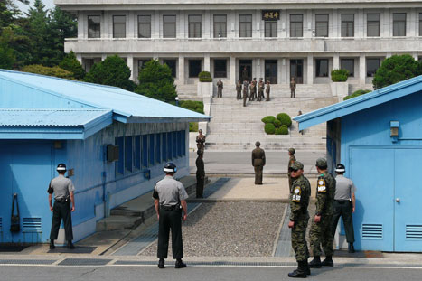
Task on Entry
See how many questions on the ‘I can tell you sheet’ you can complete at the start of the lesson.
This picture shows the border of North and South Korea.
Is this the world’s most dangerous border?

Slide 2
The Korean War 1950-3
Communication
Inquirer
Learning Objective:
KEY TERMS:
Appeasement
Economic imperialism
ROK – Republic of Korea
Pusan Perimeter
To explain the main reasons why America intervened in Korea.
To know the key events in the Korean War.
Grade 6/7
You can explain the different interpretations for the US participation in the Korean War and can explain the significant events in the outcome of the Korean War.
Learning Outcomes:
Grade 4
You can describe the key reasons why the US participated in the US War and know some of the key events.
Grade 5
You can explain the different reasons for the US intervention in Korea and know the key events in the war.

Slide 3
Connect Activity - Background
Memory exercise
In two team you will get 30 seconds to look at the diagram on the next slide which summarises why the US became involved in the Korean War. During this time you cannot make any notes.
After the 30 seconds as a team you will need to recreate the diagram outlining the key reasons why the US participated in the Korean War from 1950.

Slide 4
2. Balance of world power
By 1950 the USA believed that the balance of power was tilting in favour of Communism. Between 1948-49 a number of events in eastern Europe added to this fear. (Berlin blockade, soviet atomic bomb test) In 1949 Mao came to power in China, communism now seemed to be spreading to Asia.
3. McCarthyism & domestic political concerns
Truman needed to be seen as being tough on Communism after both his ‘Truman Doctrine’ speech (1947), McCarthy’s accusations (1950) of Communists in the State Department. His party (Democrats) also faced congressional elections in Nov 1950. Truman needed to rally the American people around their president.
1. American anti-Communism
The USA feared Communism and believed its security would be threatened if more and more Communist states existed.
4. NSC-68
The National Security Council planning paper (1950) recommended; the USA develop more powerful bombs, build up conventional forces to defend the US and fight limited wars abroad, raise taxes, seek allies and get the American public behind the fight.
Reasons for US participation in Korea
6. The UN & lessons from history
The failure of the League of nations had played a role in the outbreak of WWII. Truman believed appeasement must be avoided. He believed the UN was being tested when North Korea attacked South Korea and if it failed this could result in another World War.
5. Fears of Japan
After WWII Japan’s relations with America improved. Only 100 miles from Korea the US was worried about the threat of Communism spreading further. Japan was seen as vital for the defence of the west against Communism.

Slide 5
Progress Check
Explain how the Western viewpoint on the reasons for US intervention in Korea have changed.
Describe two different viewpoints about the reasons for US intervention in Korea.
Why did the US intervene in the Korean war?

Slide 6
Activate Activity – Key Events
Use the textbook to find the answers to the following questions about the course of events in the Korean War.
How did Truman react to the North Korean attack on South Korea?
Why was the US entry in the Korean War so significant?
How well did the US/UN/ROK forces do in the summer and autumn of 1950?
How and why did US war aims change in September 1950?
Why and with what results did China intervene in the Korean War?
Why was the battle of ‘Frozen Chosin’ such a damaging defeat for the US/UN/ROK forces?

Slide 7
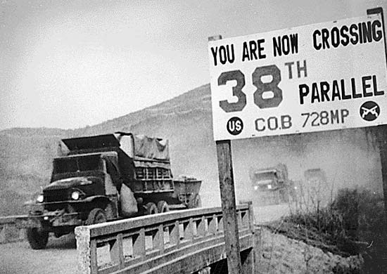
Demonstrate – I Can tell you…
How many of the 20 ‘I can tell you’ questions can you now answer?

