Slide 1
Task on Entry
Using the source below and your own knowledge, create a spider diagram with the reasons for the origins of the Cold War
Martin McCauley (2003)
“the USA and the USSR were two competing systems, each convinced of their own rectitude and of the expansionist plans of the other. Each saw the other as a threat to its existence and, from the first, both engaged in behavior that confirmed the other’s fear.”

Slide 2
President Truman and the Origins of the Cold War
Communication
Inquirer
Learning Objective:
KEY TERMS:
Orthodox
Revisionist
Grand Alliance
Doctrine
Collective Security
To know why the Cold War began.
To consider the impact of the Truman Doctrine on Latin America.
Grade 6/7
You can analyse historical evidence to reach conclusions about the impact of the Truman Doctrine in Latin America.
Learning Outcomes:
Grade 4
You can describe the key reasons why the Cold War began including knowledge of the Truman Doctrine.
Grade 5
You can explain the impact of the Truman Doctrine in Latin America.

Slide 3
Connect Activity
Each group will revise one of the key areas outlined below. You have 15 minutes to create one slide to present to the class.
Group 1 – Wartime Alliance
What brought the Grand Alliance together?
What was the biggest source of tension between the Grand Alliance members?
How can Stalin’s attitude towards Japan be interpreted?
Group 3 – Truman Doctrine & Containment
What was the Truman Doctrine?
What was Containment?
Why did Truman declare the Cold War in 1947?
What was the impact of George Kennan’s Long Telegram?
Group 2 – End of WWII
How did WWII affect both the USA and USSR?
How had the balance of power changed by the end of WWII? (Consider the Tehran, Potsdam and Yalta Conferences).
Group 4 – Historiography
Outline the views of the following schools of thought giving names of different historians;
Orthodox
Revisionist
Post-revisionist

Slide 4
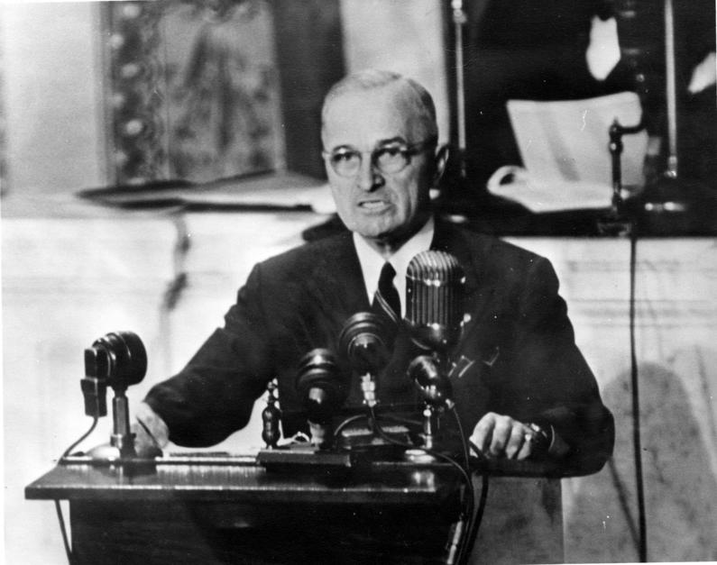
Impact of the Truman Doctrine & Containment
The Truman Doctrine led to;
Increased American involvement in Europe.
Through the Marshall Plan $13 billion was given to West European nations in order to revitalize them as allies and trading partners of the USA.
NATO was created in 1949. This cemented the political and economic associations. NATO was partly a response to Stalin’s blockade of the American, British and French zone of Germany. This was overcome by the airlift of 1948-9.
By 1949 West Germany had been divided politically and militarily into two states.

Slide 5
Truman in Latin America
Using the source below identify the main aims of Truman’s administration in Latin America.
“In Latin America we seek first and foremost an orderly political and economic development which will make Latin American nations resistant to the internal growth of Communism and to Soviet political warfare…Secondly, we week hemisphere solidarity and support of our world policy and the cooperation of the Latin American nations in safeguarding the hemisphere through the individual and collective defense measures against external aggression and internal subversion.”
National Security Council Planning Paper No: 141

Slide 6
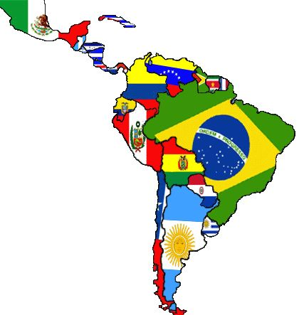
Activate Activity – Latin America
PART 1: In groups, find out about one area of US foreign policy and complete your section of the Foreign Policy Fact Sheet.
Group 1: The Rio Conference, 1947
Group 2: The organization of American States, 1948
Group 3: Aid to Latin America and the ECLA, 1948
Use your text book to help you.
PART 2: Now you are an expert, take it in turn to teach others about Truman’s policies in Latin America.

Slide 7
Demonstrate Activity 2
Judge to what extent America was a ‘good neighbor’ to Latin America using your own knowledge AND selected information from historical sources.
How far did the Truman Administration succeed in meeting their policy aims towards Latin America.
Compare and contrast the attitude of the Truman administration towards Europe and Latin America.

Slide 8
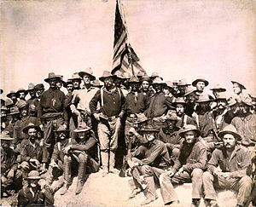
Consolidate
As a result of the lesson today I:
Know…
Understand…
Can use the information to….

