Slide 1
Sit-ins and Freedom Rides
Communication
Inquirer
Learning Objective:
KEY TERMS:
SNCC
Litigation
CORE
To know what the sit-ins and Freedom rides were.
To consider the impact of sit-ins and Freedom Rides on the Civil Rights Movement.
Learning Outcomes:
Grade 4
You can describe the key events of the sit-ins and Freedom Rides.
Grade 5
You can explain both the causes and consequences of the sit-ins and Freedom Rides.
Grade 6/7
You have considered the significance of the sit-ins and Freedom Rides in the Civil Rights Movement in the USA.

Slide 2
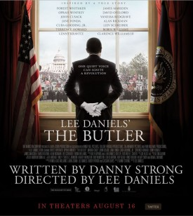
Connect Activity – Source analysis
https://www.youtube.com/watch?v=5aAhGGY6Dec
Watch the clip from the film ‘The Butler’, then answer the questions below. (You only need to watch the first 4 minutes).
What can we learn from this source about the sit-ins?
In what ways is this source limited?
How valuable is this source to a historian?

Slide 3
Activate Activity
Create two fact files. One about ‘sit-in’ the other one ‘Freedom’ Rides.
Include the following information;
Why the protests took place.
What happened during the protests. Give specific examples.
Who the key people involved were.
How effective the protest was.
What was the most significant result of the protest?
Includes pictures – can you find photographs from the time to include?
Can you find any good quotes/slogans from the people involved?

Slide 4
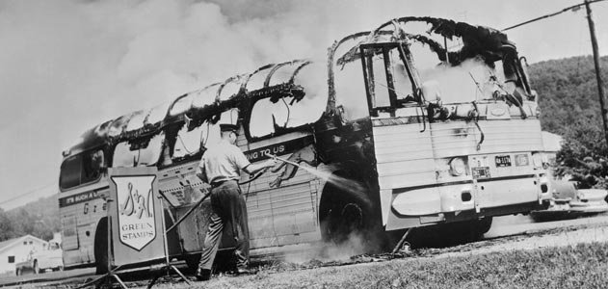
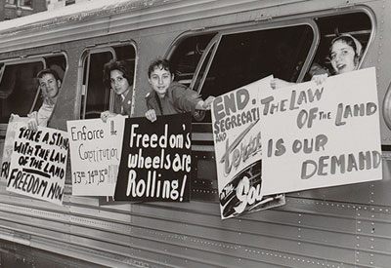
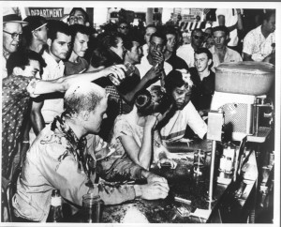
Demonstrate
Compare and contrast the effectiveness of the sit-ins and freedom ride.
Which protests do you think were the most effective and why?

