Slide 1
Task on Entry
What does this map tell us about Native Americans?

Slide 2
The indigenous population in Latin America
Communication
Inquirer
Learning Objective:
KEY TERMS:
Reservation
Bureau of Indian Affairs
NCAI (National Congress of American Indians)
NIYC (National Indian Youth Council)
AIM (American Indian Movement)
IAT (Indians of All Tribes)
To consider the extent to which the Native Americans of the United States of America achieved equality after 1945.
To consider how effective Native American organisations were in achieving equality.
Learning Outcomes:
Grade 4
You can describe examples of how improvements had been made in achieving equality for the indigenous people.
Grade 5
You can consider how far the indigenous people had achieved equality after 1945.
Grade 6/7
You can explain the extent to which indigenous people had achieved equality after 1945, supporting your points with specific examples.

Slide 3
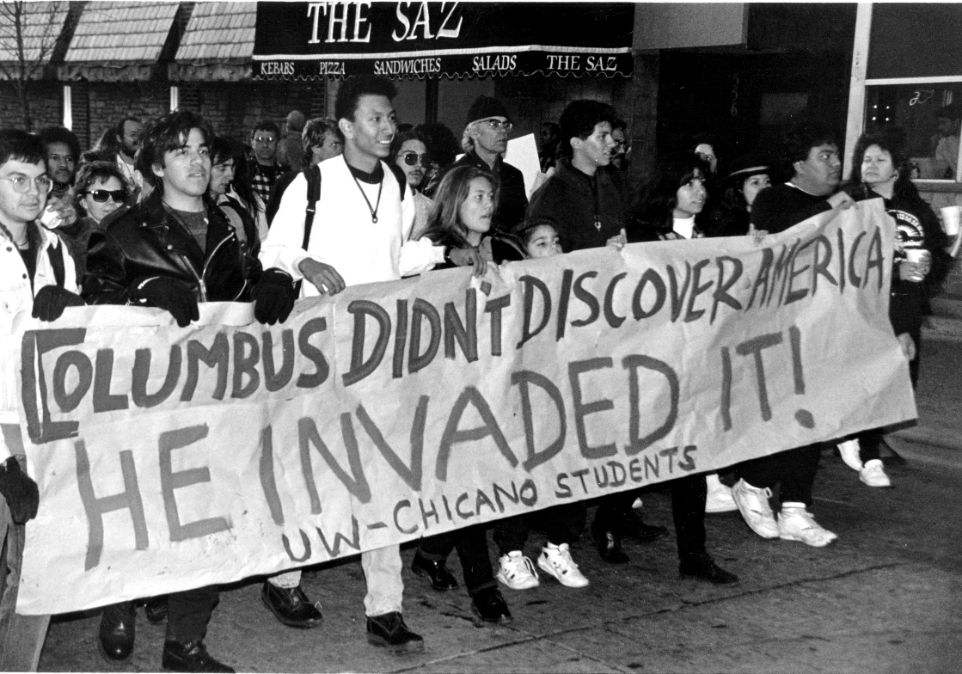
Connect Activity
In 1492 Christopher Columbus landed in America. He believed he had landed in India. In the years that followed, all sorts of countries claimed land in the Americas and England began to dominate North America.
During the 17th century, Europeans created settlements on North America’s east coast.
Native Americans were treated as inferior and their lands were taken away from them. In the 19th century a combination of force and treaties took possession of Indian lands. Native American tribes were either decimated or militarily defeated and placed on reservations on land white people did not want. Many Native American children were taken away from their parents and ‘civilized’ in federal-funded boarding schools in the 1880s.
What is the message of the photograph above?

Slide 4
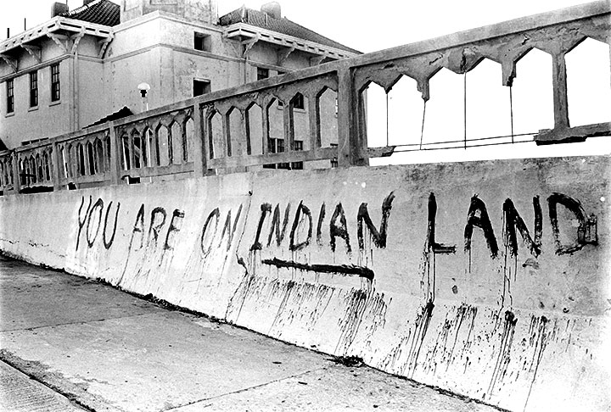
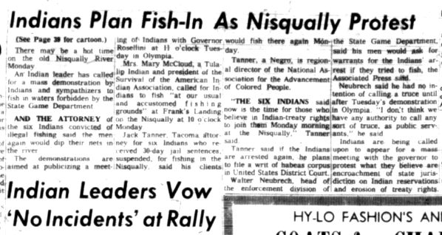
Activate Activity
Create a timeline to show the extent to which Native Americans achieved equality after 1945.
Use the worksheet provided and pages 27-36 of the textbook.

Slide 5
Demonstrate Activity
Consider the effect of the different Native American organisations. Select one organization from the list below. Give examples of their campaigns or protests. Consider the goals, successes and failures of their campaigns.
NCAI (National Congress of American Indians)
NIYC (National Indian Youth Council)
AIM (American Indian Movement)
IAT (Indians of All Tribes)

Slide 6
Consolidate
Agree
Disagree
“Native American organisations have hindered the fight for equality since 1945.”

