Slide 1
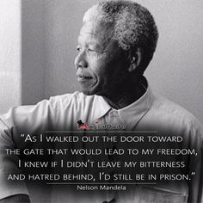
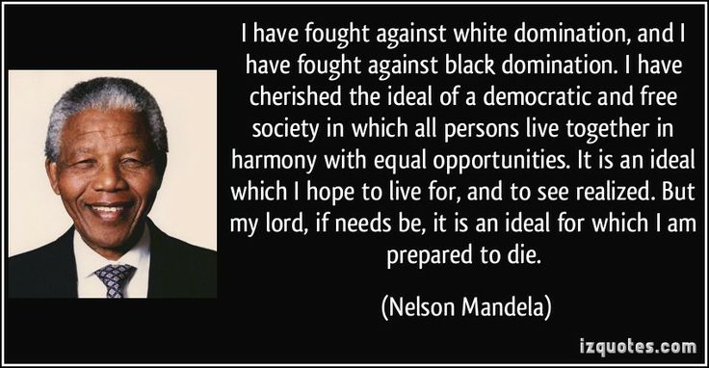
Task on Entry
TOK Question: Why do we remember certain people and events more than others? Can this shape our own interpretations of the past?

Slide 2
What was apartheid?
Communication
Inquirer
Learning Objective:
KEY TERMS:
Coalition
Apartheid
Afrikaners
Africans
Bantu
Hinterland
Pass books
Homelands
Townships
To describe the key reasons apartheid became law in 1948.
To understand the extent to which segregation existed before 1948.
Learning Outcomes:
Grade 4
You can describe what apartheid was and when it was introduced. You can describe some of the ways in which the history of South Africa led to Apartheid. You can use some of the new terms correctly.
Grade 5
You can explain what the different apartheid policies were and you can explain why Apartheid was introduced and use precisely selected historical knowledge to support my points.
Grade 6/7
You can also explain the extent to which segregation already existed within South Africa before 1948.

Slide 3
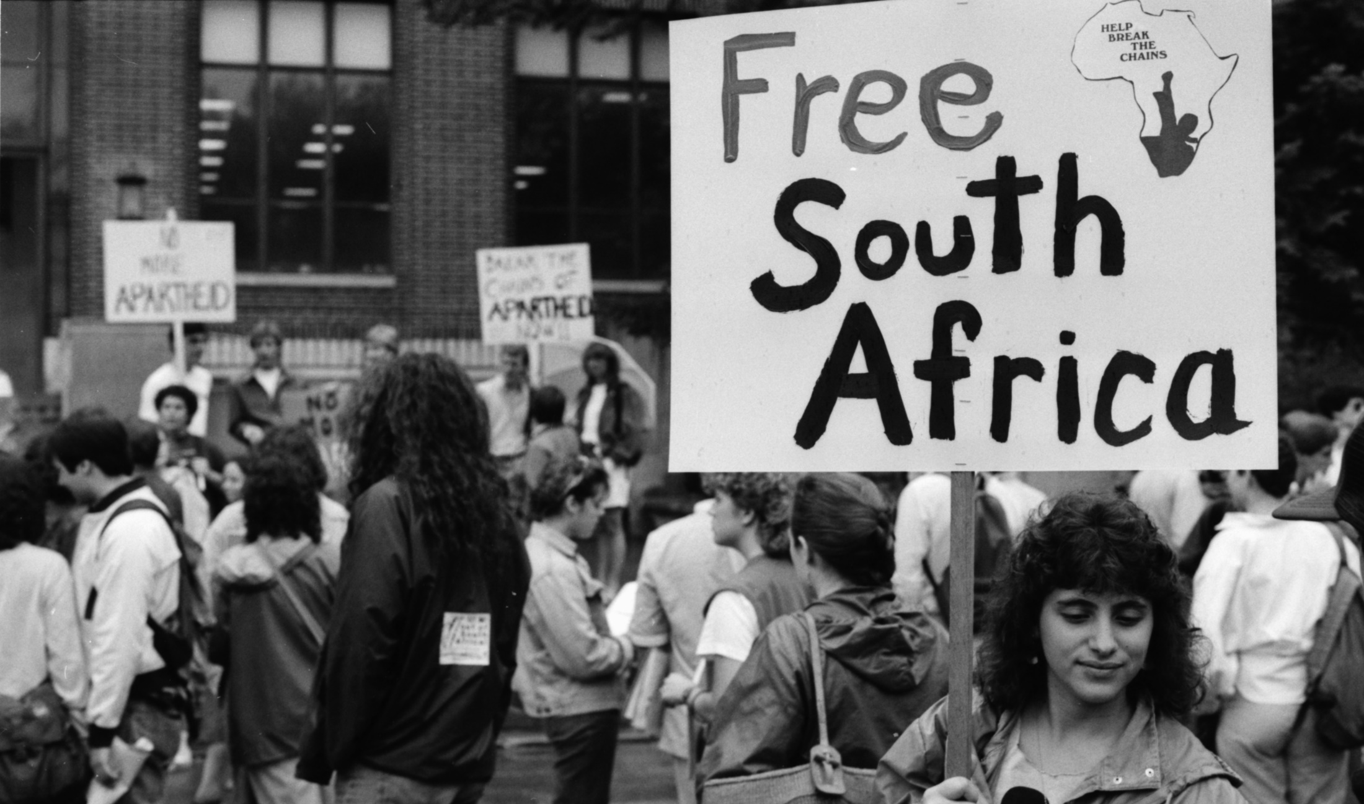
Connect Activity – Quick Fire Challenge
Watch the video on wsohistory.weebly.com and start to complete your notes page
Consider what YOU want to find out about this topic.
Write down three wonder questions

Slide 4
Activate Activity
Activity: Create notes on the following three themes. You may use the worksheet provided.
What was Apartheid in practice
South Africa
A brief History before 1948
The racial makeup of South Africa
Textbook p120-124

Slide 5
What was apartheid?
Brief South African History
Words
1652
1795
1833
1838
1899
1902
1910
1948
Grand apartheid:
Petty apartheid:
Racial Groups
4 Principles

Slide 6
Activate Activity 2
You are a member of the History faculty at Cape Town University. The government has just introduced new funding for a new research project focusing on the origins of Apartheid in South Africa.
You have been tasked with producing a one page academic briefing assessing to what extent segregation was introduced before the National Party victory.

Slide 7
Activate Activity 2
Each team will assess a different aspect of the origins of apartheid between 1910-1936.
Team 1: Segregation in legislation (law-making) – p. 124-127
Team 2: Transient migration and urbanization p.128-130
Team 3: South Africa and political power - p.130-132
Please complete your report in a format that is shareable with other team members.
You have thirty minutes to prepare you Academic report.

Slide 8
Demonstrate
Each team will verbally present their findings to the History faculty.
The focus of this meeting is to consider this question:
‘To what extent was segregation introduced before the National Party victory?
Once the findings have been reported and shared, all faculty members will be expected to contribute to the debate on this question.

Slide 9
Consolidate
Have a look at the wonder questions on the forum at the bottom of the wsohistory page.
Answer at least one question from another student.

