Slide 1
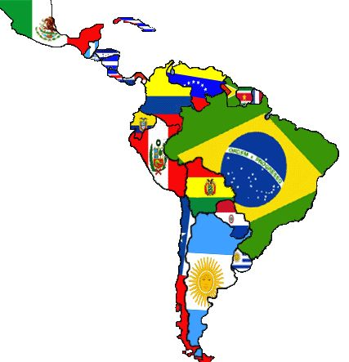
Task on Entry
Connect: How are the ideas and information connected to what you already knew?
Extend: What knew ideas do you get that extend or broaden your thinking in new directions?
Challenge: What challenges or puzzles have come up in your mind from the ideas and information presented?
Extract from the Roosevelt Corollary of 1904.
“Flagrant cases…[of] chronic wrongdoing or an impotence which results in a general loosening of the ties of civilized society…may ultimately require intervention by some civilized nation…[and] force the United States, however reluctantly, to the exercise of an international police power.”

Slide 2
Why and with what results was the US interested in Latin America before 1945?
Communication
Inquirer
Learning Objective:
KEY TERMS:
foreign policy
corollary
neo-colonialism
Colossus of the North
protectorate
To know what American foreign policy in Latin America pre-1945 involved.
To know what the consequences of US foreign policy were for Latin America.
Grade 6/7
You can judge to what extent America was a ‘good neighbor’ to Latin America using your own knowledge AND selected information from historical sources.
Learning Outcomes:
Grade 4
You can describe the key features of US foreign policy towards Latin America pre-1945.
Grade 5
You can explain the consequences of US foreign policy in Latin America pre-1945.

Slide 3
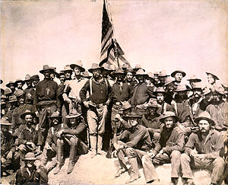
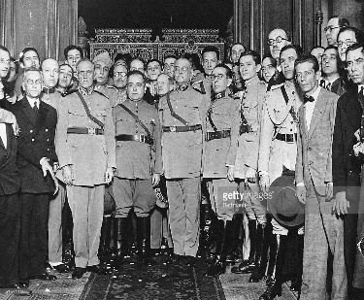
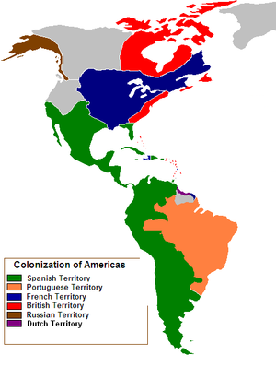
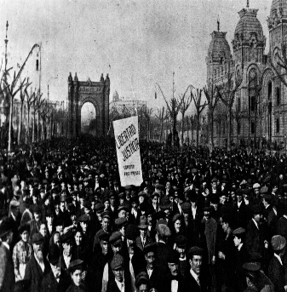
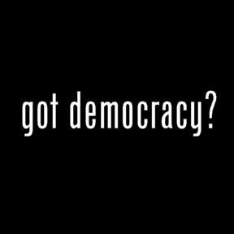
Connect Activity
Use the images below to identify the main problems facing Latin America in the early 20th century.

Slide 4
Background: Latin America in 1945
Latin America faced a diverse range of political, economic and social issues in the early part of the 20th century. Issues that arguably continue to affect much of Latin America today.
European conquest and colonization beginning in the 15th century resulted in deep-set racial, political and economic inequalities.
Descendants of European colonists remained politically, socially and economically dominant.
Colonial elites owned most of the land and dominated agriculture.
Latin America economies mainly agricultural and frequently dependent on one crop or staple product.
Little domestic industrialization undertaken. Investment in industrialization was principally by foreign governments, particularly America.
National armies had often replaced the monarchies of the colonizing countries as the major central powers in politics following widespread revolutions in the 19th century.
Few Latin American nations had a strong and established democratic system of government. Exceptions like Chile did exist.

Slide 5
Activate Activity
PART 1: In groups, find out about one area of US foreign policy and complete your section of the Foreign Policy Fact Sheet.
Group 1: The Monroe Doctrine, 1823
Group 2: Cuba, the Canal Zone and the Roosevelt Corollary (1904)
Group 3: The ‘Good Neighbour’ 1934-1945.
Use page 9–13 of your text book to help you.
Websites
The Monroe Doctrine: https://tinyurl.com/zqwp9sb
USA and Latin America: https://tinyurl.com/jcly5qj
Interventions: https://tinyurl.com/pw4pc44
Videos
https://www.youtube.com/watch?v=QfsfoFqsFk4

Slide 6
Activate Activity 2
Read source A and answer the accompanying focus question in your own words.
Look at source B and answer the accompanying focus question in your won words.
Read source C and answer the accompanying focus question in your own words.

Slide 7
Demonstrate Activity 2
Judge to what extent America was a ‘good neighbor’ to Latin America using your own knowledge AND selected information from historical sources.
Explain the consequences of US foreign policy in Latin America pre-1945.
You can describe the key features of US foreign policy towards Latin America pre-1945.

Slide 8
Consolidate
As a result of the lesson today I:
Know…
Understand…
Can use the information to….

Slide 9
Home Learning
Read Section 2 and Section 3 of Chapter 1, p.14-15.
Make Cornell Method note son US foreign policy and relations with Canada and China pre-1945.
Include details on:
What foreign relations were like between each pre-1945.
What factors contributed to US relations with China and Canada
Include definitions of new key terms and AT LEAST two questions you want to ask about what you have learned.
Create a summary bullet-point list of the key features of US foreign policy pre-1945.

