Slide 1
Connect Activity
True or False?
China is nearly 50 times the size of Britain, larger than Europe and slightly smaller than the total area of the USA.
In the early 20th century the majority of the population barely had enough to eat.
By the 20th century China resented the interference of foreign nations. This led to a rebellion from 1898-1901.
Society was very structured but didn’t value education or scholarship. The highest rank was a tradesman.

Slide 2
Key Question: What circumstances favoured the rise of Mao Zedong?
Learning Objective:
Critical Thinking
To assess the key events between 1911-34 that led to Mao’s rise to power.
To understand the significance of the Yanan period in Mao’s rise to power.
6-7 Grade
You can analyse the different events and reach a judgement comparing different events to explain which is the most significant.
Learning Outcomes:
5 Grade
You can explain why some events are more significant than others in Mao’s rise to power.
4 Grade
You can identify why different events were significant in Mao’s rise to power.

Slide 3
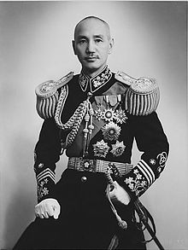
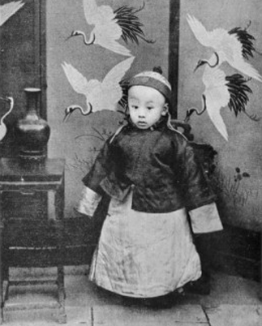
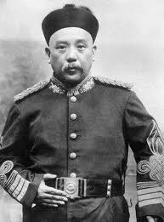
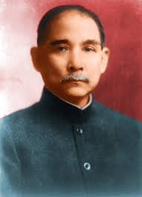
What was China like in the early 20th century?
Activate Activity
Key People: Create a short biography of the following people. Max 30 words on each.
Emperor Puyi
Chiang Kaishek
Sun Yatsen
Yuan Shikai

Slide 4
What circumstances favoured the rise of Mao Zedong? 1911-1934
19th Century Problems
Challenge Question: How did the unstable conditions in the 19th century contribute to Mao’s rise?
Sun Yatsen & The Chinese Republic
Challenge Question: How does the actions of Sun Yatsen favour Mao’s rise to power?
The Guomindang (Nationalists)
Challenge Question: How does Mao work with the Nationalists?
Warlords & WWI
Challenge Question: How did the May Fourth movement pave the way for Mao?
Mao’s background
Challenge Question: Who or what influenced Mao’s ideas/beliefs?
The CCP (Communists)
Challenge Question: What factors led to the early growth of the CCP?

Slide 5
Summary Questions
Demonstrate Activity
Why did the control of the government in Beijing over the provinces of China break down in the years 1912-26?
What explains the success of the Northern Expedition of 1926?
Why did the United Front (alliance between CCP and GMD) come to an end in 1927?
How does Mao reveal his ruthless nature during the Jiangxi period?

Slide 6
Key Question: What circumstances favoured the rise of Mao Zedong?
Learning Objective:
Critical Thinking
To assess the key events between 1911-34 that led to Mao’s rise to power.
To understand the significance of the Yanan period in Mao’s rise to power.
6-7 Grade
You can analyse the different events and reach a judgement comparing different events to explain which is the most significant.
Learning Outcomes:
5 Grade
You can explain why some events are more significant than others in Mao’s rise to power.
4 Grade
You can identify why different events were significant in Mao’s rise to power.

Slide 7
Activate Activity
TASK: Create a series of notes which answer the following questions about the Long March and the Yanan Soviet;
Why did Mao have to abandon the Jiangxi Soviet?
What was the Long March?
Why is the Long March significant in Mao’s rise to power?
Why was the Yanan period so significant in Mao’s rise to power?
Resources:
Pages 123-125 of Access to History for IB

Slide 8
Importance of the March
The CCP had survived and found a new base which was remote and safe from attack from the KMT & Japanese
Mao was hailed as a great hero and was re-established as the unchallenged leader of the CCP
Many Chinese saw the CCP as heroes & Long March became part of CCP mythology
The good behaviour of the Red Army impressed peasants
1.) Which is the most important consequence of the march? Why?
2.) How did the success of the march help boost CCP support across China?

Slide 9
Key Question: What circumstances favoured the rise of Mao Zedong?
Demonstrate Activity
Using all the knowledge you have acquired today create a diagram to show the different events that led to Mao’s rise to power.
You must be able to show how some events are more significant that others.
Use the toolkits on the wall to find inspiration for different diagrams.

Slide 10
Consolidate Activity

