Slide 1
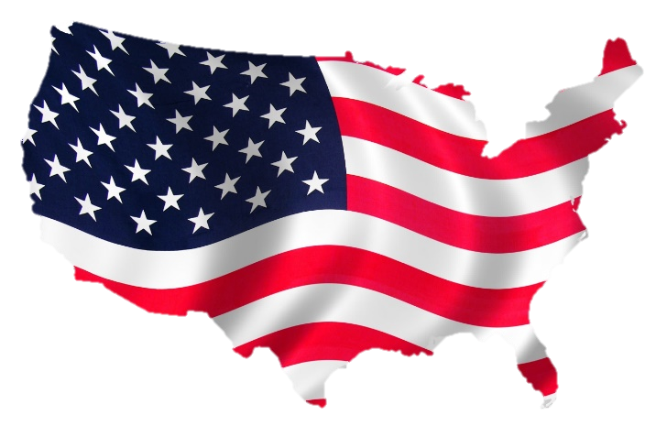
Task on Entry
Divide into two teams. Each team needs to try to memorise as many of the states in America as possible within 1 minute. When the time is up your team will be given a blank map. You will have 2 minutes to fill in as many of the 50 states as you can.

Slide 2
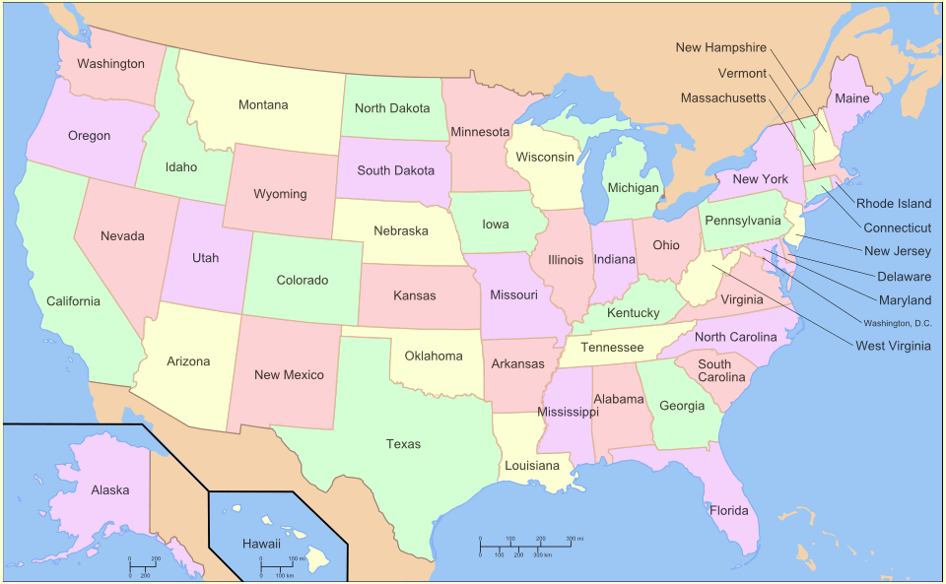
USA

Slide 3
PAPER 1: Rights and Protest
What will you study?
You will explore two significant movements in the quest for basic human-rights in the mid-twentieth century.
The two case studies are from different region;
Case Study One: The Civil Rights Movement in the USA, 1954-1965.
Case Study Two: Apartheid in South Africa, 1948-1964
How will you be assessed?
You will answer 4 source-based questions in a 1 hour exam.
HL = 20%, SL = 30%

Slide 4
What was the background to the Civil Rights Movement?
Communication
Inquirer
Learning Objective:
KEY TERMS:
Constitution
Civil Rights Movement
Federal system of government
Congress
Legislature
Supreme Court
Amendments
To know what the term ‘Civil Rights’ means within the American constitution.
To know how the US system of government works.
Learning Outcomes:
Grade 4
You can describe the different branches of the US system of government.
Grade 5
You can explain the balance of power between the central government and individual states.
Grade 6/7
You can explain what barriers the US system of government presented to Civil Rights law amendments.

Slide 5
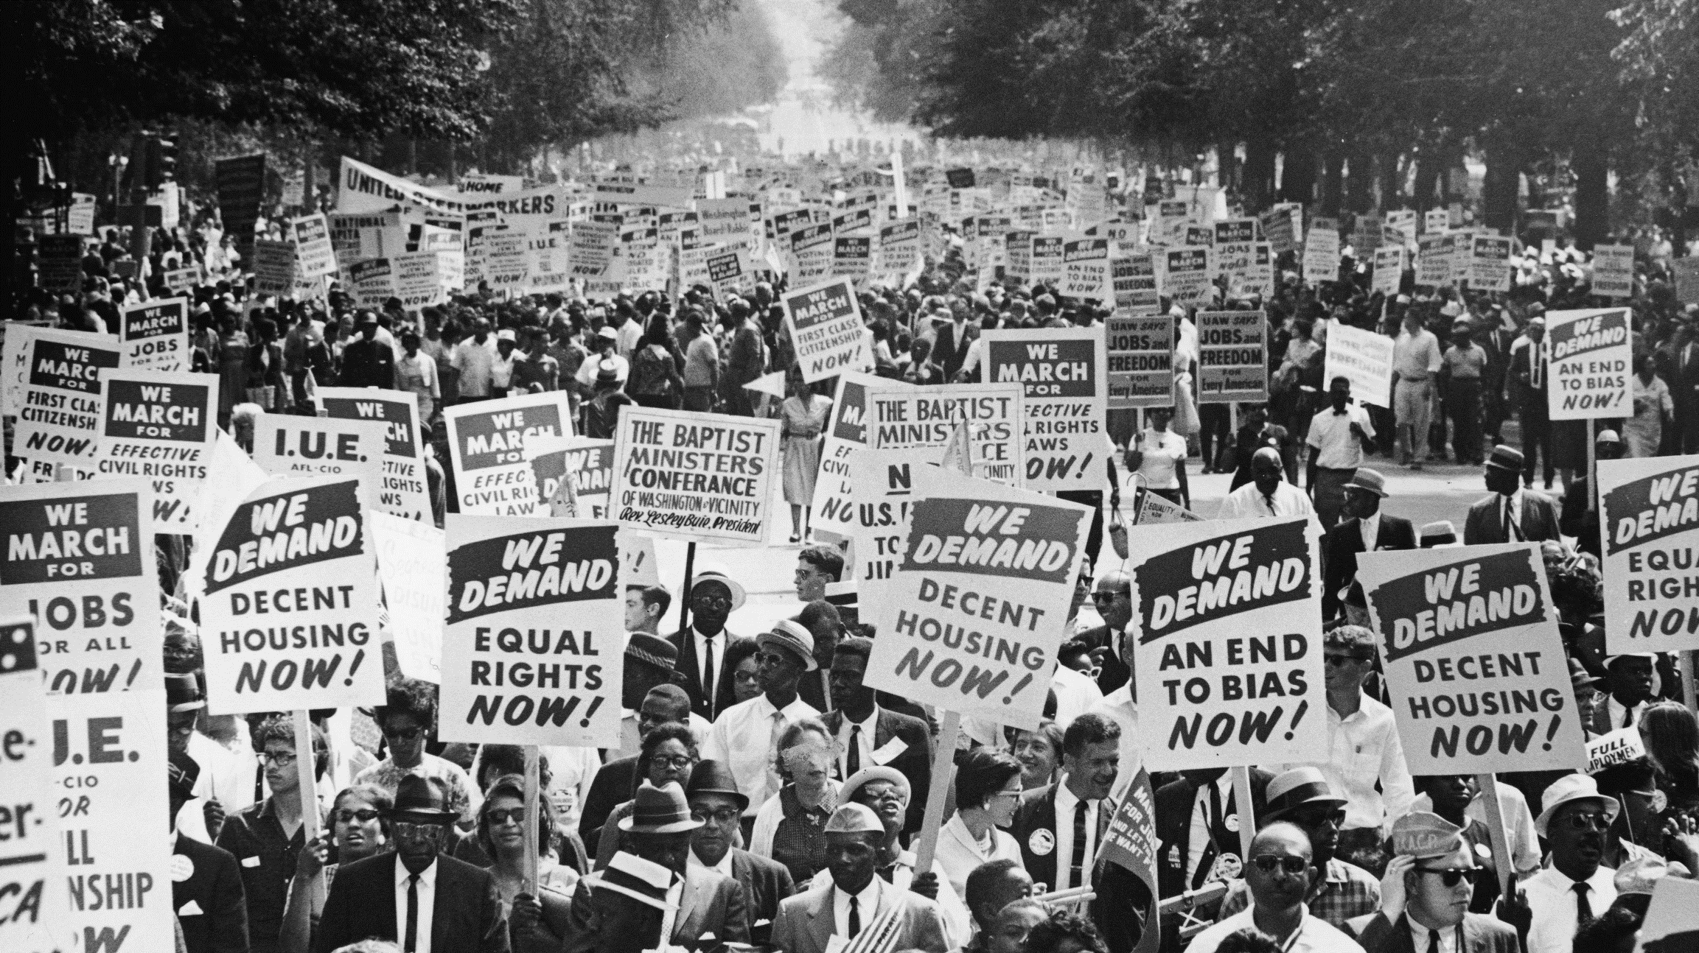
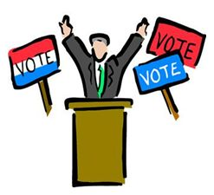
Connect Activity
Use the images below to write a definition of the term ‘Civil Rights’
S of S
tial
0 AED
dom

Slide 6
Background
When the United States was created in 1783, it was made up of thirteen states from Massachusetts in the north to Georgia in the south. These states had been thirteen colonies of the British Empire. Most of the colonists were of British origin, together with upwards of 40 per cent from other European countries. In their Declaration of Independence of 1776, the American colonists declared their commitment to equality and liberty for the United States of America. The first words are: ‘We hold these truths to be self-evident, that all men are created equal…with certain inalienable Rights, that among these are Life, Liberty and the pursuit of Happiness.’
Yet large minorities of Americans were not entitled to these rights: they were neither equal or free in their newly independent United States of America. One group was Native Americans. Another group consisted of the black slaves, mostly living in the South.

Slide 7
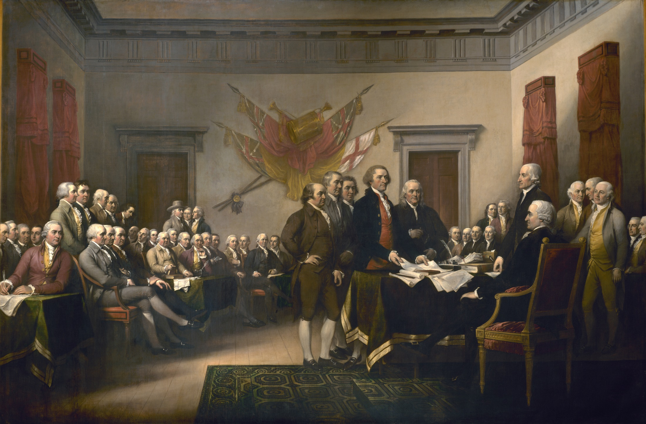
Background
1775-1783: War of Independence
1773: Boston Tea Party
A rebellion against taxes imposed on tea by the British. This was the trigger for the American War of Independence.
Benjamin Franklin’s message
“We must indeed all hang together or most assuredly we shall all hang separately.”
1776 – Declaration of Independence

Slide 8
Background
1783-1861: Moves towards Civil War
UNION (North)
Confederate (South)
Vs
Manufacture
Iron & Steel
Agriculture
Cotton

Slide 9
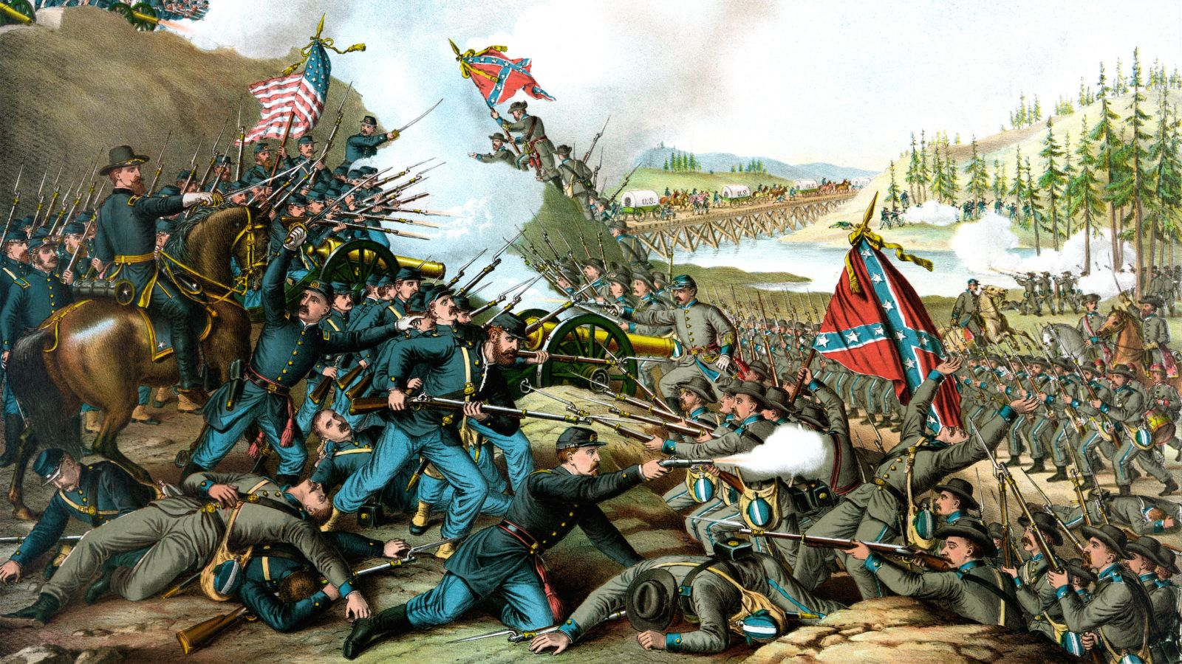
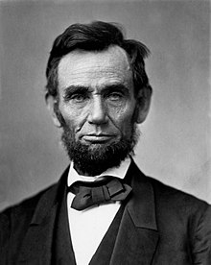
Background
1861-1865: Civil War
Southern States declare they are breaking away from the USA to form their own “Confederate States of America.” The Union refuses to accept their right to do so.
1863 – Emancipation Proclamation (1st Jan)
Radicalised the war by finally making it a war of freedom against slavery rather than on the abstract issue of state rights.
1863 – The Gettysburg Address (19th Nov)

Slide 10
Background
1863 – The Gettysburg Address (19th Nov)

Slide 11
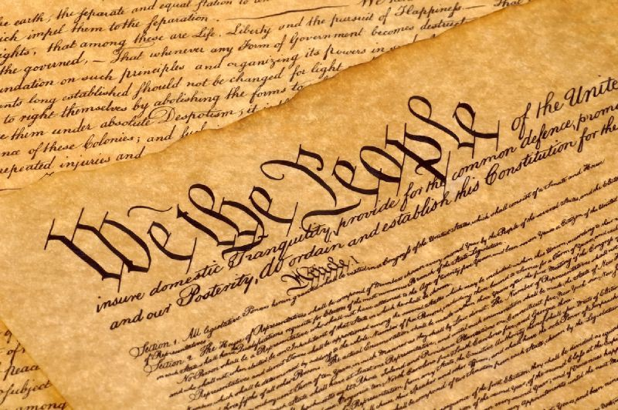
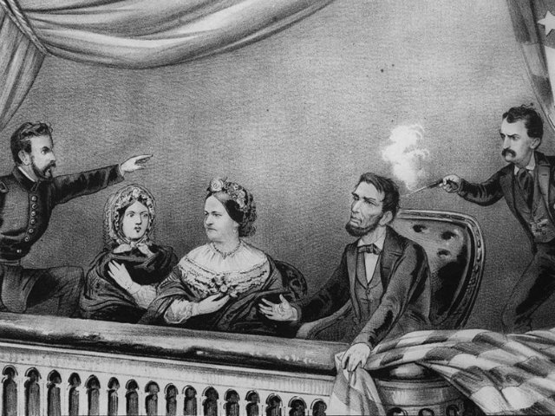
Background
1866-1877: Reconstruction
Constitutional Amendments
1865 – 13th Amendment
Abolished Slavery
1868 – 14th Amendment
‘Equal protection of the laws’
Confirmed Black people were US citizens
1870 – 15th Amendment
Gave every US citizen the right to vote (women were not included until 1920)
1865 – Lincoln’s assassination

Slide 12
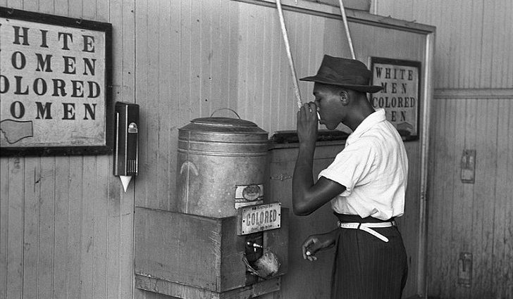
Background
1877-1954: Jim Crow Laws
Although the Constitution had been changed, there was little will to ensure the southern states complied.
State laws were passed which discriminated against black people. These were referred to as ‘Jim Crow Laws’.
These were permitted by the Federal government on the basis that ‘separate but equal’ facilities were being provided.

Slide 13
Activate Activity
Find out about the following;
The political system within America and how it works.
The American Constitution and exactly which civil rights are written into it.
Use your textbook and create notes using pages 12-15
Websites
http://www.ducksters.com/history/us_government.php
http://news.bbc.co.uk/2/shared/spl/hi/americas/04/us_election/govt_system/html/introduction.stm
Videos
Try creating your own diagram of the US system of government
https://www.youtube.com/watch?v=bO7FQsCcbD8

Slide 14
Demonstrate
Explain how the US system of government can make amendments to the constitution difficult.
Explain the balance of power between the federal and state governments.
Describe the key features of the executive, legislative and judicial branch of the US system of government.

Slide 15
Consolidate
As a result of the lesson today I:
Know…
Understand…
Can use the information to….

