Slide 1
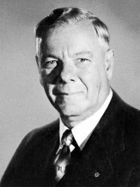
The Department of Native Affairs
Staff
What was it?
Words
Main Responsibilities
Hendrik Verwoerd
How significant was the Department of Native Affairs?

